Slide 1
Python
Ing. Jan Turčínek, Ph.D.

Slide 2
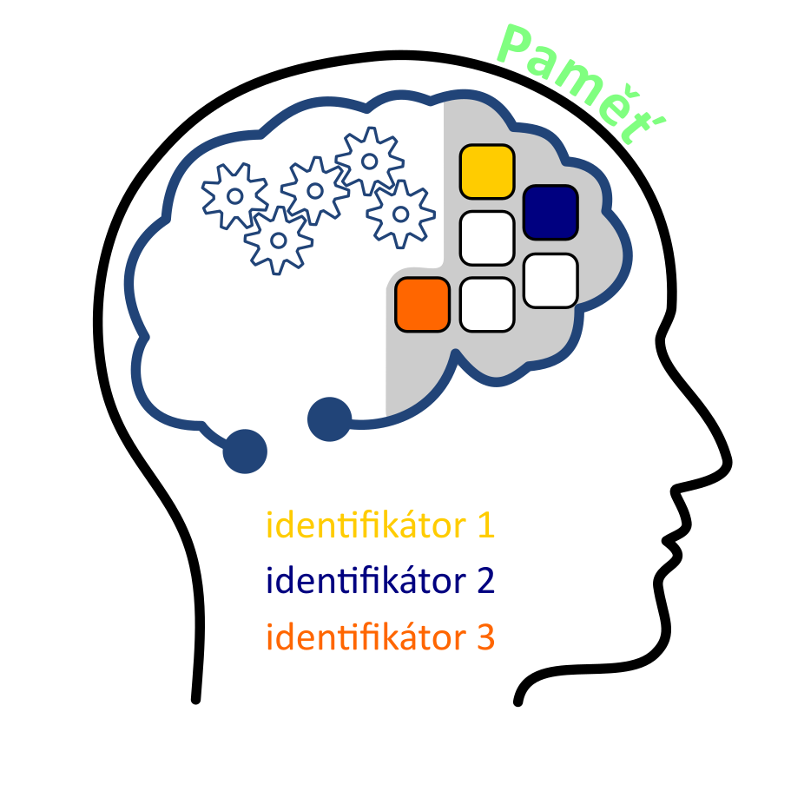
Variable
There is a named place in the computer's memory for storing values
Variable values can change during the running process
The variable is represented by the identifier identifier in the algorithm

Slide 3
Variable
Memory location capable of taking on various values
Thanks to variables algorithms can be general.

Slide 4
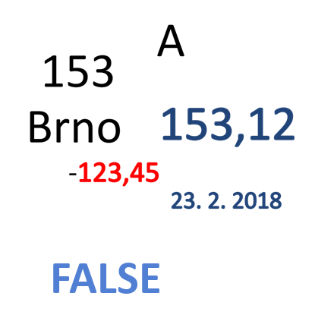
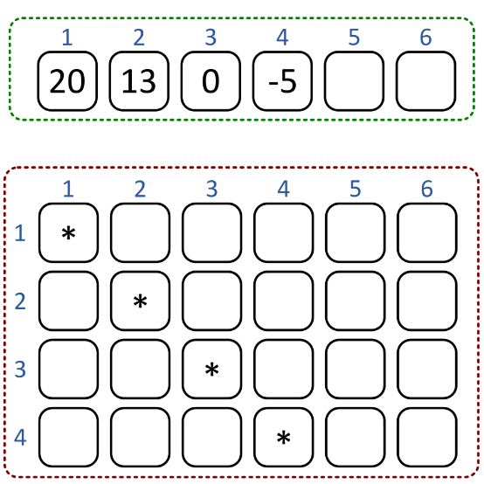
Data types
Data type determines
A set of permissible values
Operations that can be performed with these values
Data types may be
Simple (contains only one value )
Structured (They contain more values)

Slide 5
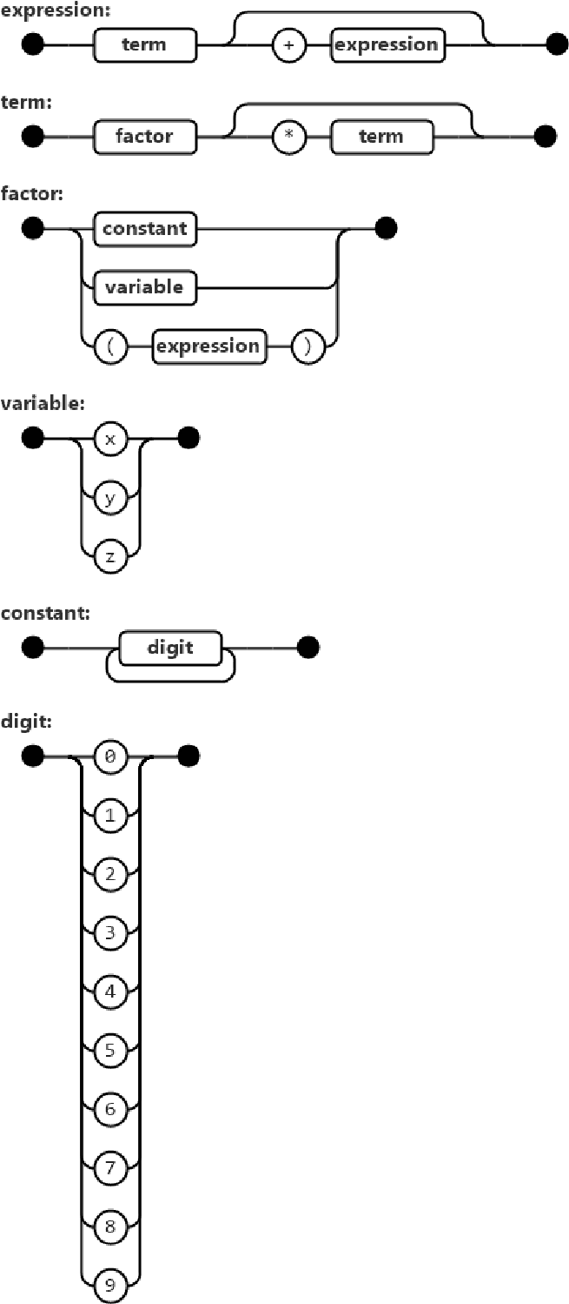
Syntax and semantics
Syntax – rules of notation (grammar):
Semantics – meaning of notation

Slide 6
Expressions and commands
We have to distinguish them!
Commands describes the action to be done
purpose: execution of something
Expressions describes how to find out the value
prupose: finding a value
The expression cannot be used separately
always must be part of a command

Slide 7
Commands
Commands (Instructions)
Sequence
Commands for execution follow one after the other in a precisely specified sequence
Conditions (Branching)
Based on a condition, we decide which command will be executed
Loop
A certain command is repeated until conditions for termination are met

Slide 8
Expresions
The expression result is a value of a specific data type
Arithmetic expressions
The result is number
Logical expresions
The result is logical value (True, false)
String expressions
výsledkem je textový řetězec

Slide 9
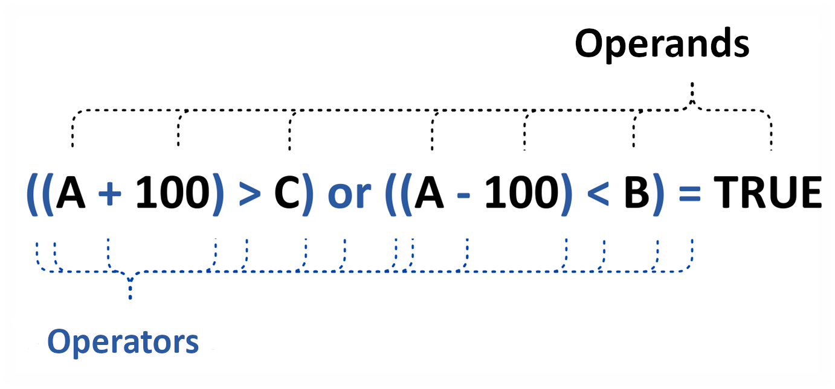
Expressions

Slide 10
Operands
Cosnstants
Variables
Function calling

Slide 11
Arithmetic expressions
Result is numeral value
Integer, real,…
Arithmetic operators:
+, -, ×, /, %, Mod, (),
Integer:?
Real: ?
…

Slide 12
Logical expressions
Result is logical value
Relational Operators:
<, >, <=, >=, ==, !=,
Logical operators
AND, OR, NOT
Logical constansts: TRUE FALSE

Slide 13
Data types
Data type is determined by:
A set (range) of permissible values
Operations that can be performed with these values
data types could by:
Simple (carry a single value)
Structured (carry multiple values that are related in some way)

Slide 14
Python
Currently the most used language
Why?
Simplicity
Clarity
Good readability (one command for one line, obligation of line indentation )
Simple syntax

Slide 15
Data types
Numbers
Whole numbers (int)
Real numbers (float)
Complex numbers (complex)
Strings and characters (str)
A character is a single character string
Logical values (bool)
just two values (True, False)

Slide 16
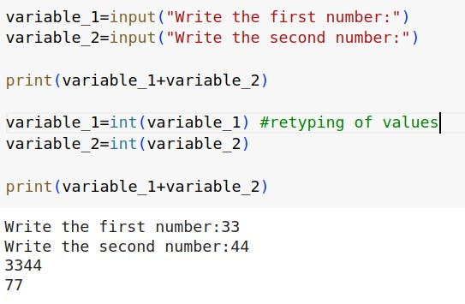
Python commands
Reading and writing values
input, print

Slide 17
Python commands
Reading and writing values
All inputs in Python are strings
If we want to calculate with numbers, we have to convert the values into numbers
Retyping
Changing the data type of a value

Slide 18
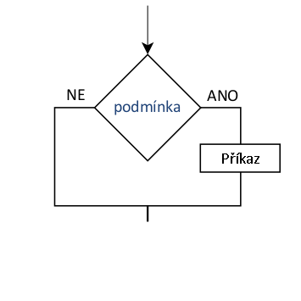
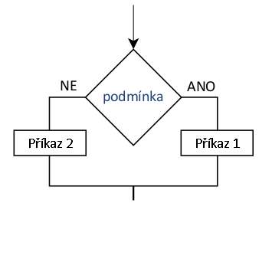
Python commands
A conditional statement in Python
if condition:
command
if condition:
Command
else:
command

Slide 19
Python commands
A conditional statement in Python
if condition:
Command
elif condition:
command
elif condition:
command
else:
command

Slide 20
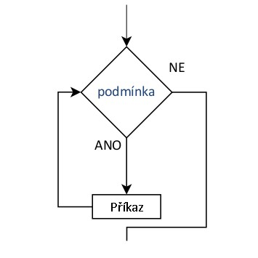
Python commands
A loop statement in Python
while condition:
Command
else:
command

Slide 21
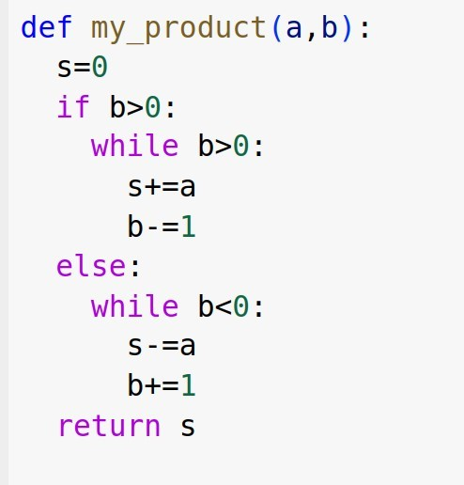
Python commands
Affiliation of the command to the block
The assignment of the command to the block is determined with the help of indentation

Slide 22
Methods: procedures and functions
Method is part of the algorithm solving a partial problem
The procedure is a method that makes a certain action
The function is a method that makes a certain action and returns the result (value)
Procedures and functions may have parameters for passing input values

Slide 23
Definition of function
Syntax
def identifier(parameters)
Commands
return output_value

Slide 24
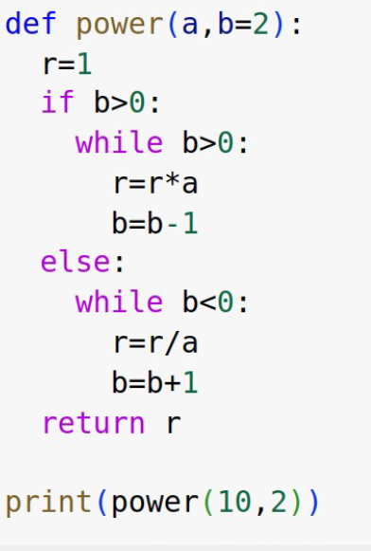
Parameters
In addition to parameters, the function receives input values
Parameters can be:
mandatory,
optional
we set the optional attribute by specifying a default value when defining the function, which it will contain if it is not specified when the function is called.

Slide 25
Function calling
We can use functions as separate commands
or as part of various expressions

Slide 26
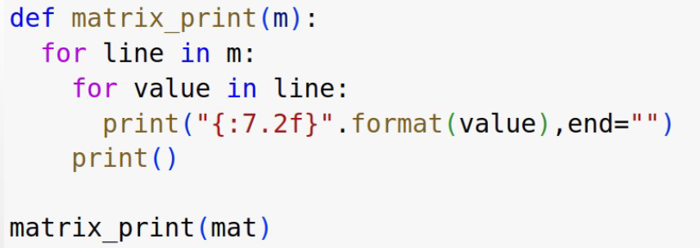
Function as procedure
A procedure is a function whose task is not to find a value, but to perform a certain operation that consists of a certain number of steps

Slide 27
Lists
Indexed structured variables
They allow multiple values to be stored in one variable
Object and direct access
They could be
Homogeneous (composed of values of one type)
Heterogeneous (…items of different data type)

Slide 28
Strings
Sequence of characters
We can work with them as a whole
We can browse them by individual characters
We can split them into lists of strings
A constant, string value is written in quotation marks
split()

Slide 29
Lists
List object methods(list)
append() – Adds an element at the end of the list
clear() – Removes all the elements from the list
copy() – Returns a copy of the list
count() – Returns the number of elements with the specified value
extend() – Add the elements of a list (or any iterable), to the end of the current list
index() – Returns the index of the first element with the specified value
insert() – Adds an element at the specified position
pop() – Removes the element at the specified position
remove() – Removes the item with the specified value
reverse() – Reverses the order of the list
sort() –Sorts the list

Slide 30
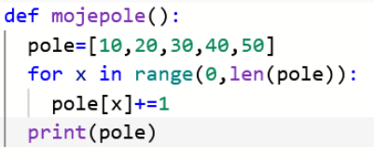
Lists – Access to values
variable_name[index]
• pole[4]=pole[4] + 1
• semantics – increase the value of the item with index 4 by one

Slide 31
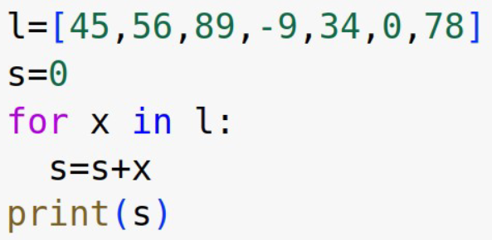
Lists – Access to values
The list is an iterable object, the for cycle gradually passes individual items to us
An iterable variable
for item in list:
print(item)
For each value of the list, the statement (body of the loop) is executed

Slide 32
Lists – Access to values
item index
function enumerate
It successively passes the index and value to the pair from the list

Slide 33
Dictionary
An iterable variable
Stores value pairs (key / value)
Extends the set data type
A pair of sets
A set of desired properties
A set of individual property values

Slide 34
Dictionary
pesrson={
‘name ’: ’Jan’,
‘surname’: ’Turčínek’,
‘place’:{‘town’:’Brno’,
’street’:’Zemedelska’,
’no.’:1
}
}

Slide 35
Dictionary
For val in person.values():
print(val)
For key in osoba:
print(key)
For key,value in person.items():
print(key,value)

