Slide 1
Faculty of Business and Economics
Mendel University in Brno
Czech Republic

Slide 2
City of Brno
The second largest urban agglomeration in the Czech Republic
Historical town with a large number of historical monuments
Home of 6 universities (approx. 85 000 students)
Industrial and science center
Sport center (motoGP, ice hockey, …)
Cultural center (theaters, galleries, Leoš Janáček, traditional culture, …)
Moravian cuisine and drinks (wineries, breweries, …)

Slide 3
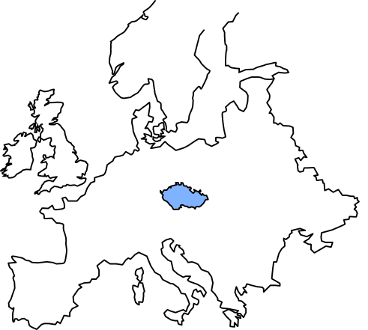
City of Brno

Slide 4
Faculty of Business and Economics

Slide 5
City of Brno

Slide 6
City of Brno

Slide 7
City of Brno

Slide 8
City of Brno

Slide 9
Southern Moravia Region

Slide 10
Southern Moravia Region

Slide 11
MENDEL University in Brno
Established in 1919
As a university of agriculture and forestry
Five faculties (schools)
Agronomy
Forestry and Wood Technologies
Business and Economics
Horticulture
Regional development and International studies
11,000 students
ECTS Label

Slide 12
Faculty of Business and Economics
Member of the European Council for Business Education
Established in 1959 as the oldest faculty of economics in Moravia
A modern building (Building of the year 2005)
Computer labs (Laboratory of Network Technology; Virtual Reality Laboratory, Eye-tracking laboratory)
10 departments, more then 3.5 thousands students at the bachelor, master and doctoral level

Slide 13
Study programs
Study Programs | Field | Bachelors | Masters | Doctoral
Economics and Management | Managerial Economics | X | X
 | Agriculture and Food Economics | X | X
 | Tourism Management | X
 | Social Economics | X
 | Business Management | X
 | Business Economics and Management |  |  | X
Economics and Management (EN) | Business Economics and Management | X | X | X
Economic Policy and Administration | Finance | X | X | X
 | Accounting and Taxes |  | X
 | Finance and Investment Management |  | X
 | Public Administration | X
Systems Engeneering and Informatics | Economic Informatics | X | X | X
Engineering Informatics | Automation Management and Informatics | X | X

Slide 14
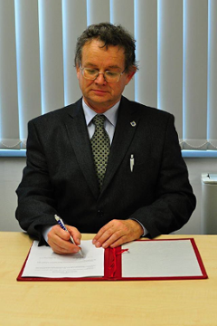
Faculty organizational structure
Assoc. prof. Ing. Arnošt Motyčka, CSc.

Slide 15
Student and Teacher Mobilities
ECTS credit system
Access to electronic databases (JSTOR, SCOPUS, Safari Business Books Online, EU-SILC, Science Direct...) and microeconomic datasets (Amadeus, Bankscope...)
More than 80 international partner universities
High ratio of incoming and outgoing students of the faculty (at about 120:120 each year)

Slide 16
Research and Learning Laboratories
Hydraulic and Pneumatic Systems Laboratory
Laboratory of Information Processing
Laboratory of Intelligent Systems
Networked Systems Laboratory
Virtual Reality Laboratory
Eye-tracking Laboratory

Slide 17
Modern and Pleasant Environment
Computer Study Room
80 PCs
E-tests
Individual work on projects
Project Classroom
24 PCs
19 iMacs
Round tables
Lecture rooms
From 20 to 360 people
Relax Zones

Slide 18
Modern and Pleasant Environment

Slide 19
Certification for students

Slide 20
Research Fields
Applied Computer Vision
Robotics
Geographical Information Technologies
User Experience
Mobile Application Development
Machine Learning and Data Mining
Text mining
Natural language processing
Sentiment analysis
Computer Networks
QoS, QoE
MENDELU network maintenance and development
ICT support of Decision Making
Monitoring and evaluation of environmental changes
Process management
Economic Policy at National and Regional Levels
Business cycle synchronization
Monetary economics and banking
Welfare
Pension systems
Socio-Economics
Social innovation in rural areas
Consumer behavior
Eye tracking applied science laboratories
Social and economic development
Culture, mobility, demographic changes
Ethical issues
International Taxation
Harmonization
Environment taxation

Slide 21
Research Fields
Business Economics
Corporate social responsibility
Corporate philanthropy in SME
Management of specialized industries – winegrowing
Business environment – EU integration, globalization
Corporate performance and sustainability
Applied mathematics, statistics and econometrics
Bioeconomic modelling
Econometrics
Biometrics
Plagiarism and Academic Integrity
Plagiarism detection
Plagiarism prevention
Academic integrity

Slide 22
Research Cooperation
Main International Research Partners
Austrian Institute of Economic Research (WIFO)
Halle Institute for Economic Research (IWH)
Corvinus University in Budapest
Vienna University of Technology
Vienna Graduate School of Economics
Coventry University
Contracted research
17 contracted international and national companies
tight cooperation with many others

Slide 23
Selected funding of current projects
Horizon 2020 (European Commission)
7th Framework Programme (European Commission)
International Visegrad Fund
Jean Monnet Programme (European Commission)
Czech Science Foundation (GACR)
Technology Agency of the Czech Republic (TACR)

Slide 24
Annual International Conferences
Enterprise and the Competitive Environment
European Integration and Policies
Plagiarism across Europe and beyond
every 2 years
PhD conference “PEFnet”

Slide 25
Contacts
Faculty of Business and Economics
Mendel University in Brno
Zemědělská 1, 613 00 Brno
www.pef.mendelu.cz
Facebook.com/pef.mendelu
International Coordinator
Mgr. Tomáš Foltýnek, Ph.D.
E-mail: foltynek@pef.mendelu.cz
Phone: +420 545 13 244
International Relations Office
Ing. Šárka Braunerová
E-mail: sarka.braunerova@mendelu.cz
Phone: +420 545 132 799
Student Counselor for Foreign Students
Ing. Petra Křupalová
E-mail: petra.krupalova@mendelu.cz
Phone: +420 545 132 727
Head of Research Center
Ing. Veronika Krůtilová, Ph.D.
Email: veronika.krutilova@mendelu.cz
Phone: +420-545 132 556

