Slide 1
NATIONAL PARK PLITVICE LAKES

Slide 2
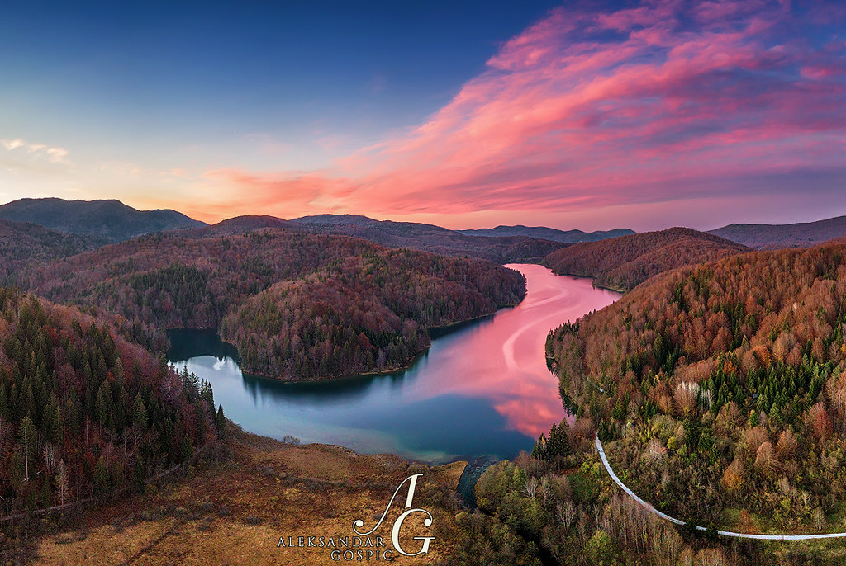
CONTENT
1. Basic informations
2. Climate
3. Flora
4. Fauna
5. Terrain
6. Sedimentation processes
7. Karst landscape
8. Ecologial issues
9. Solutions to the problems

Slide 3
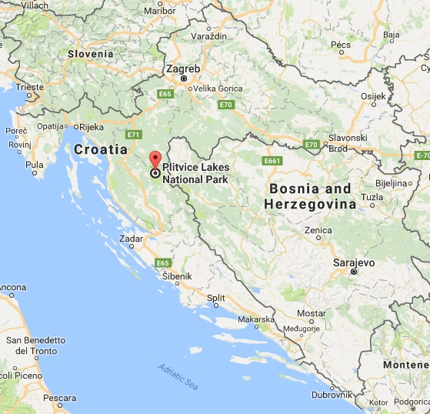
NATIONAL PARK PLITVICE lakes
Plitvice Lakes National Park is one of the oldest and largest national parks in Croatia.
In 1979, Plitvice Lakes National Park was added to the UNESCO World Heritage register
Area: 296.85 km2
About 90% of this area is part of Lika-Senj County, while the remaining 10% is part of Karlovac County.
Entrancece is subject to variable charges, up to 250 kuna or around €34 per adult per day in summer 2018.

Slide 4
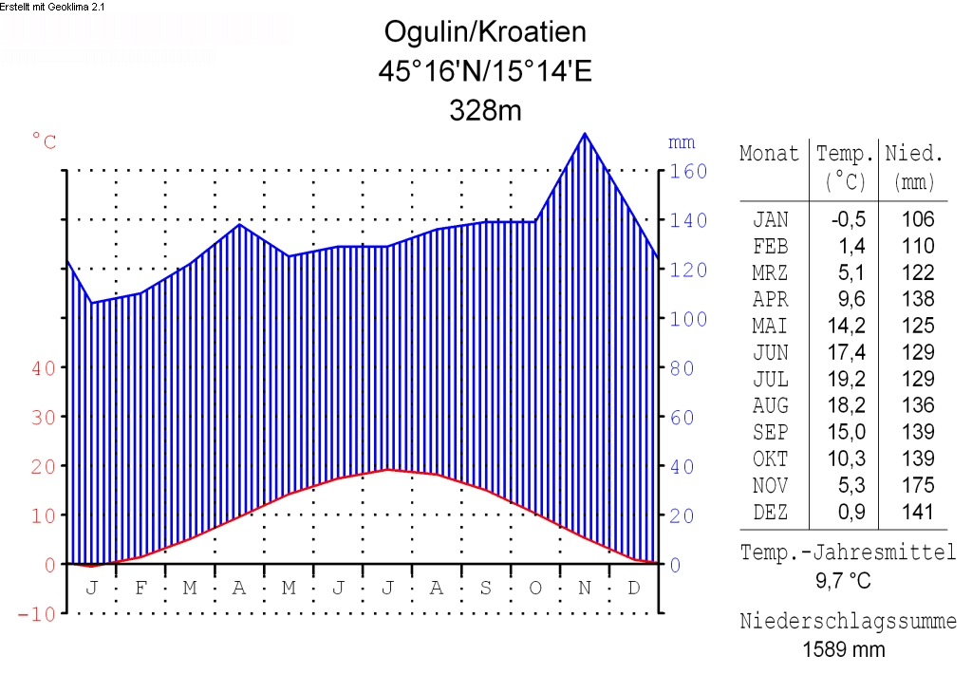
Climate
On average, the annual precipitation rate at the Plitvice Lakes is 1,500 mm (59.06 in)
Usually, in spring and fall (autumn) the largest rain quantities are measured
The average relative air humidity is 81.8 percent
In January, the average temperature is 2.2 °C (36 °F)
During the summer months of July and August, the temperature rises to 17.4 °C (63 °F).
The general average annual temperature is 7.9 °C (46 °F)

Slide 5
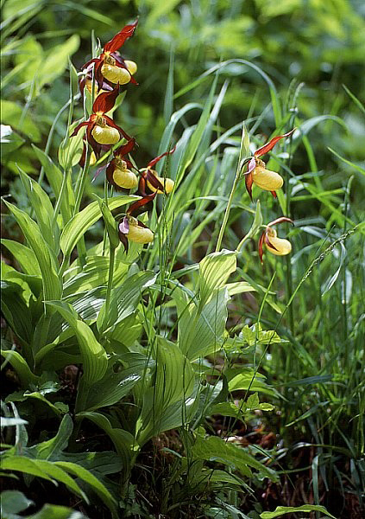
Flora
The Plitvice Lakes national park is heavily forested, mainly with beech, spruce, and fir trees, and features a mixture of Alpine and Mediterranean vegetation.
It has a notably wide variety of plant communities, due to its range of microclimates, differing soils and varying levels of altitude.
Scientists have so far identified 1,267 different types of plants belonging to the 109 species so far recorded in the area of the national park.
75 species of plants are endemic, which means that they were first defined and classified in this area of the world or nearby.

Slide 6

Fauna
The area of the national park is home to an extremely wide variety of animal and bird species.
Rare fauna such as the European brown bear, grey wolf, eagle, owl, Eurasian lynx, European wildcat, and capercaillie can be found there, along with many more common species.

Slide 7
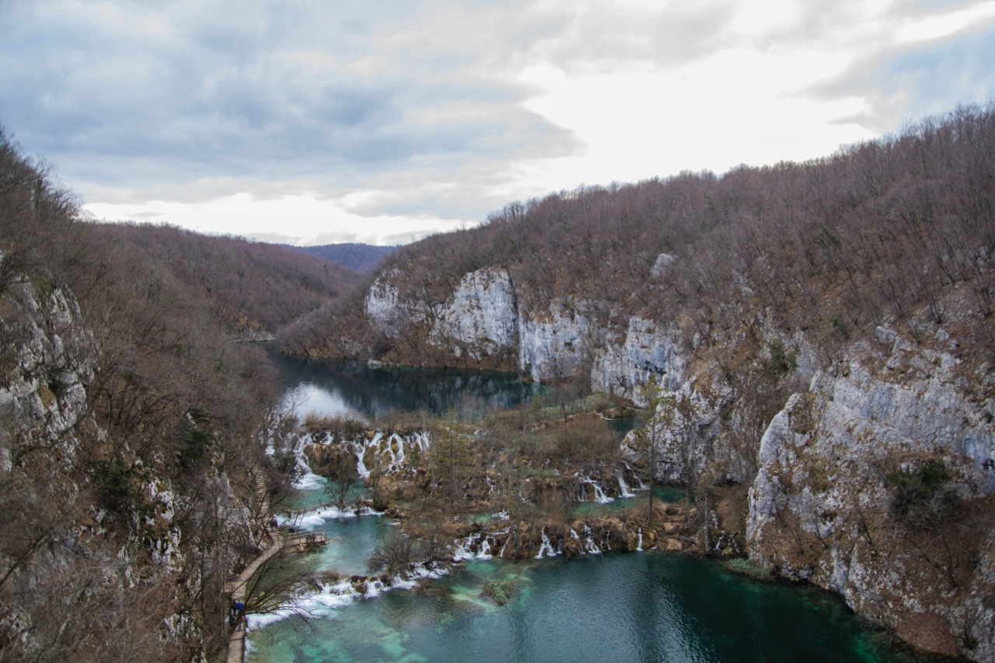
Terrain
The Plitvice Lakes are surrounded by various mountains.
The western side of the national park area is enclosed by the Mala Kapela mountain, while the eastern side is enclosed by the Plješevica mountain, which also represents the border to Bosnia and Hercegovina.
Plitvice Lakes National Park is situated in the Plitvice plateau which is surrounded by three mountains that are part of the Dinaric Alps: Plješevica mountain (Gornja Plješevica peak 1,640 m), Mala Kapela mountain (Seliški Vrh peak at 1,280 m), and Medveđak (884 m).

Slide 8
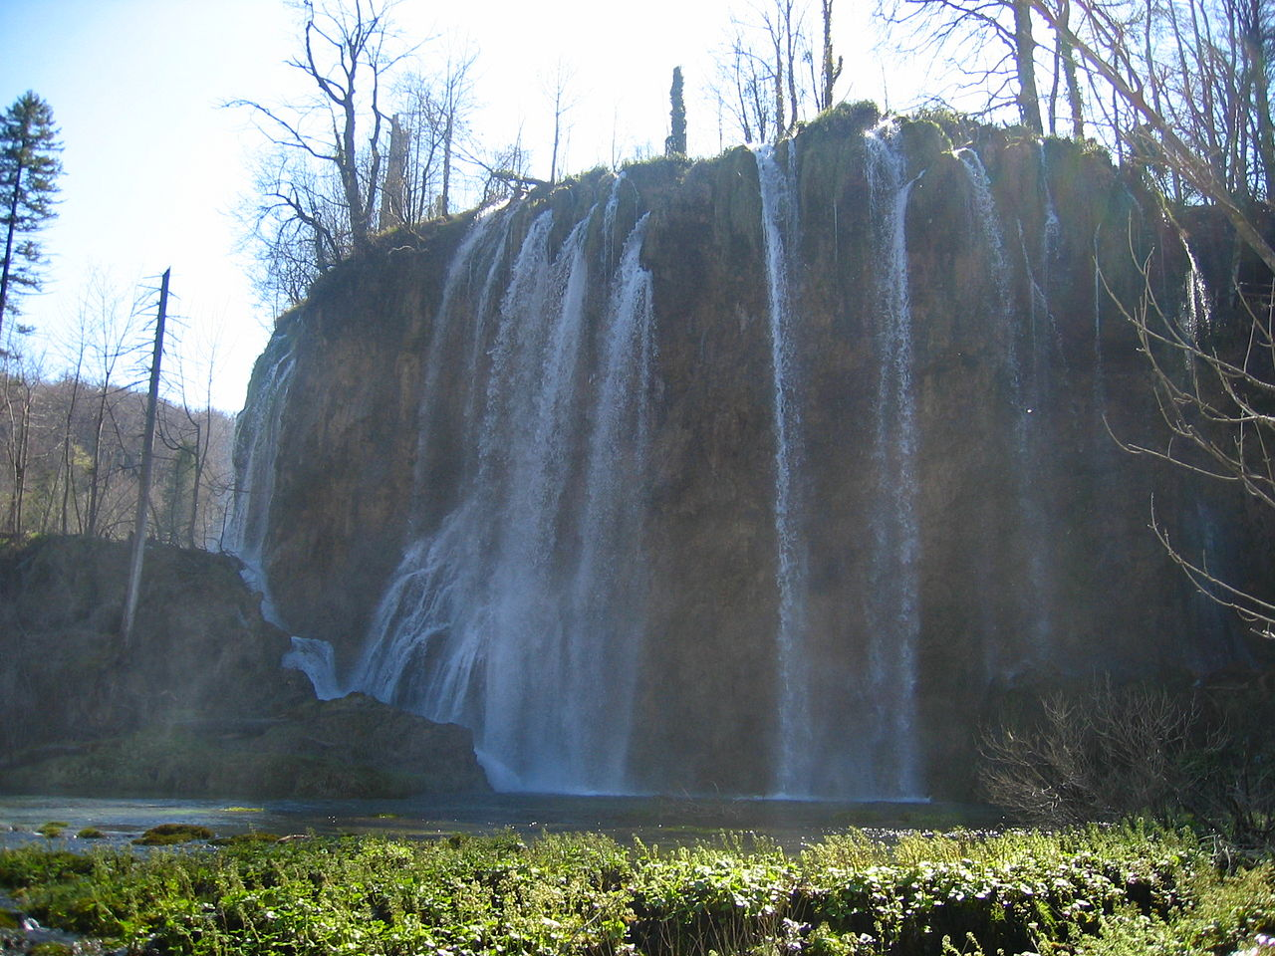
Sedimentation processes
A unique process occurring at the Plitvice Lakes, however, is the sedimentation of water-bound chalk at certain places.
With regard to other similar phenomena in the world, at Plitvice Lakes the sedimentation of chalk and the formation of tufa happens dynamically all along the watercourse and in various forms (fluviatile sedimentation). It is thus not a static phenomenon occurring at only single places.

Slide 9
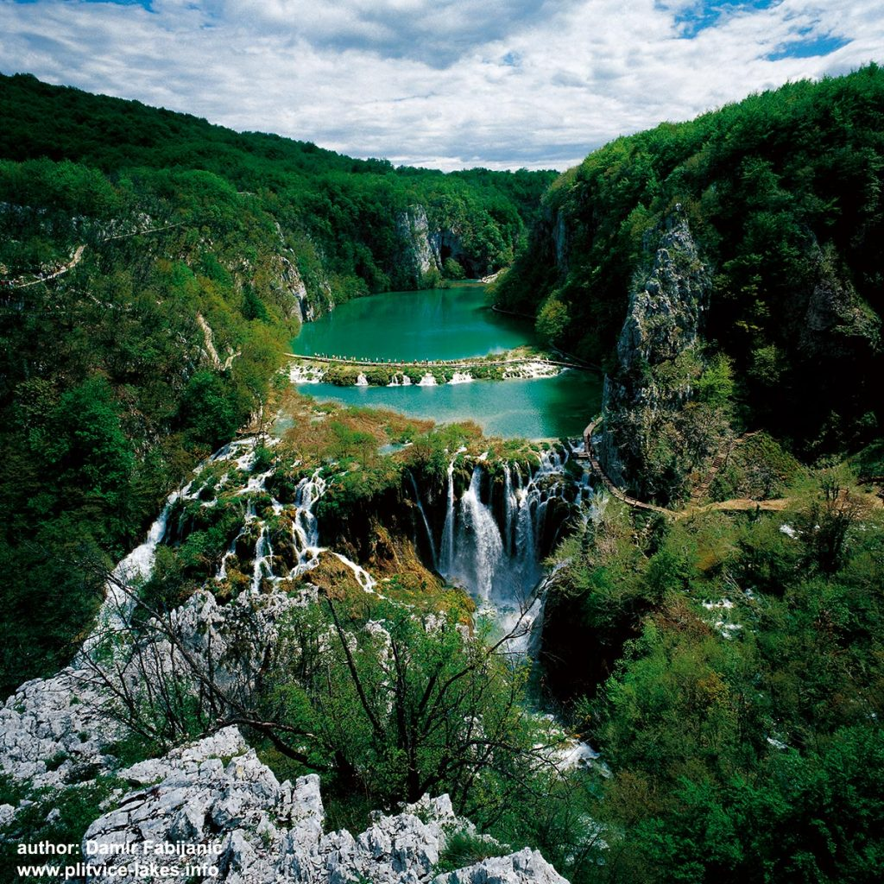
KARST LANDSCAPE
Plitvice lakes are located on karst terrain.
Karst is a topography formed from the dissolution of soluble rocks such as limestone, dolomite, and gypsum.
It is characterized by underground drainage systems with sinkholes and caves.
It has also been documented for more weathering-resistant rocks, such as quartzite, given the right conditions.[

Slide 10
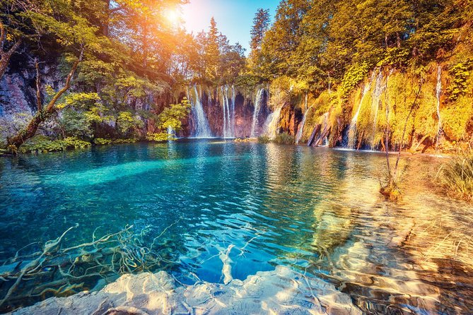
Ecologial issues
One of the biggest problem in this area is the pollution of lakes and waterfalls in this national park by wastewater from (virtually nonexistent) sewage, that is, from septic tanks in the porous terrain around the lake.
So, in the picturesque forest, there are sometimes even (not very picturesque) stinking ponds above the Plitvice waterfalls.

Slide 11
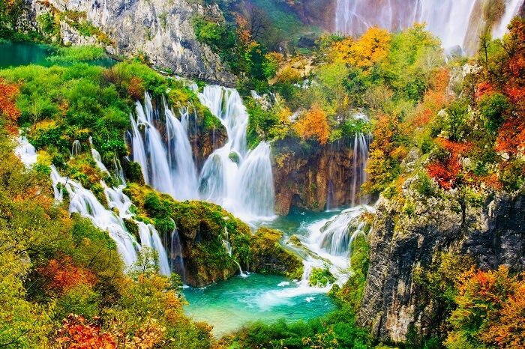
Ecologial issues
Road built but not sewer
The roots of the problem lie in the 1960s, when a road to the Adriatic sea was built through Lika, passing right through the center of the national park.
It has also resulted in the rapid development of tourism in the area, as well as spontaneous and uncontrolled construction in the surrounding area.

Slide 12
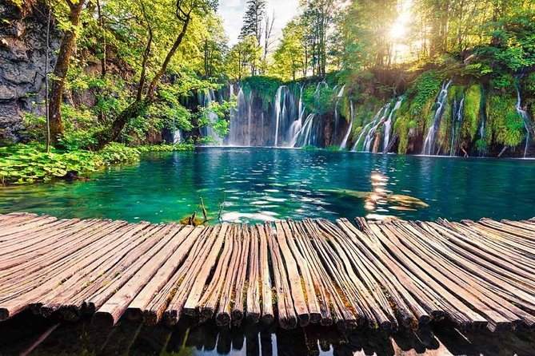
Ecologial issues
Plitvice Lakes National Park has been systematically devastated for years because of the impermissible (against law) permit to build large tourist and catering facilities and the illegal activity of extracting water from Kozjak Lake for the water supply network

Slide 13
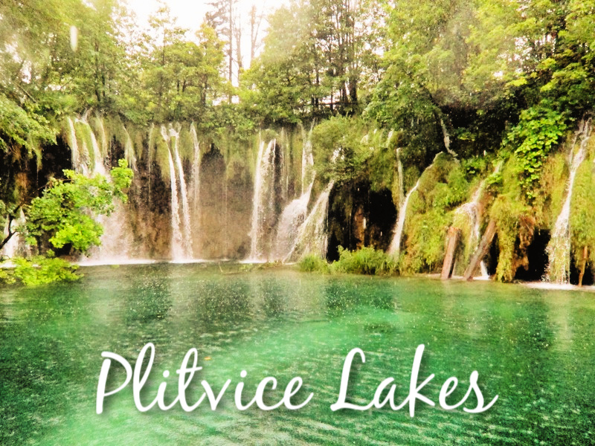
Solution to the problem
The essence lies in a statement recently received (2018) from the minister in cherge stating that the wastewater problem will be fully resolved with the implementation of the EU Plitvice Lakes agglomeration project in 2023.
Until then, interventions will be implemented, they say, to alleviate the problem.

Slide 14
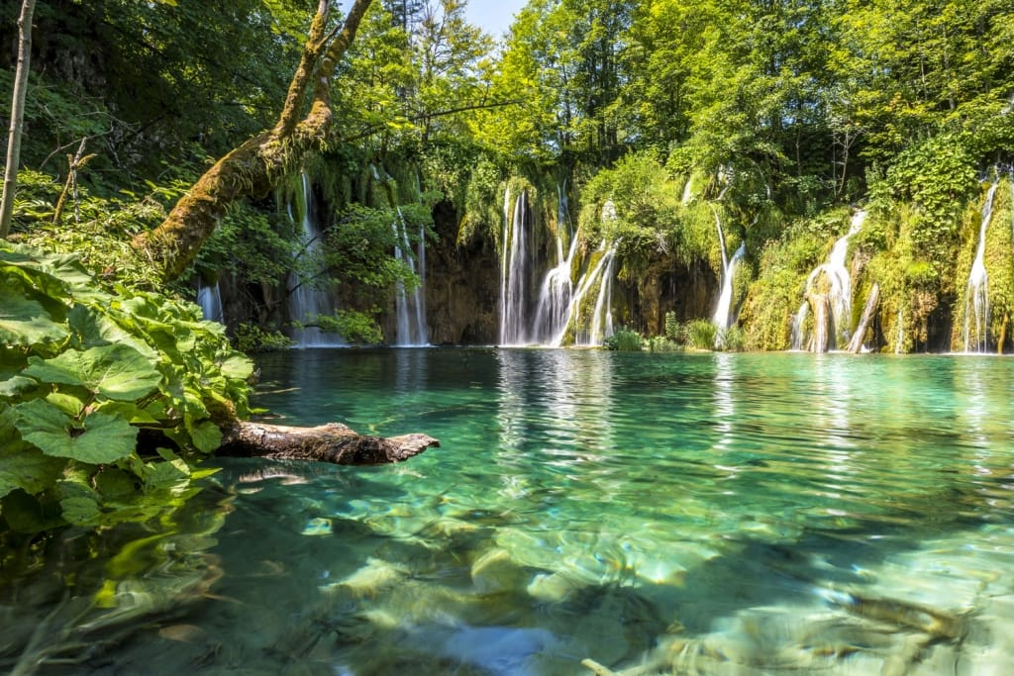
Ecologial issues
Article from newspapers:
The director of the Plitvice Lakes National Park spoke about all the problems that are taking place in the park, pointing out, with the privatization and the possible problem of the dried up Great Falls.
Since the beginning of the year, the number of visitors to the Plitvice Lakes has increased by 50 percent compared to last year, and Plitvice already, with 15,000 daily guests in the peak, were on the verge of shooting.
So now they are specifically preparing for the new season

Slide 15
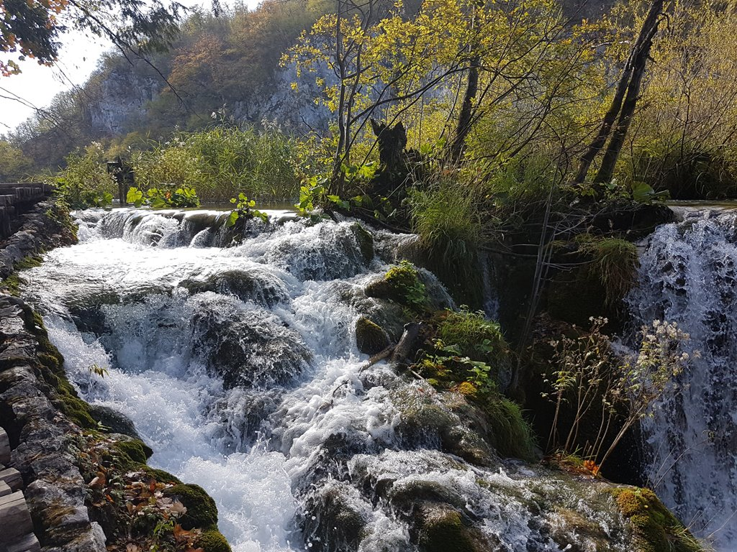
Solution to the problem
The latest Management Plan aims to preserve nature.
While visitors are angry because they wait for hours to see something, it has a significant effect on nature.
“The model envisages twenty measures; summer price correction, spatial and temporal dispersion and limitation of visitors, organization of additional educational programs, online ticket purchase, etc.

Slide 16
LITERATURE
https://en.m.wikipedia.org/wiki/Plitvice_Lakes_National_Park
http://blog.croatian.holiday/plitvice/
https://en.m.wikipedia.org/wiki/Karst
https://www.google.com/amp/s/dnevnik.hr/amp/vijesti/hrvatska/komentar-dubravke-blasko-zagadjenje-u-nacionalnom-parku-plitvicka-jezera---522426.html
https://lider.media/aktualno/sustavno-unistavanje-plitvickih-jezera-u-odgovoru-mosta-na-milinoviceve-kadrovske-vapaje-32757

