Slide 1
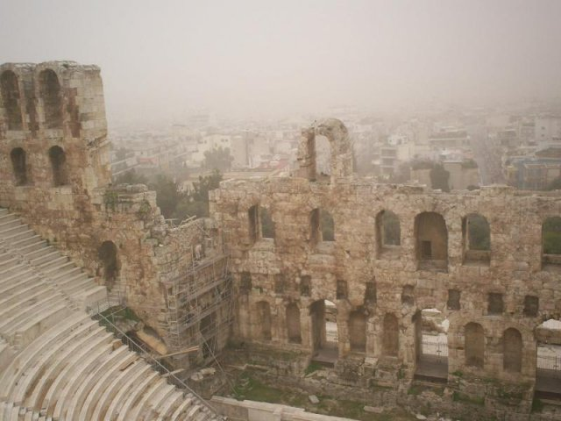
Εcological issues in Greece
Landscape ecology
Tsinipizoglou Nikolaos

Slide 2
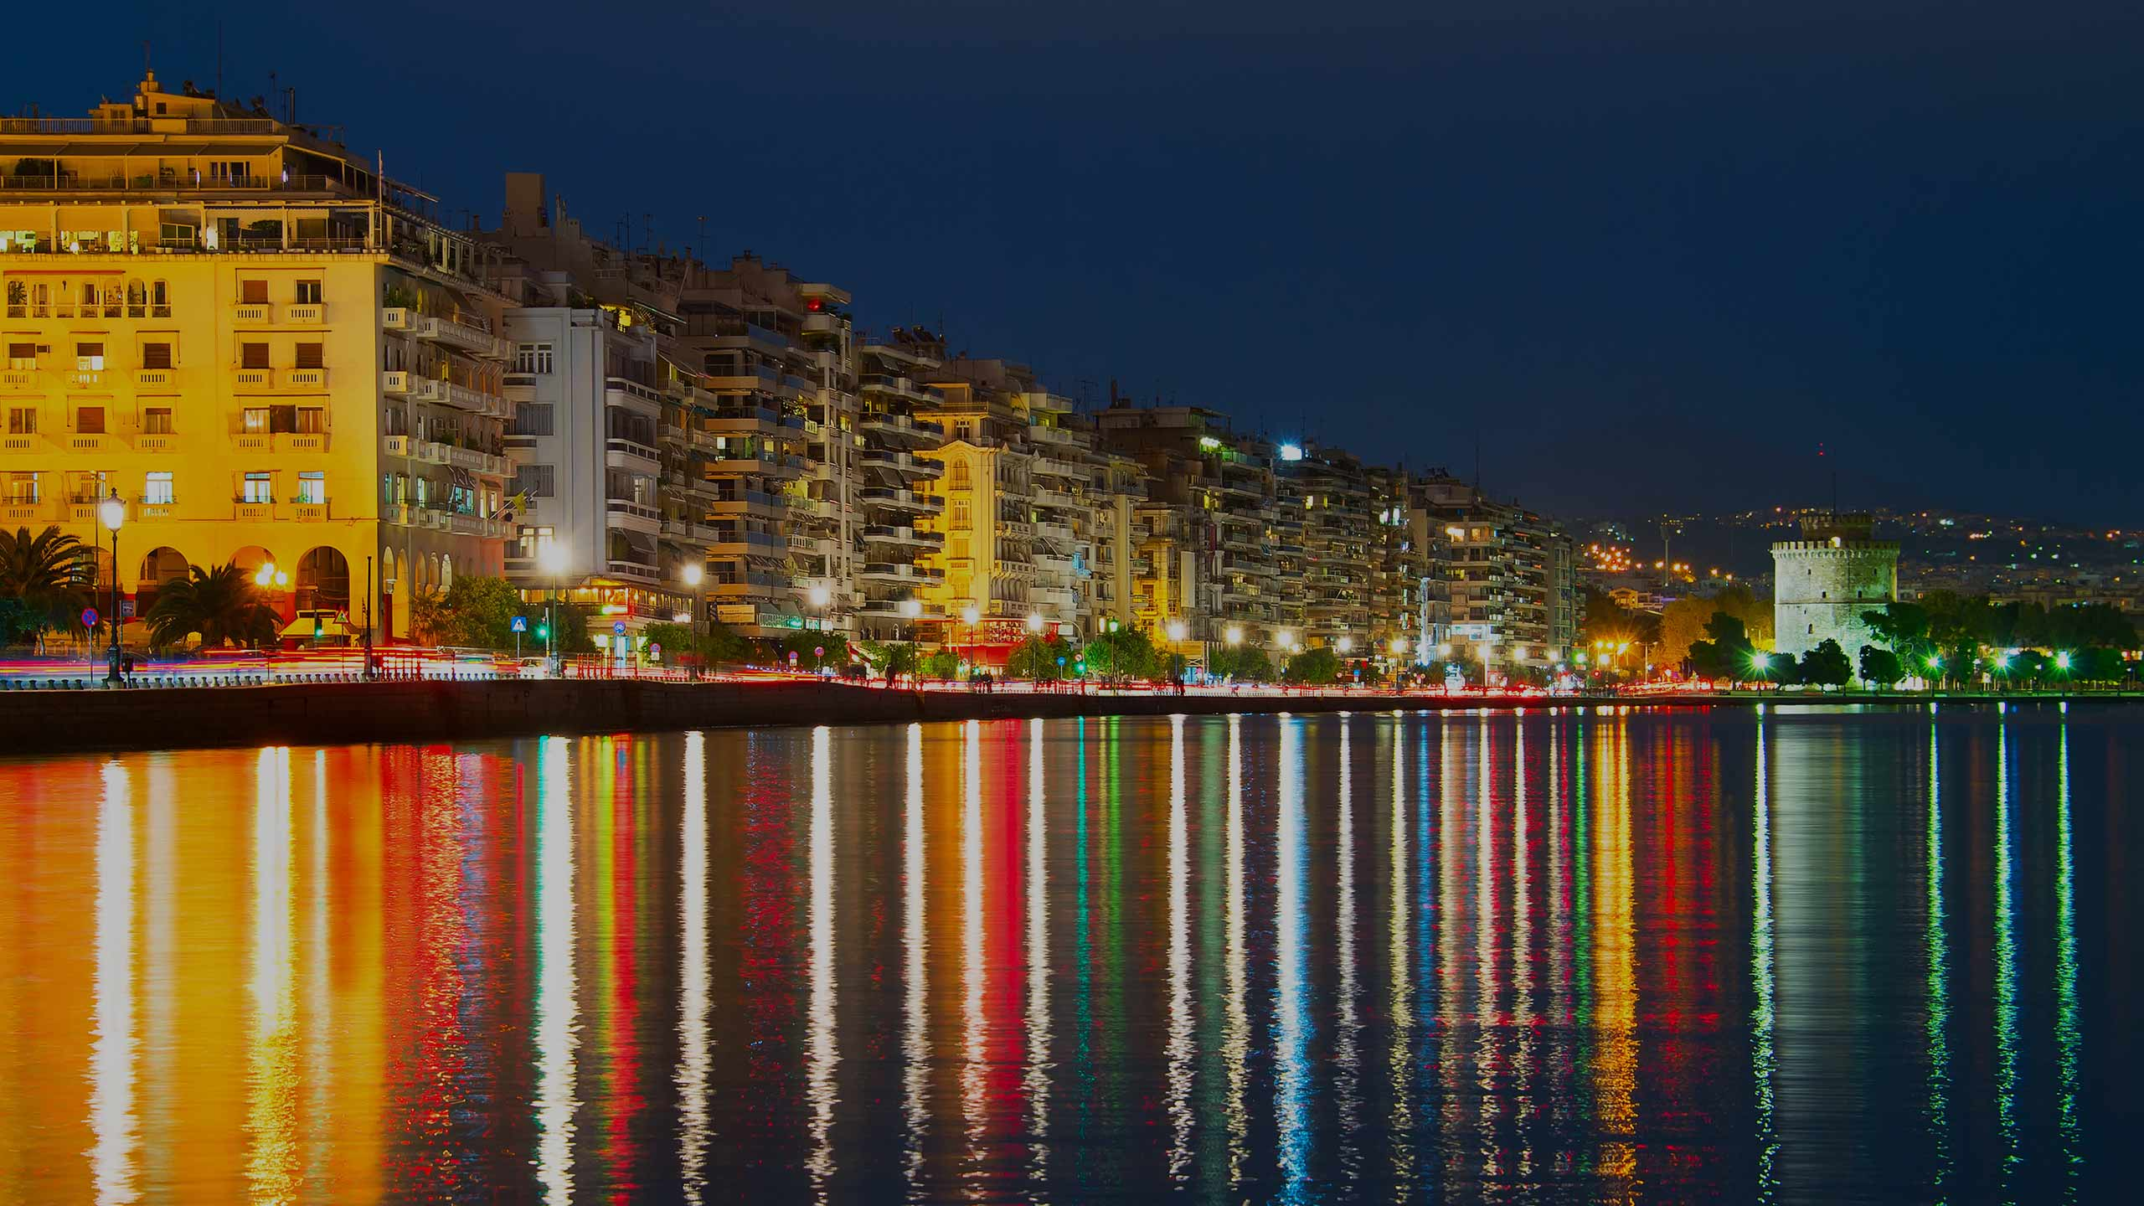
I have lived my whole life in Greece and i have witnessed numerous environmental problems.
That is why i chose this country.

Slide 3
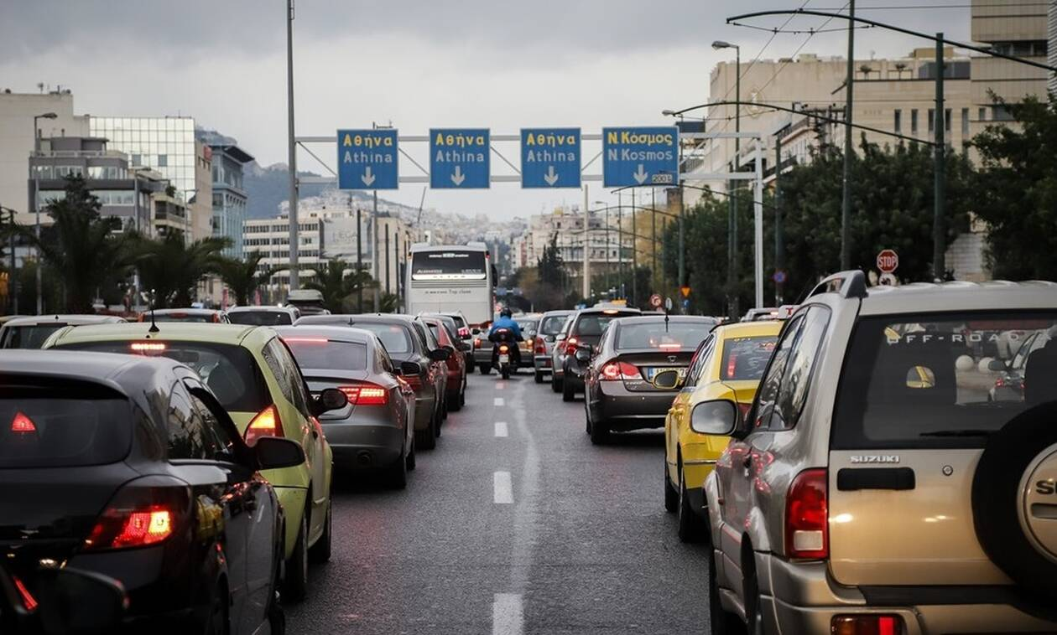
From my experience, most of them occure in urban landscapes.

Slide 4
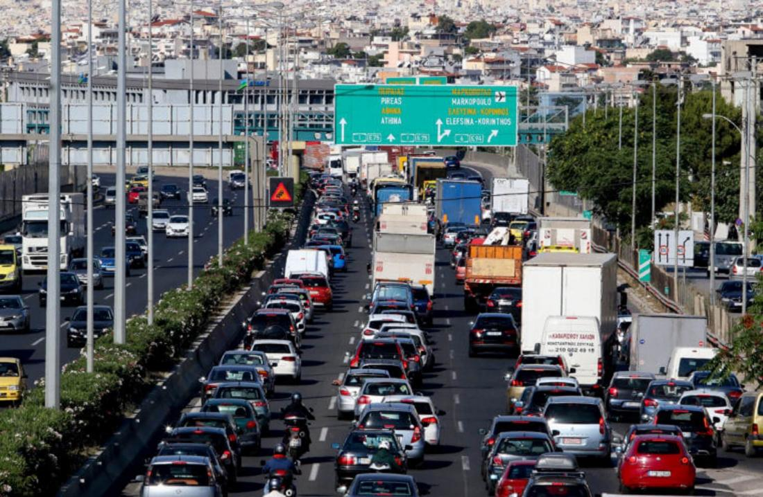
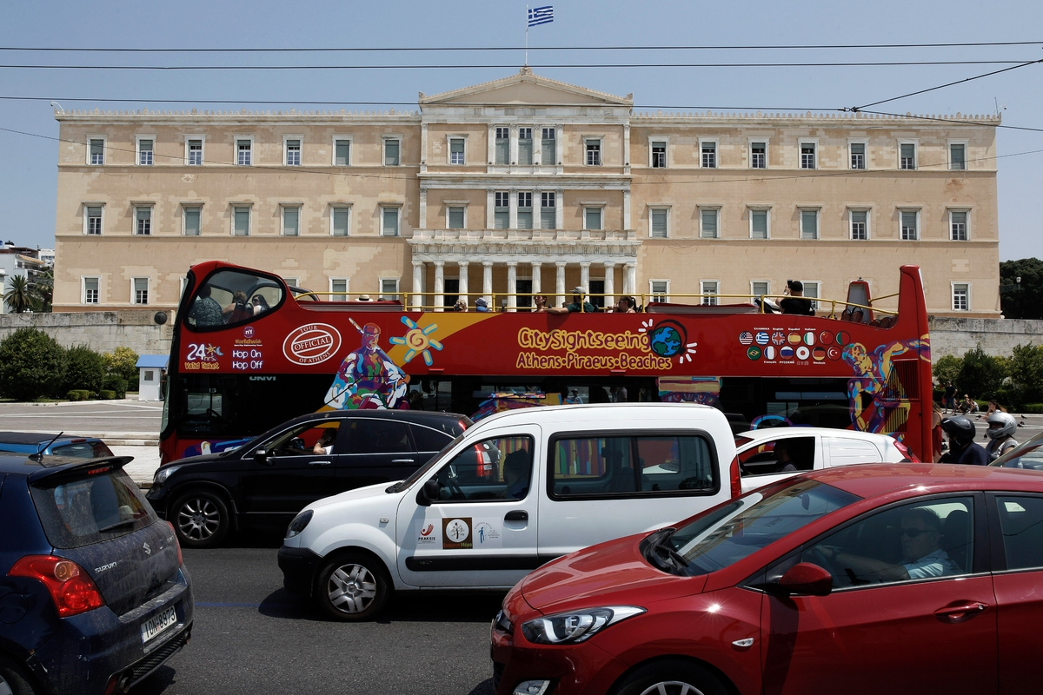

Slide 5
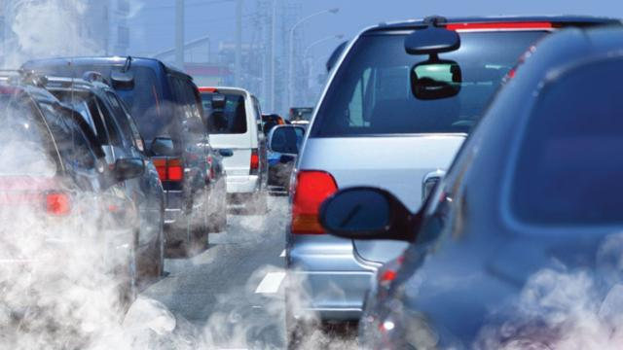
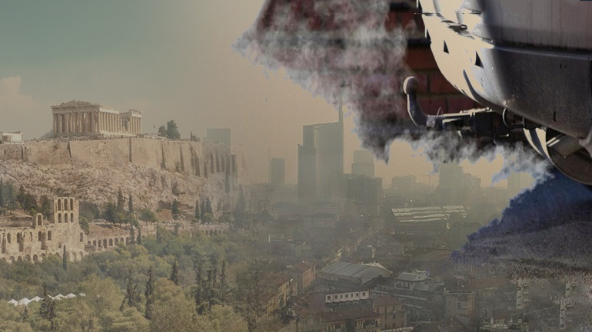
One problem leads to another.

Slide 6
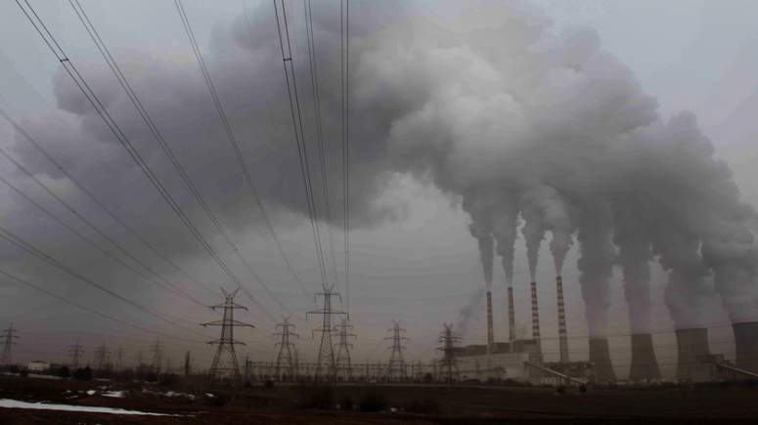
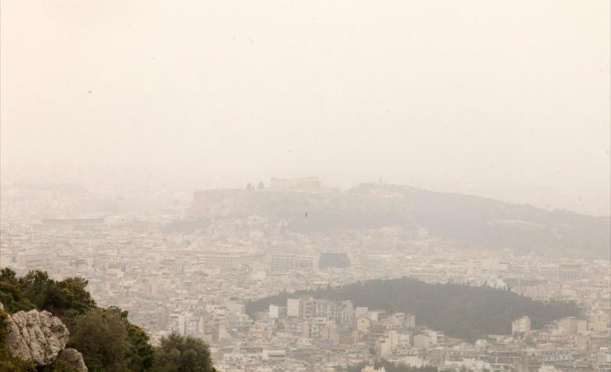
Smog has linked to the increase of cancer deaths.

Slide 7
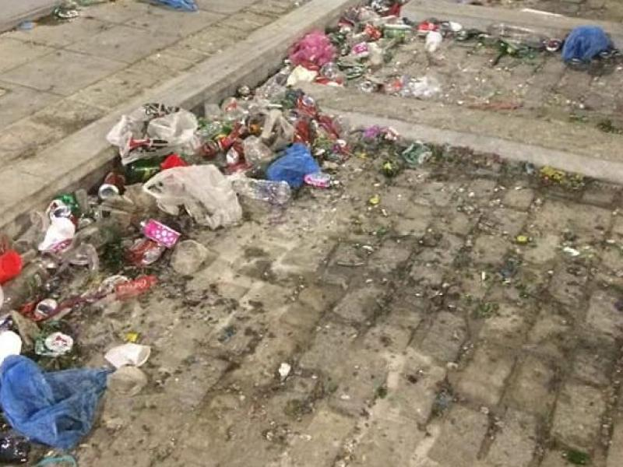
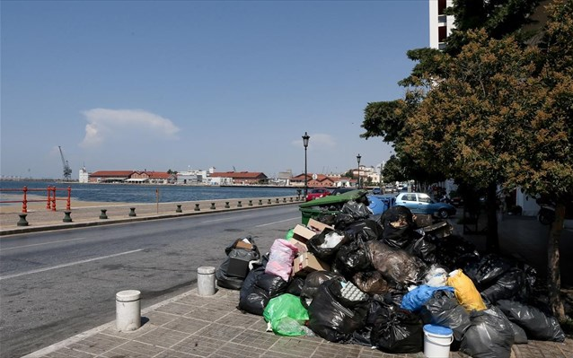
But the most dangerous problem is...

Slide 8
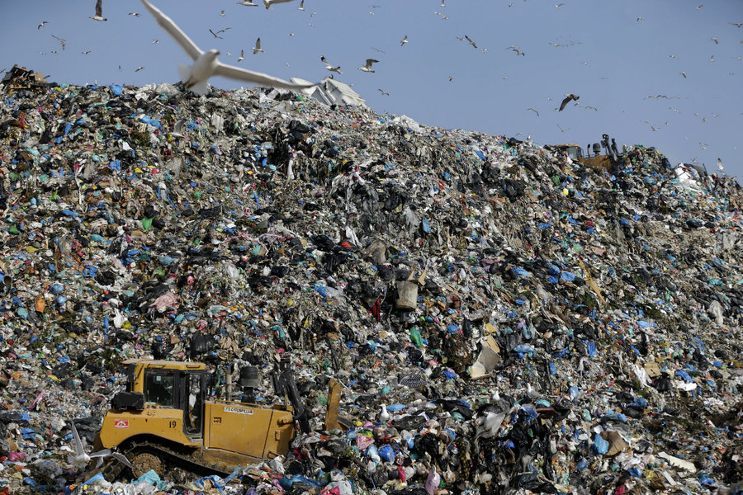
...garbage dispossal...

Slide 9
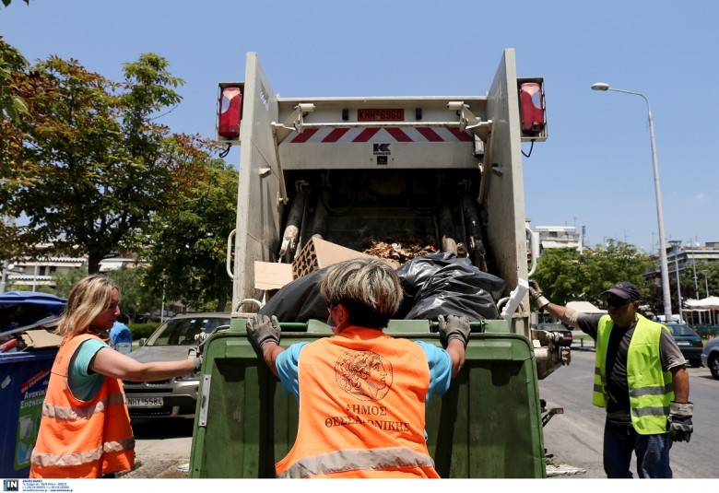

... due to frequent strikes of garbage workers.

Slide 10
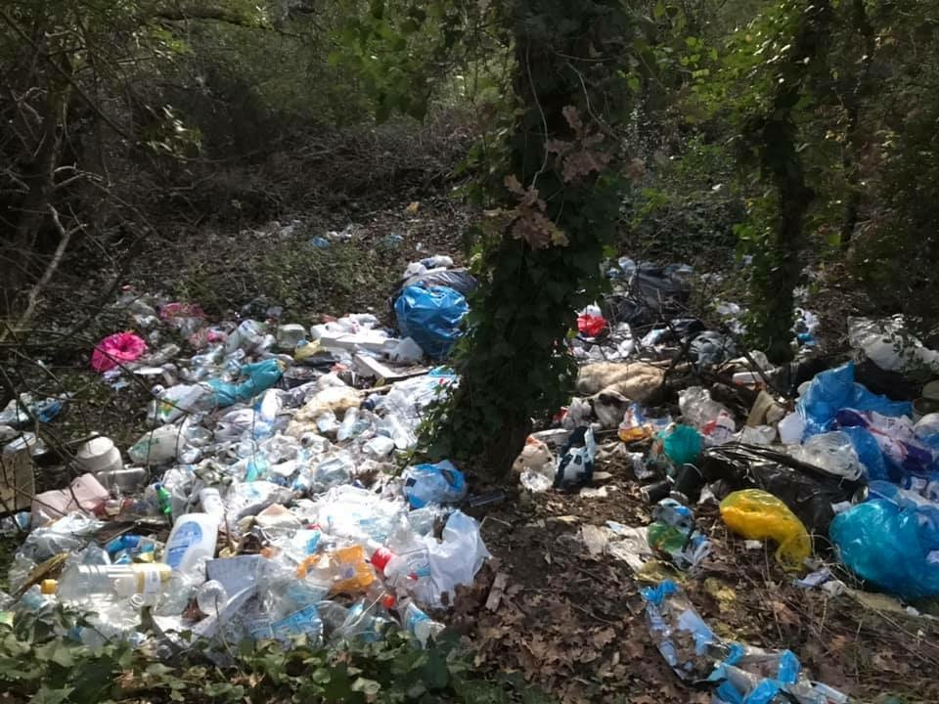
At the same time, however i have witnessed ecological problems in natural landscapes

Slide 11
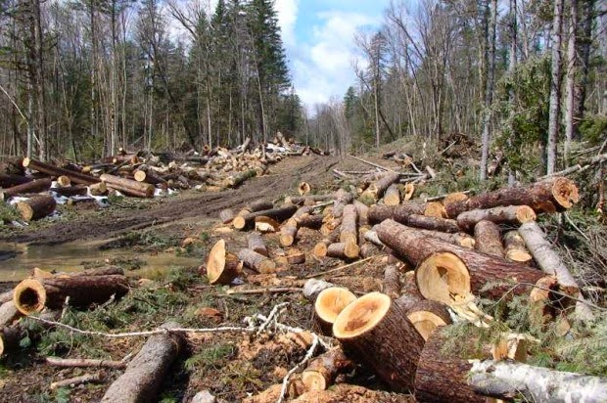
And it is not just pollution. Illegal logging has greatly damaged the greek forests.

Slide 12
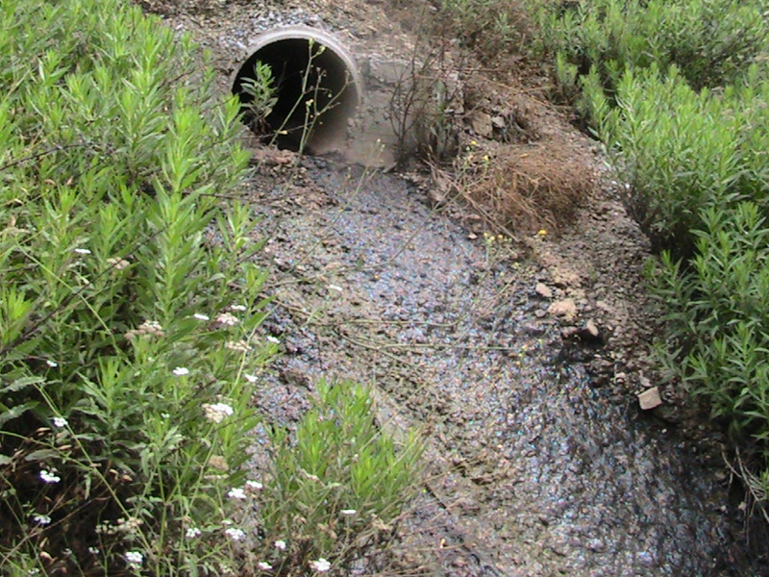
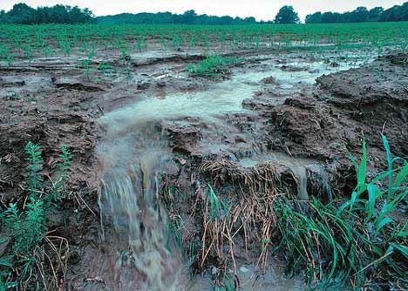
Greek waters are also tainted by pollution both from industrial waste and exessive use of fertilizers.

Slide 13
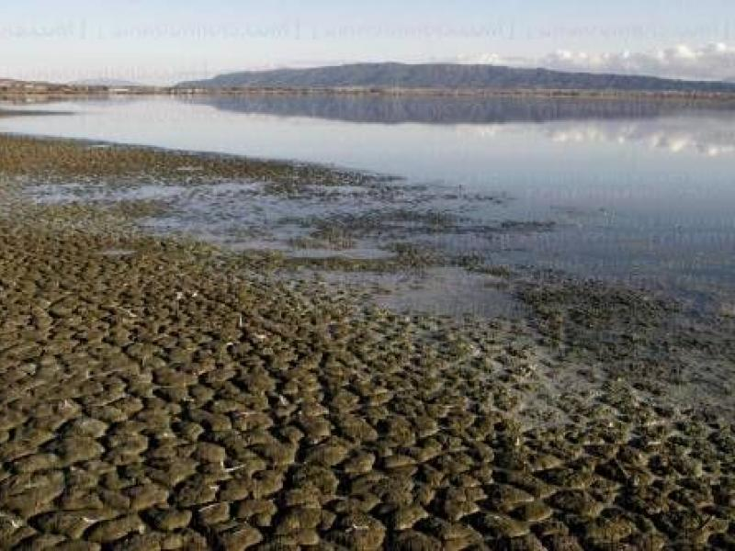
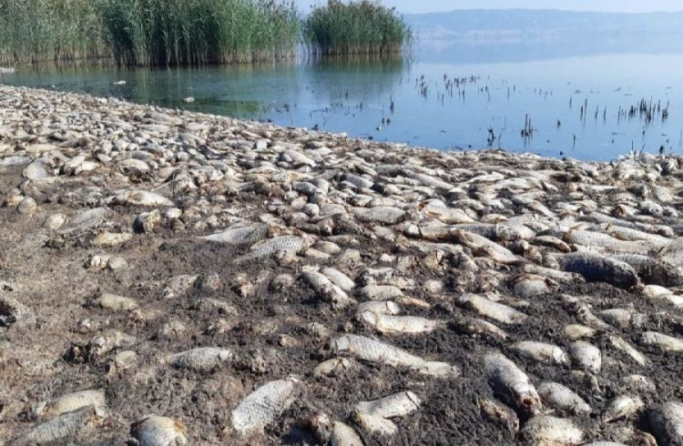
This leads to the death of coastal ecosystems.

Slide 14

Despite all of that i have hope that things will change for the better.

Slide 15

So not only Greeks but the whole world can live in a greater planet.

Slide 16
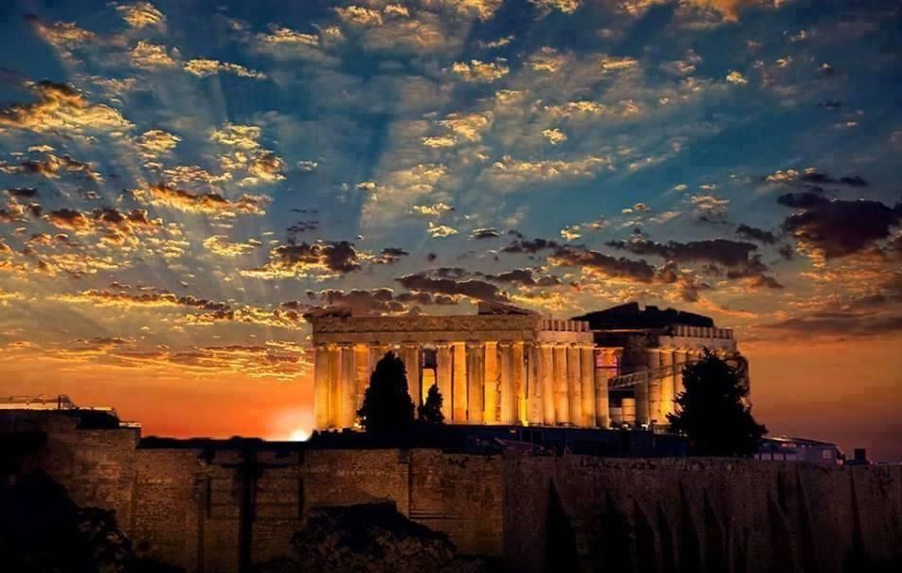
Thank you for your attention!

