Slide 1
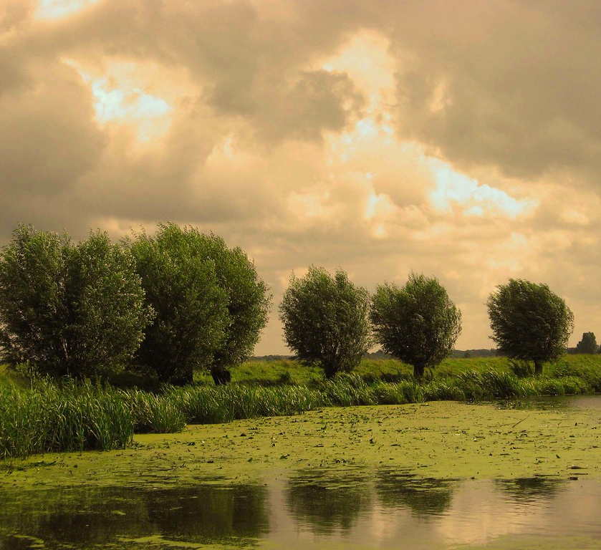
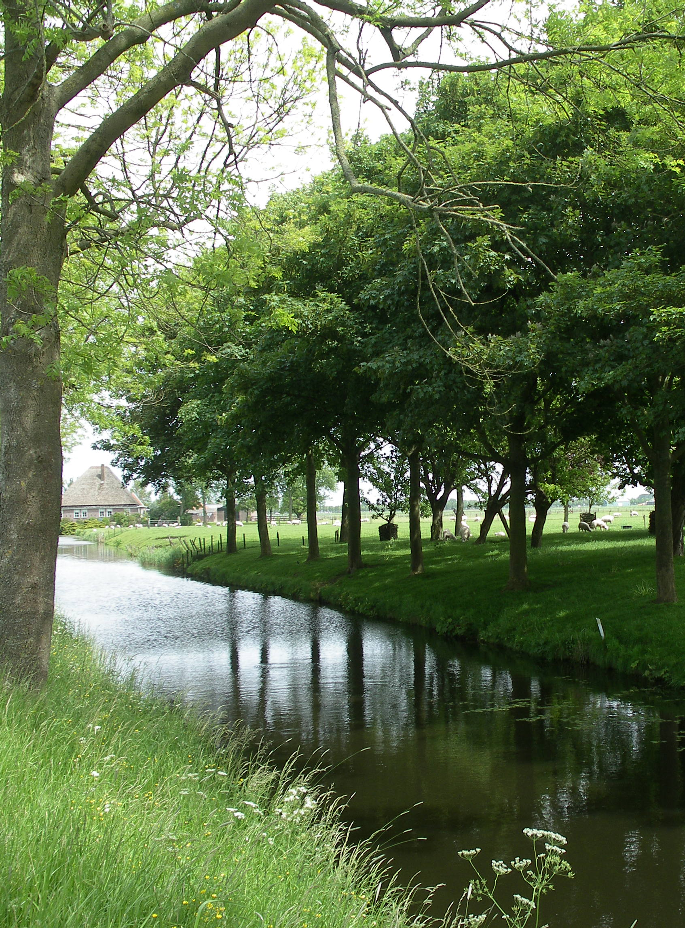
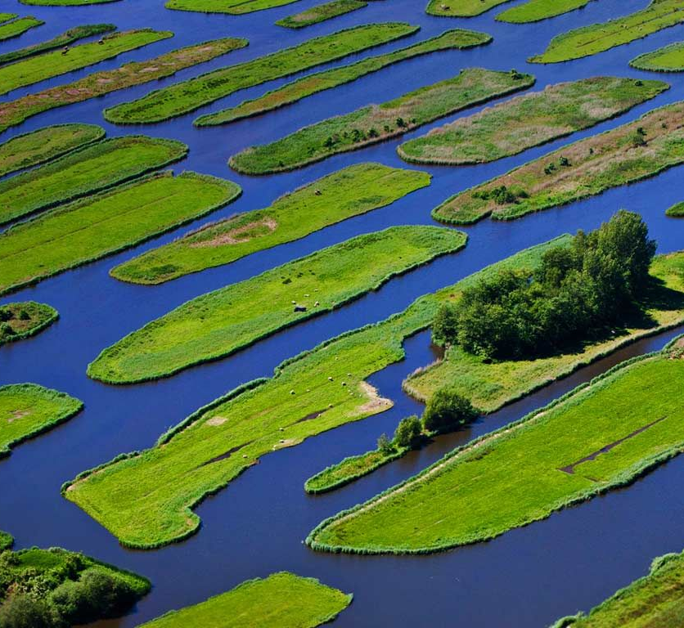
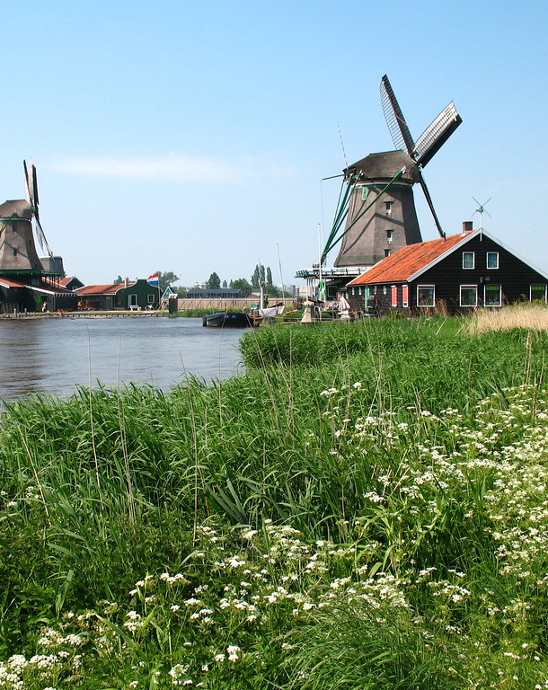
Google image search: “the Netherlands landscape”
Typical Dutch landscapes are always with water?
Notes:
https://upload.wikimedia.org/wikipedia/commons/f/f1/Landscape-netherlands-twisk.JPG
https://c2.staticflickr.com/2/1395/896242414_50319bd6d5_b.jpg
https://i.pinimg.com/originals/45/e6/58/45e658294f6be91ca4d59770bc5565c9.jpg
https://farm3.staticflickr.com/2162/2537534868_7e62cf0e56_b.jpg
These pictures are some of the results you get when you do a google image search on “the Netherlands landscape”. This is apparently what is seen as the typical Dutch landscape, and that is probably correct. The Netherlands is a country that lies below sea level, is home to the river deltas of several rivers and is partly made up of land that the Dutch reclaimed from the sea. This means that a lot of landscapes in the Netherlands are wet. However, the Netherlands hosts a diverse collection of typical landscapes and I would like to present a lesser known typical Dutch cultural landscape with high ecological value.

Slide 2
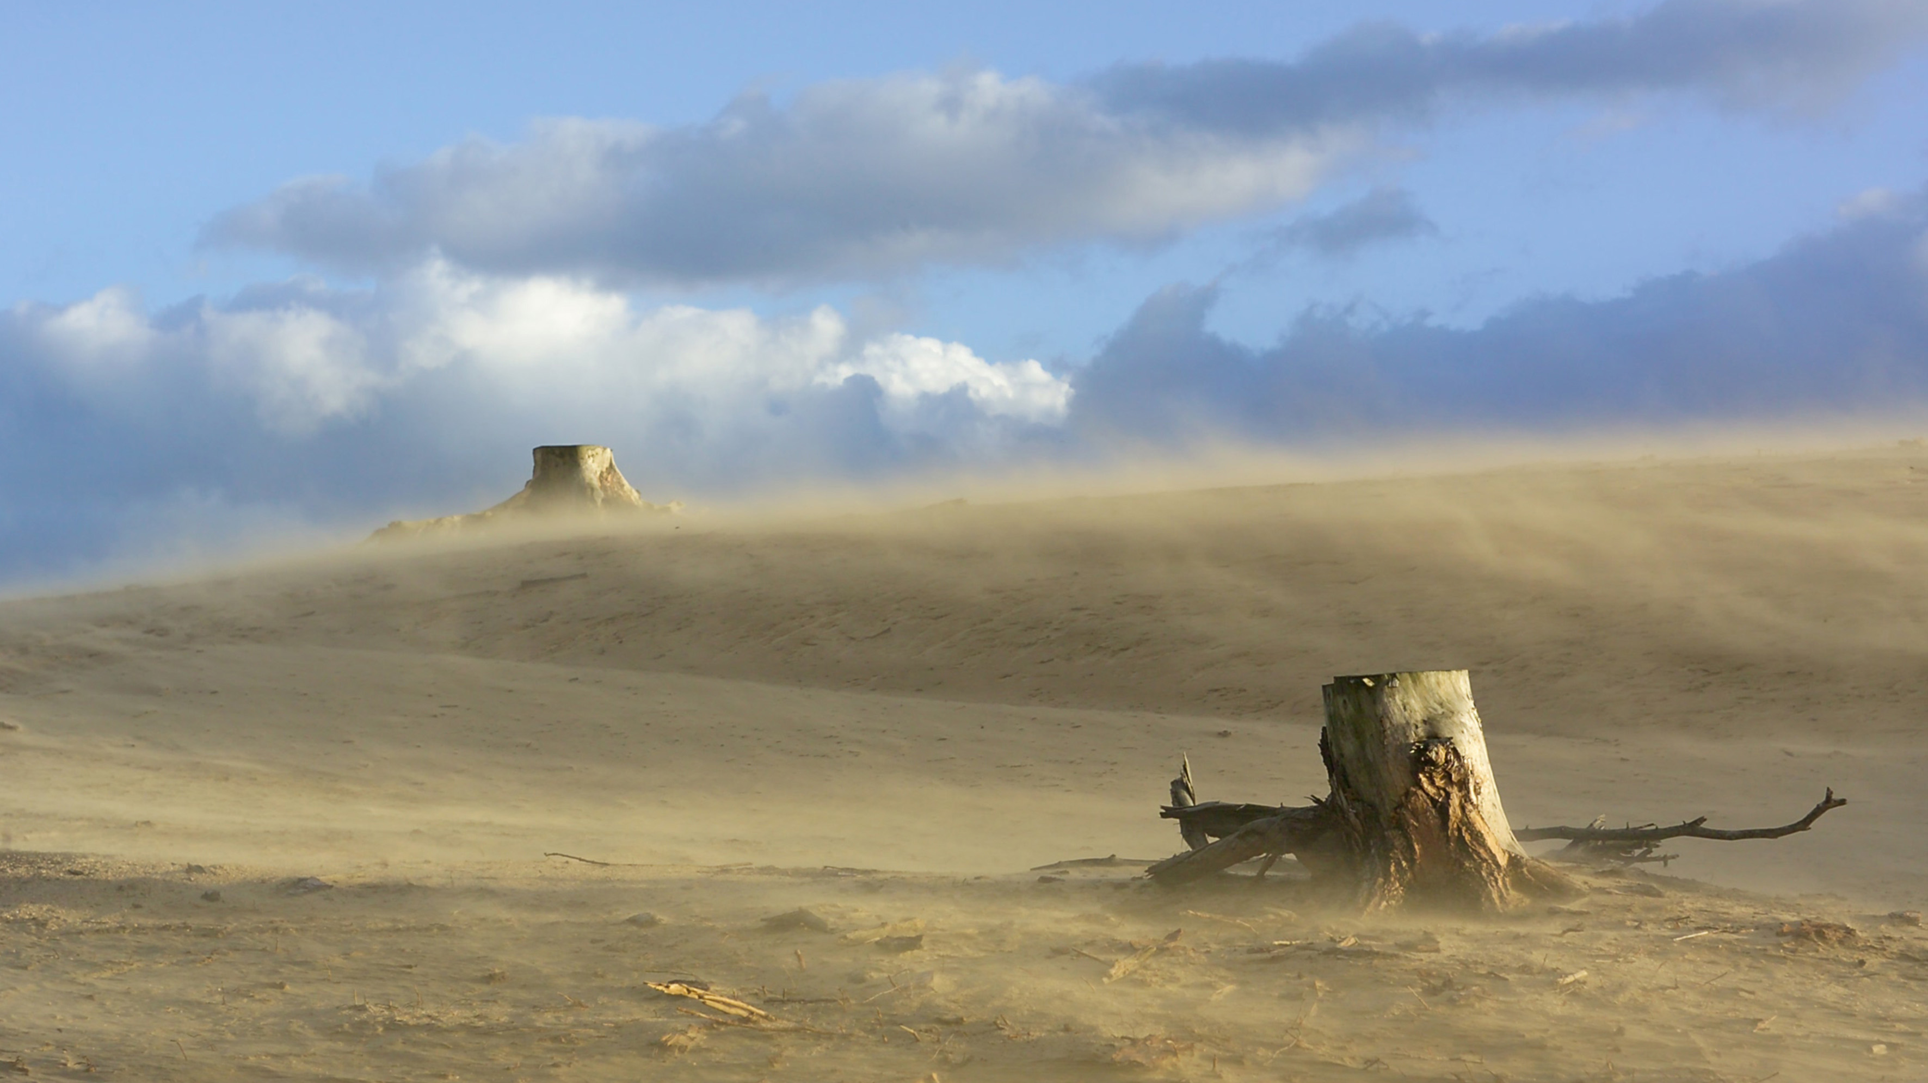
Drift sands of The Netherlands
Ruben Baan Hofman
Landscape Ecology
Mendel University
Notes:
https://www.hogeveluwe.nl/system/images/images/000/000/014/original/Landschap_Stuifzand__Robbert_Maas_edit.jpg?1419950376

Slide 3
In this presentation
Landscape Description & Occurrence
Cultural History & Ecological Significance
Developments, Threats & Solutions

Slide 4
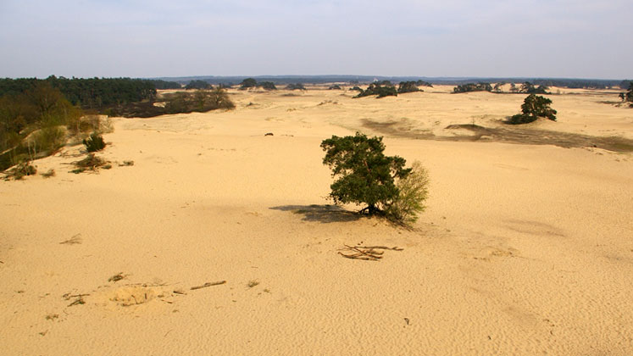
Landscape description
Characteristics of drift sand landscapes are:
Mosaic of drift sand, heather shrubs and Scots Pine forest vegetation
Nutrient poor sandy soils and a hot and dry micro-climate
Dynamic aeolian sand distribution and erosion
Habitat for several Red-Listed species unique for Europe
Notes:
https://www.dekampkootwijk.nl/sites/default/files/omgeving-slide-image-4.jpg

Slide 5
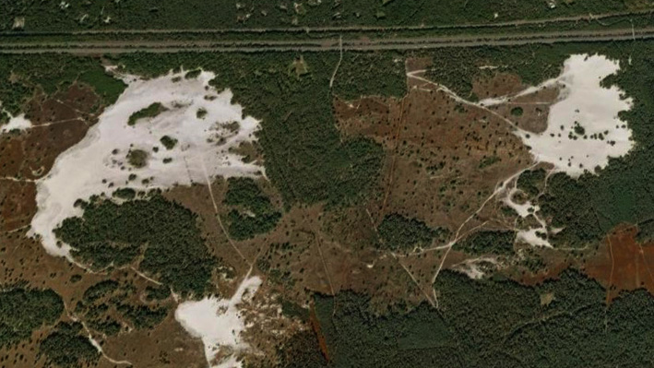
Mosaic landscape
Notes:
https://throughthesandglass.typepad.com/through_the_sandglass/2009/11/europes-inland-sand-seas-2-dutch-deserts-and-geoconservation.html

Slide 6
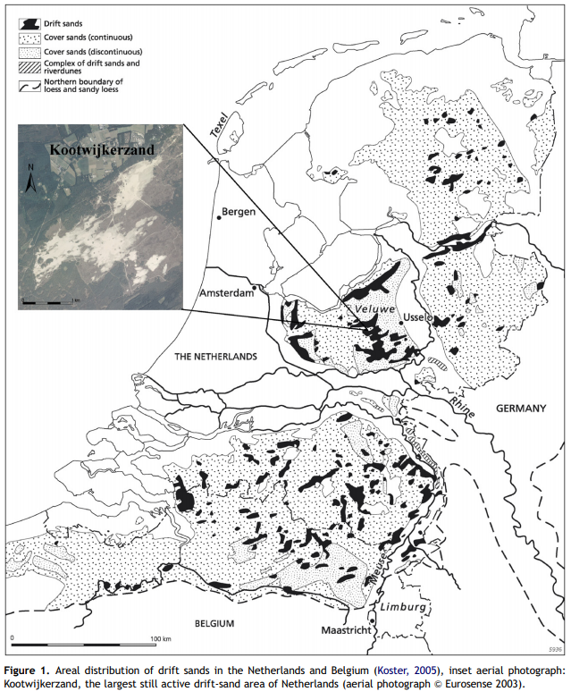
Occurrence
Drift sands occur in the southern, central and eastern parts of the country
Most drift sands disappeared over time,1400 ha out of 80 000 ha remains

Slide 7
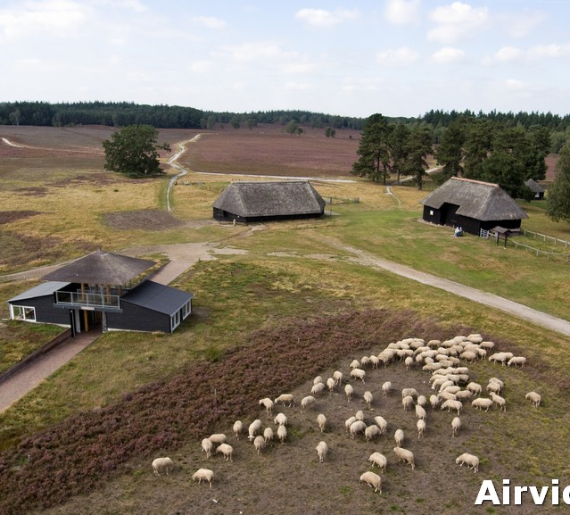
Historic significance
Formed by agricultural practices and the deep litter system (potstal in Dutch)
Poor soils were fertilized with sheep feces mixed with heather sods.
Continues removal of heather sods exposed the bare Pleistocene sands
Notes:
https://schaapskudde-epe-heerde.nl/images/pagina/44_1377175966.jpg

Slide 8
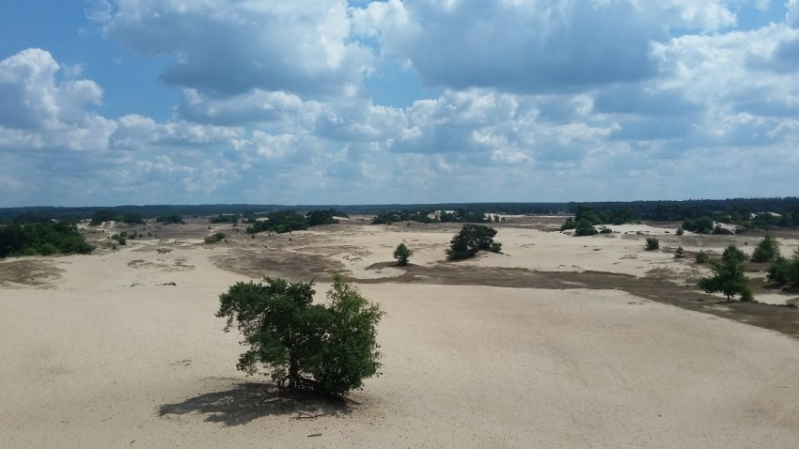
Ecological significance
Although sand drifts are species-poor, they are ecological significant for the preservation of several Red-Listed species such as the Tawny Pipit, Tree Grayling, Blue-winged Grasshopper & European Nightjar
Furthermore, sand drifts are very dynamic ecological occurrences with several stages of pioneer vegetation that alternate into a ever-changing mosaic
Notes:
https://www.wandel.nl/upload_mm/0/7/5/636_fullimage_kootwijkerzand_850x478.jpg

Slide 9
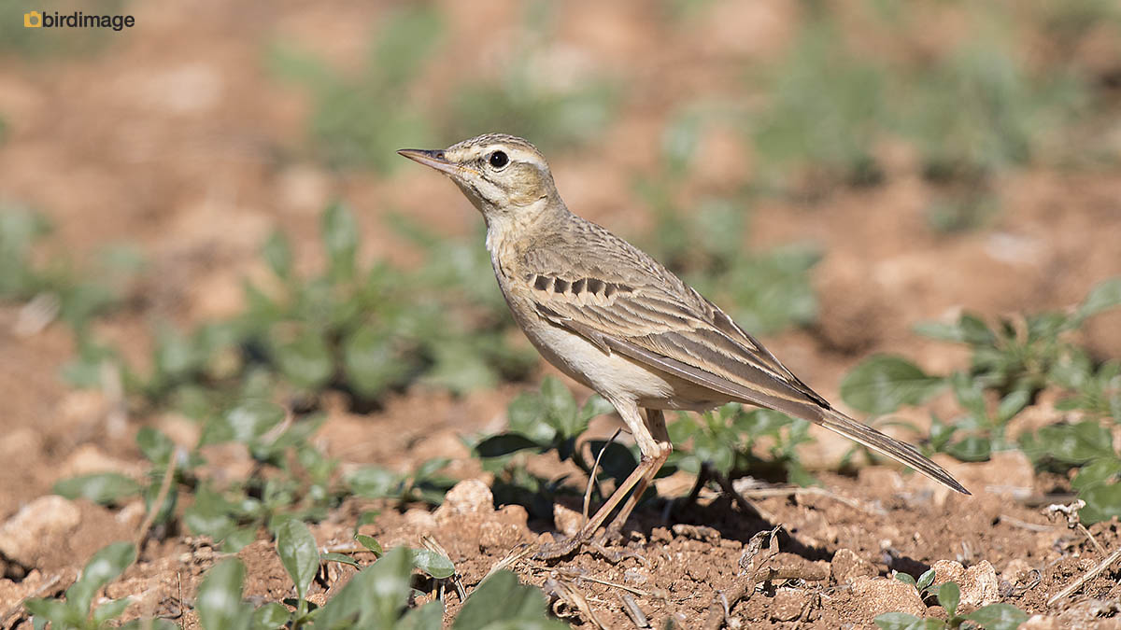
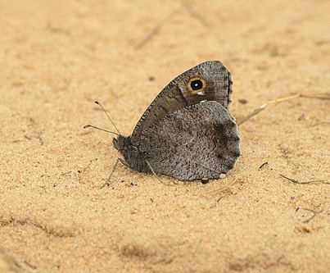
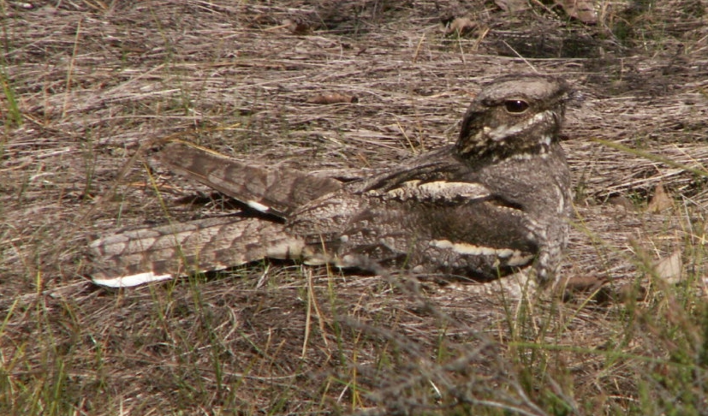
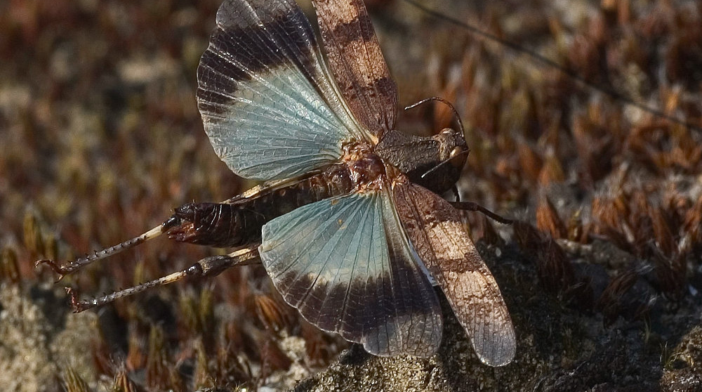
Red-listed animal species
Notes:
http://www.insectenroutes.nl/images/strbr35sprinkhaanI.jpg
http://www.macrografie.nl/vlinders/kleine_heivlinder_hipparchia_statilinus_tree_grayling/kleine_heivlinder_hipparchia_statilinus_tree_grayling_img_3.jpg
https://www.birdimage.nl/wp-content/gallery/duinpieper/Duinpieper-Tawny-Pipit-04.jpg
https://upload.wikimedia.org/wikipedia/commons/b/b0/Paukstelis.jpg

Slide 10
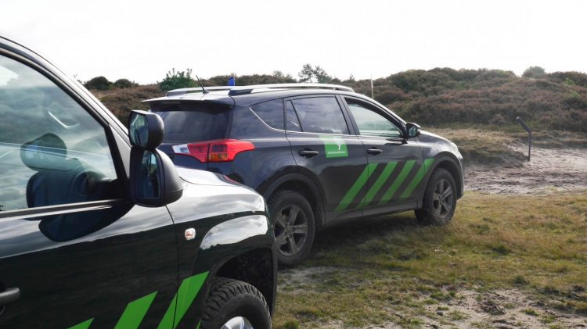
Developments
In the 19th century the sand drifts formed a threat to communities and coastal protection. State Forest Management (Staatsbosbeheer) was established to plant along the edges of the drifts to keep the sand at bay.
Today the sand drifts are no longer seen as threat but as precious natural area that needs to be protected.
Notes:
https://www.mrsmama.nl/wp-content/uploads/2016/10/Op-pad-met-staatsbosbeheer-4-750x502.jpg

Slide 11
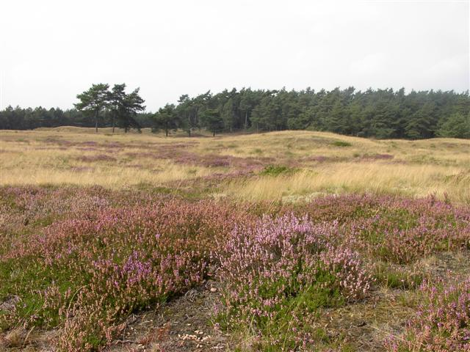
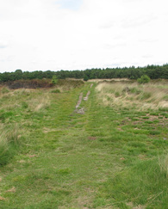
Ecological threat
The main threat to the landscape is loss of its dynamic characteristics
This usually expresses through grass overgrowth after which more vegetation can establish itself and the sand drift will be lost
Main factor in this process is nitrogen deposition.
Notes:
http://wandelroutes.maakjeroute.nl/heelsum/images/2_heelsum_doorwerthse_heide_knooppunt_2_sumr_4011.jpg
http://www.drents-friese-wold.nl/dfw0606.jpg
https://upload.wikimedia.org/wikipedia/commons/thumb/d/dd/Limitische_Heide_98.JPG/1200px-Limitische_Heide_98.JPG

Slide 12
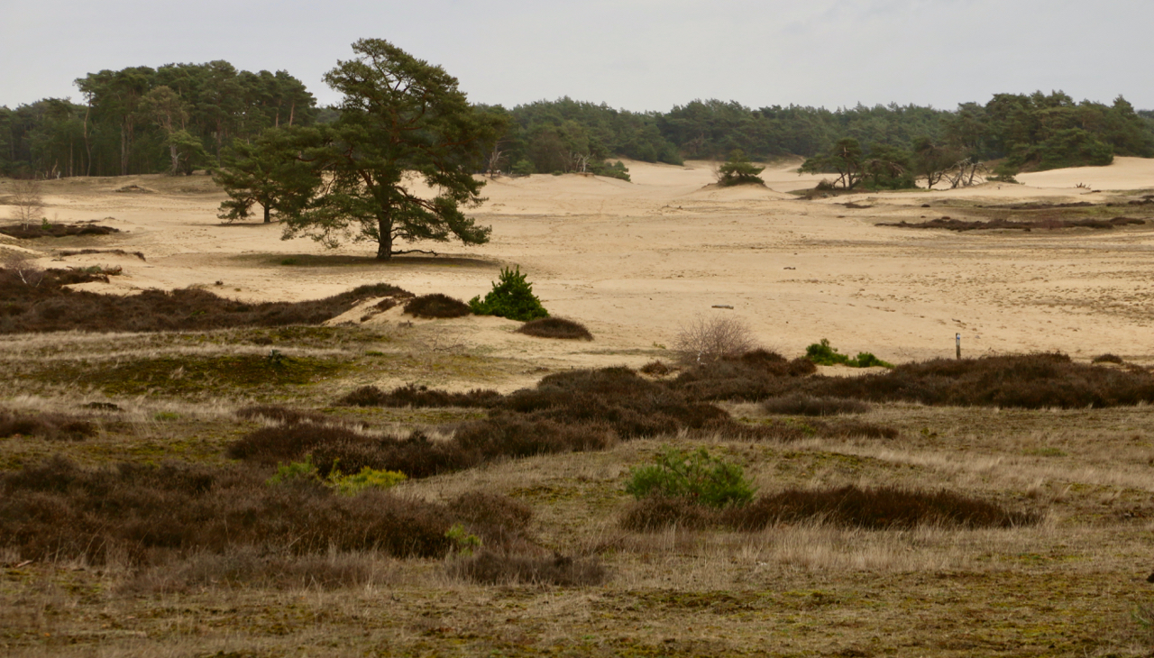
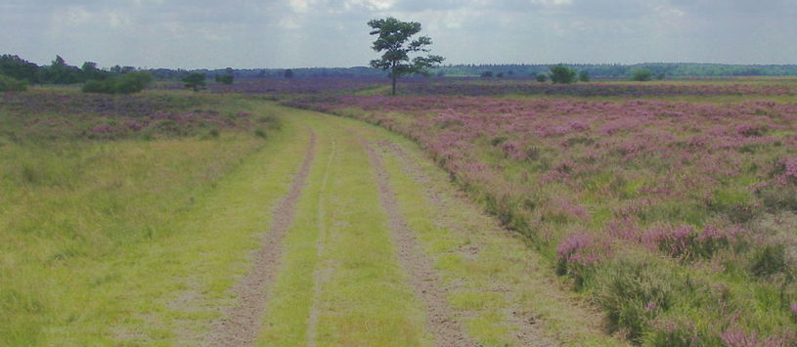
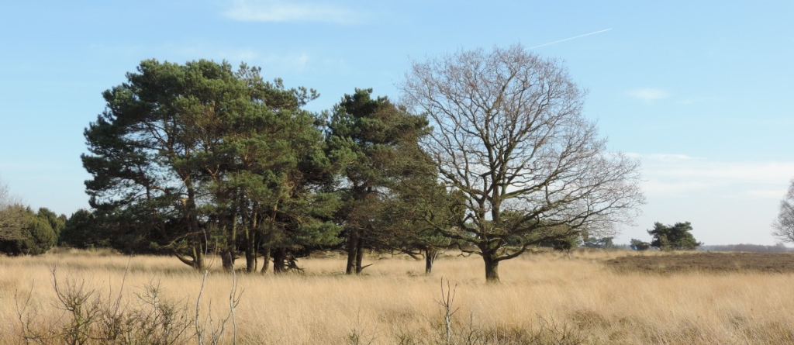
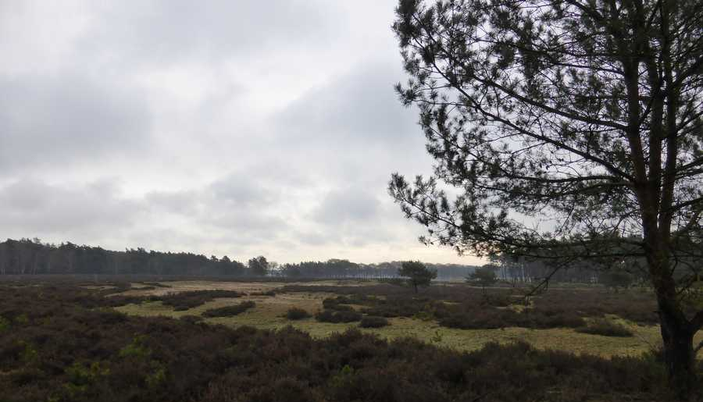
Notes:
https://natuurfotosdrenthe.files.wordpress.com/2014/03/vliegdennen-en-eik.jpg
https://wimtenbrinke.nl/wp-content/uploads/7-1.jpg
https://www.henrifloor.nl/plaatjes/2018/02/03/foto14.jpg
https://www.doggydating.com/images/news/m3578/large_17247_3.jpg?4842

Slide 13
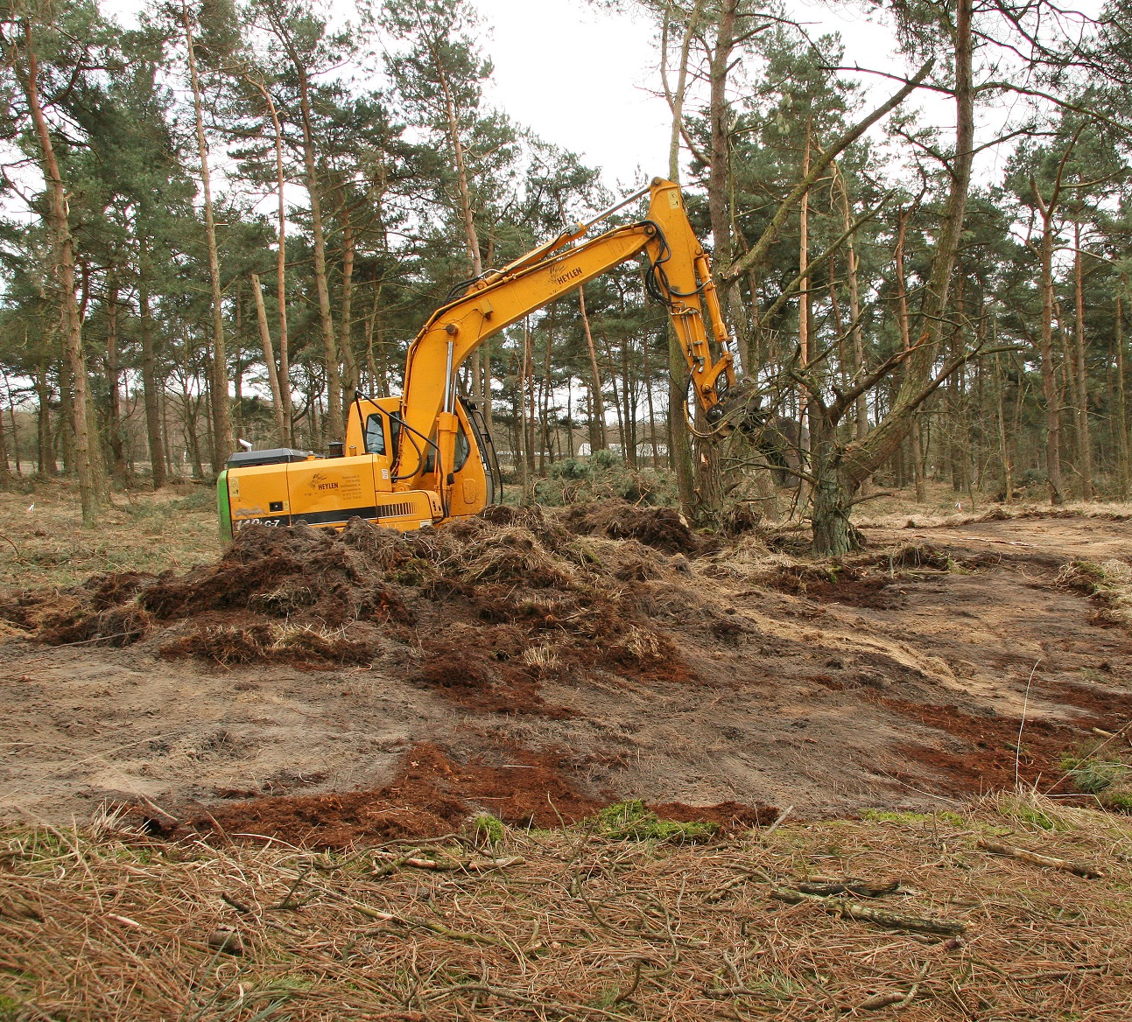
Solutions
The main priority is to take away the organic build up and to reintroduce disturbance and wind erosion.
The removal top soil and/or milling and sieving of the sand is usually a good method uncover the sand.
Land clearances and cutting down trees can increase wind erosion but may get resistance from the public
Notes:
https://www.natuurpunt.be/sites/default/files/images/inline/plaggen_maarten_jacobs.jpg

Slide 14
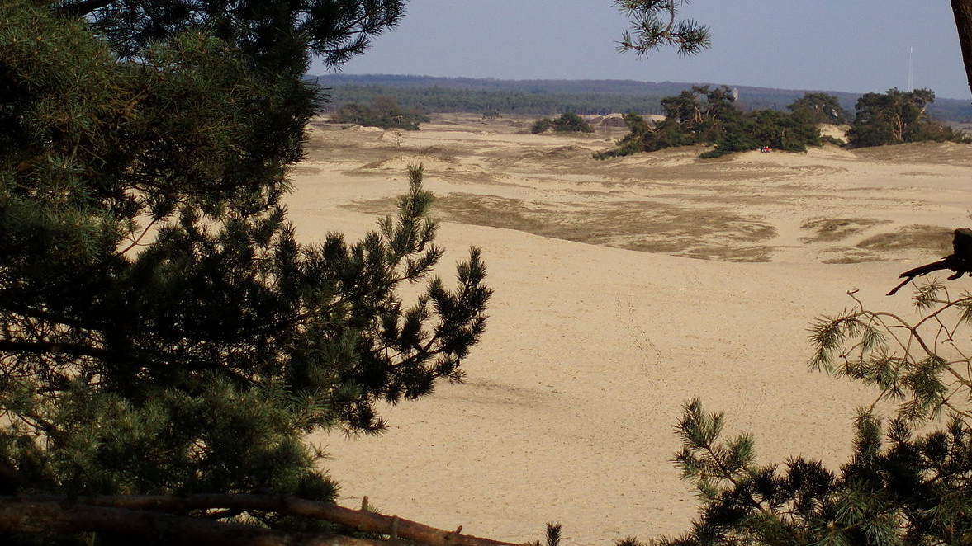
Thank you for your attention
Notes:
https://upload.wikimedia.org/wikipedia/commons/thumb/c/c0/Kootwijkerzand_1.jpg/1200px-Kootwijkerzand_1.jpg

Slide 15
Literature
Koomen, A. J. M., Maas, G. J., & Jungerius, P. D. (2004). Het stuifzandlandschap als natuurverschijnsel. Landschap: tijdschrift voor landschapsecologie en milieukunde, 21(3), 159-169. https://library.wur.nl/WebQuery/wurpubs/fulltext/190489
Riksen, M., Ketner-Oostra, R., van Turnhout, C., Nijssen, M., Goossens, D., Jungerius, P. D., & Spaan, W. (2006). Will we lose the last active inland drift sands of Western Europe? The origin and development of the inland drift-sand ecotype in the Netherlands. Landscape Ecology, 21(3), 431-447. https://doi.org/10.1007/s10980-005-2895-6
Riksen, M., Spaan, W., & Stroosnijder, L. (2008). How to use wind erosion to restore and maintain the inland drift-sand ecotype in the Netherlands?. Journal for nature conservation, 16(1), 26-43. https://doi.org/10.1016/j.jnc.2007.07.002
Nijssen, M., & Riksen, M. J. P. M. (2010). Herstel van stuifzand: ingewikkelder dan kaal zand creeëren. Accessable on: https://www.yumpu.com/nl/document/view/50991016/herstel-van-stuifzand-ingewikkelder-dan-kaal-veldwerkplaatsen

