Slide 1
Iceland
Landscape ecology

Slide 2
Iceland is a Nordic island country in the North Atlantic, with a population of 338,349 and an area of 103,494 km² making it the most sparsely populated country in Europe. Forest area of Iceland is about 744 sq. Km, this is 1%.
Notes:
Over 10 percent of Iceland’s territory is covered by glaciers, which includes Vatnajökull, the largest glacier in Europe. Icelandic landscapes are shaped by the forces of nature and vary from deep fjords to vast volcanic deserts. Through to black sand beaches, snow-capped mountains, and staggering waterfalls. Iceland’s nature remains mostly unspoiled as the island is scarcely populated.

Slide 3
Phytogeographically, Iceland belongs to the Arctic province of the Circumboreal Region within the Boreal Kingdom.
Notes:
Ice sheet and polar desert

Slide 4
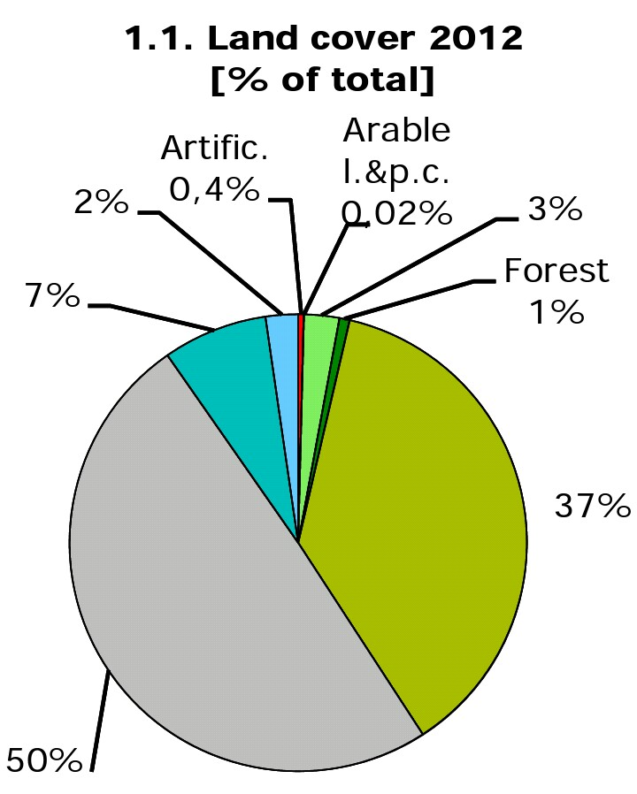

Slide 6
Protected area table Iceland
IUCN management categories of Iceland
Management categories | Count | %
Ia | 2 | 1.55
Ib | 2 | 1.55
II | 5 | 3.88
III | 43 | 33.33
IV | 19 | 14.73
V | 29 | 22.48
VI | 13 | 10.08
Not reported | 6 | 4.65
Not Applicable | 10 | 7.75

Slide 7
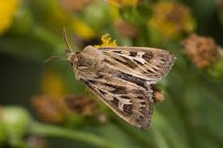
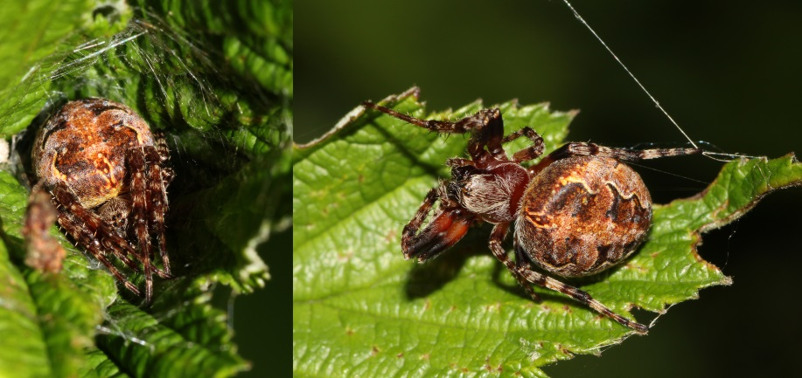
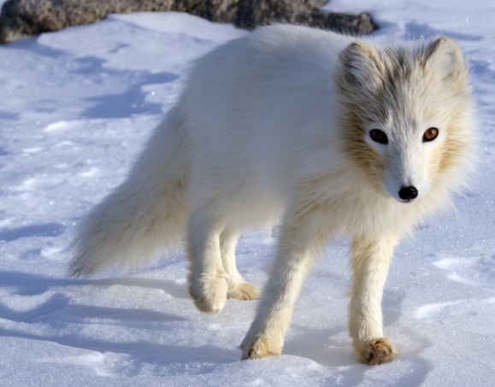
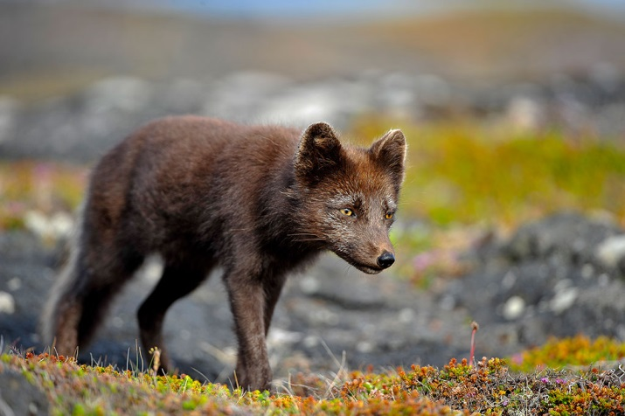
Dominant animals
The furrow spider
(Larinioides patagiatus)
The antler moth
(Cerapteryx graminis)
Reindeer bull
(Rangifer tarandus)
Artic fox (white morph) (Vulpes lagopus)
Artic fox (brown morph) (Vulpes lagopus)

Slide 8
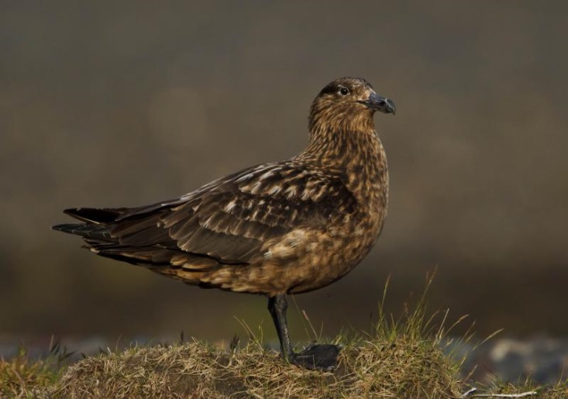
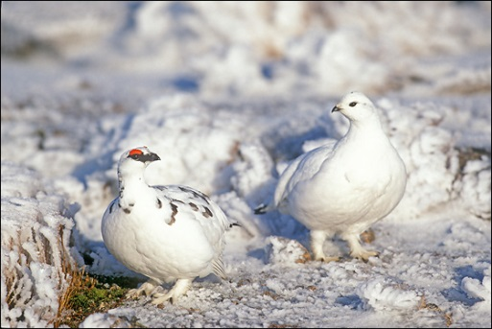
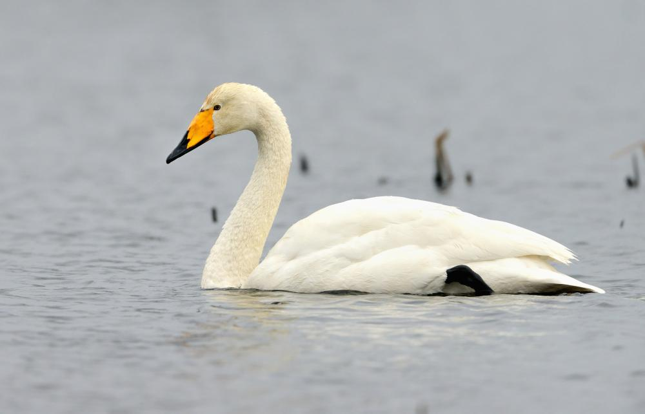
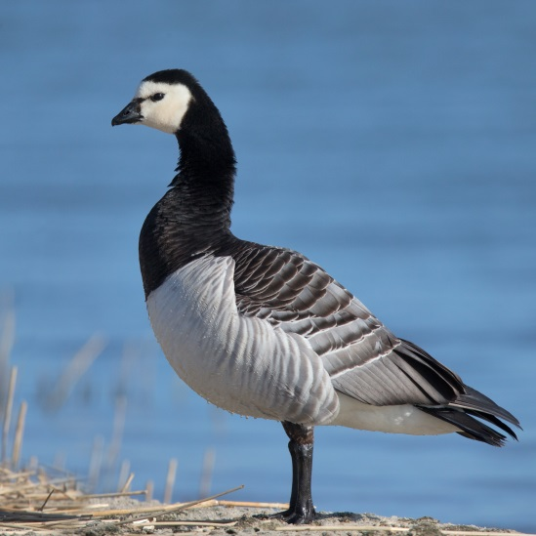
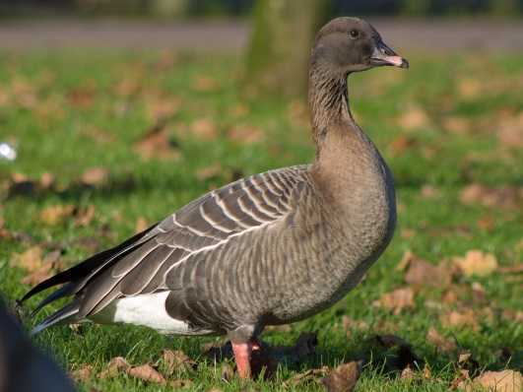
Dominant birds
Great skua
(Stercorarius skua)
Rock ptarmigan
(Lagopus muta)
Whooper swan
(Cygnus Cygnus)
Pink-footed goose
(Anser brachyrhynchus)
Barnacle goose
(Branta leucopsis)

Slide 9
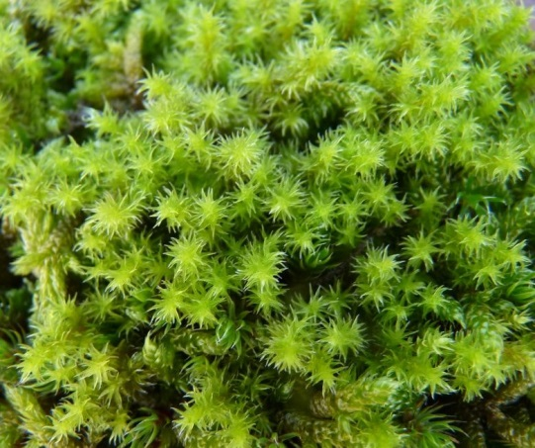
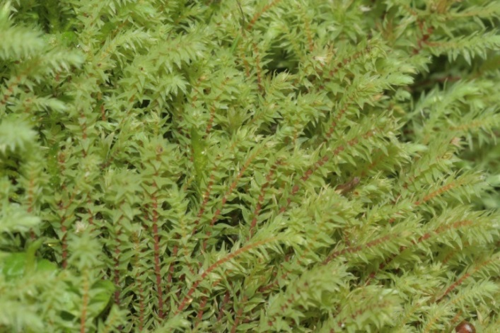
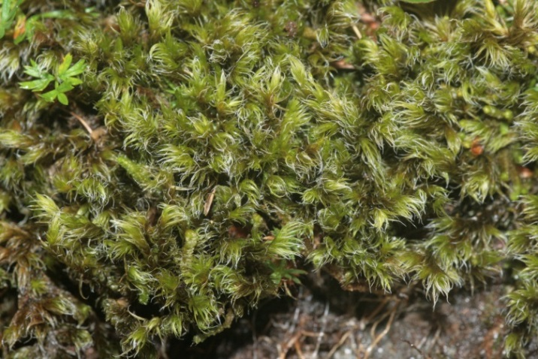
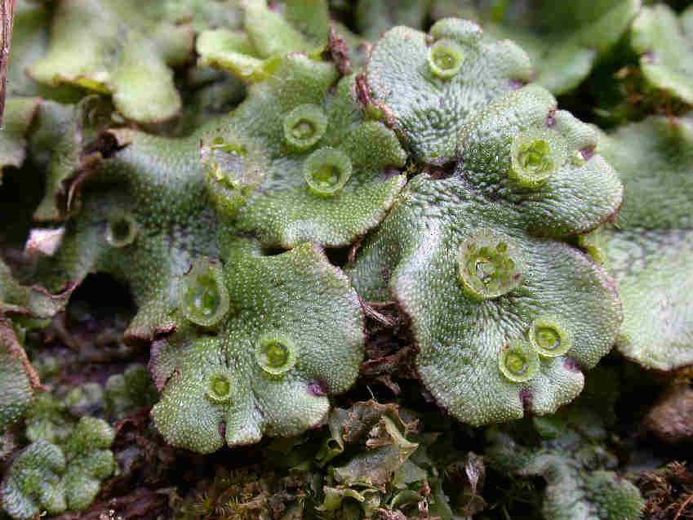
Dominant mosses
Hoary Fringe-moss
(Racomitrium canescens)
Wahlenberg's pohlia moss
(Pohlia wahlenbergii)
Hairy fringe-moss mat
(Racomitrium lanuginosum)
Umbrella liverwort
(Marchantia polymorpha)

Slide 10
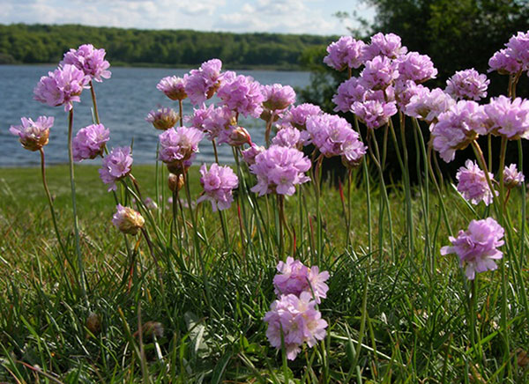
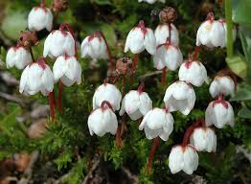
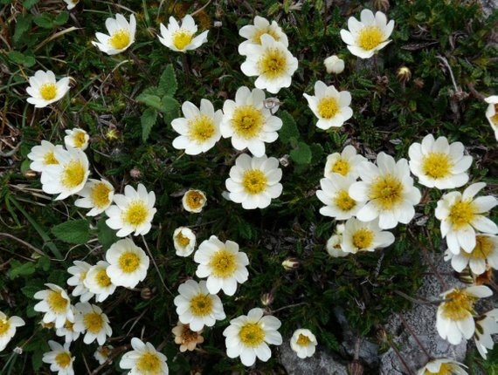
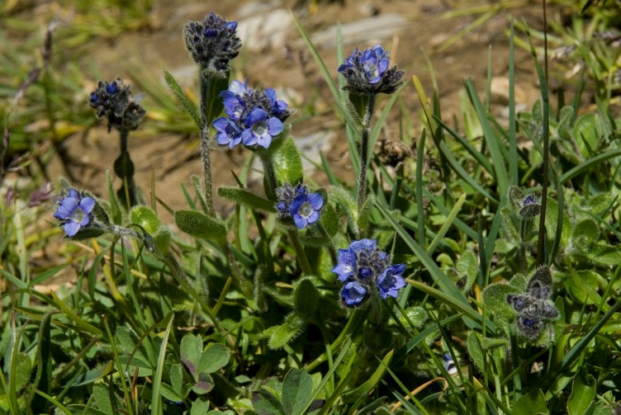
Dominant flowers
Sea thrift
(Armeria maritima)
Mossy mountain-heather
(Harrimanella hypnoides)
Mountain avens
(Dryas octopedala)
Alpine speedwell
(Veronica alpina)

Slide 11
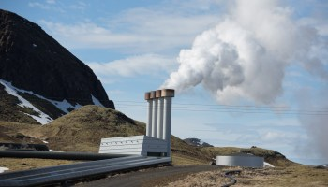
Basic environmental/ecological issues of the Iceland
In spite of the fact that "green energy" accounts for almost all space heating and electricity (geothermal sources for heat, and hydropower for electricity), Iceland's greenhouse gas footprint (in tonnes of carbon per capita per year) is relatively high compared to other OECD countries. This is mainly because of large emissions from primary metal smelters and the dependence on fossil fuels by the transport and fishery industries.
High greenhouse gas footprint

Slide 12
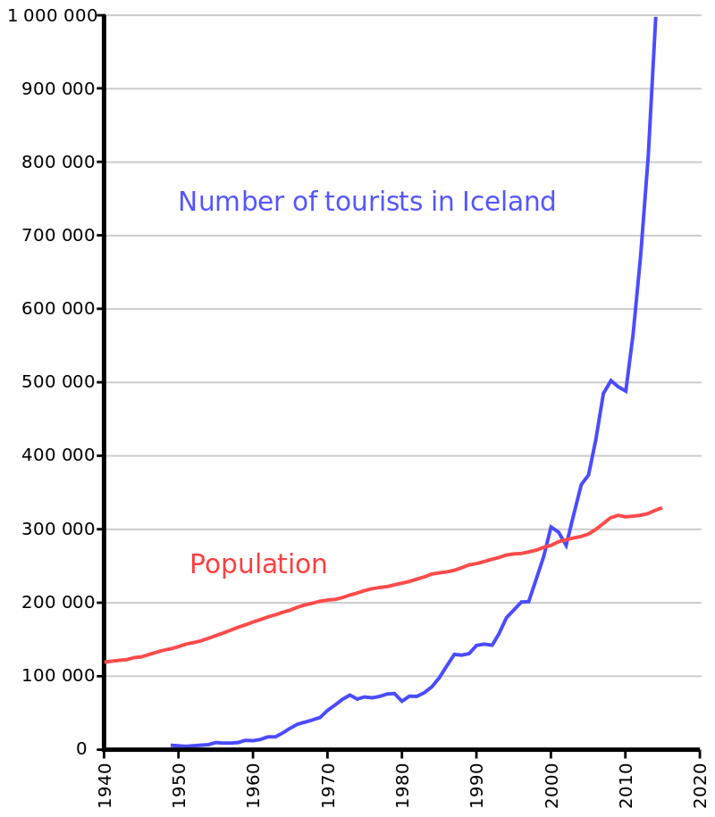
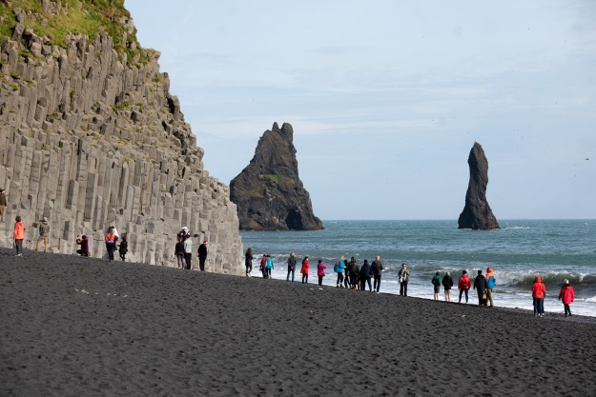
Basic environmental/ecological issues of the Iceland
Tourism
Many areas are vulnerable to intrusion and a constant stream of visitors, and can thus lose their natural value in a relatively short period of time.

Slide 13
Potential solutions
To strive to continue to meet its Kyoto commitments for the current commitment period 2013-2020.
Alternative energy solutions such as wind power and tidal energy.
Also an increasing focus on electric cars as a way to reduce the country's environmental footprint. Green electricity and relatively short commuting distances should bode well for such a major shift.
An active campaign has been ongoing against the use of studded tyres (removing the studded tyres would reduce PM pollution) and major steps have been taken to extend and improve bike paths and promote public transport in the Reykjavík area to reduce environmental pressures.
Environmental policy how to manage the Icelandic tourist industry in a sustainable way, especially with respect to the highly sensitive natural sites.

Slide 14
Thank you for attention!

