Slide 1
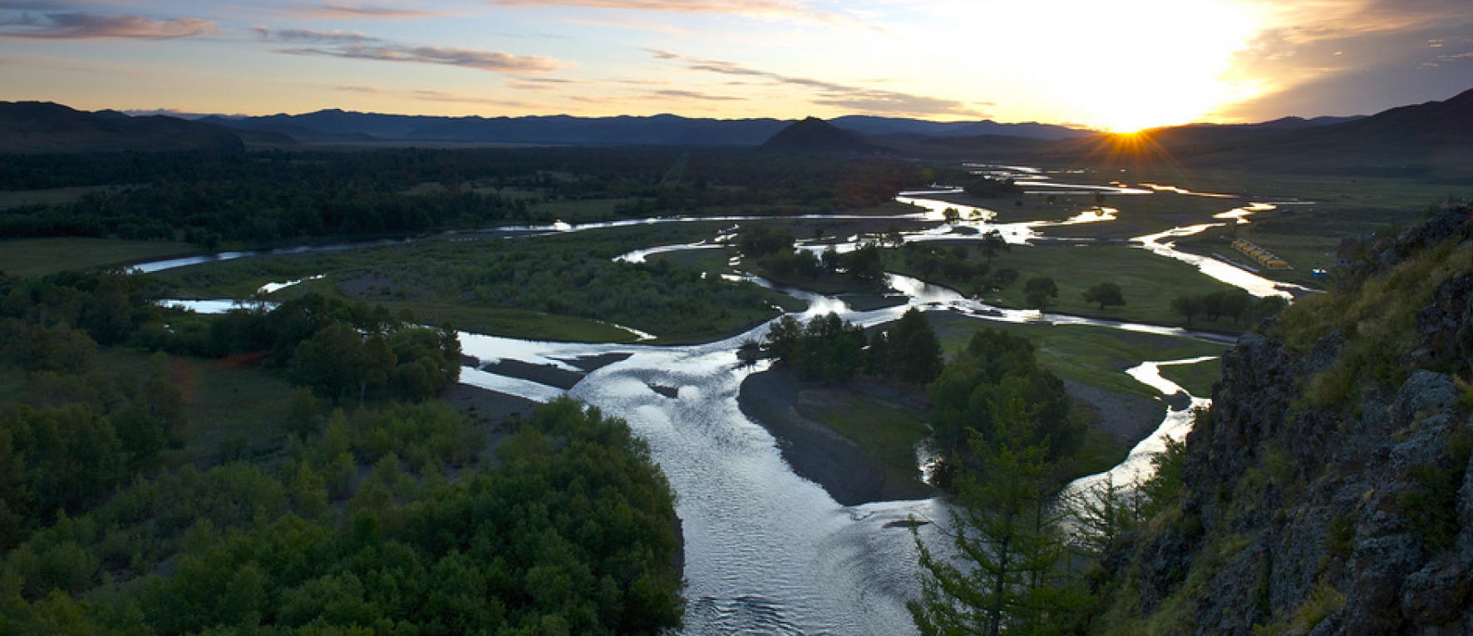
Tuul River in Mongolia
Ulaanbaatar city
Khoszul Batbayar

Slide 2
Why I chose the pollution of the Tuul river?
The Tuul River is the main source of drinking water for the people of Ulaanbaatar . However, in recent years, the river has become severely polluted and in danger of drying up.

Slide 3
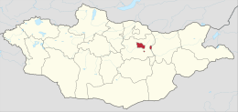
Ulaanbaatar city
Ulaanbaatar, the capital city of Mongolia, is located in the Tuul river valley elevated at 1,300m above the sea level. Territory is 4,704.4 km². Ulaanbaatar where 1.3 million people out of Mongolia's just over 3 million population. The city is divided into 9 districts.
July is the warmest month with an average of 17.1 °C. In January, the average temperature is -21.2 °C.

Slide 4
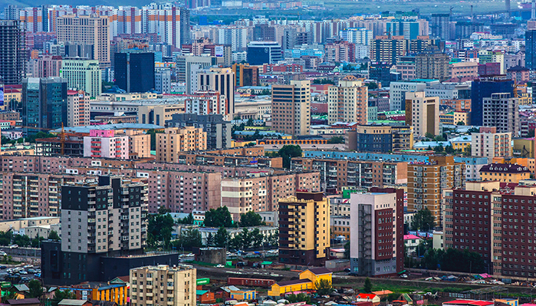
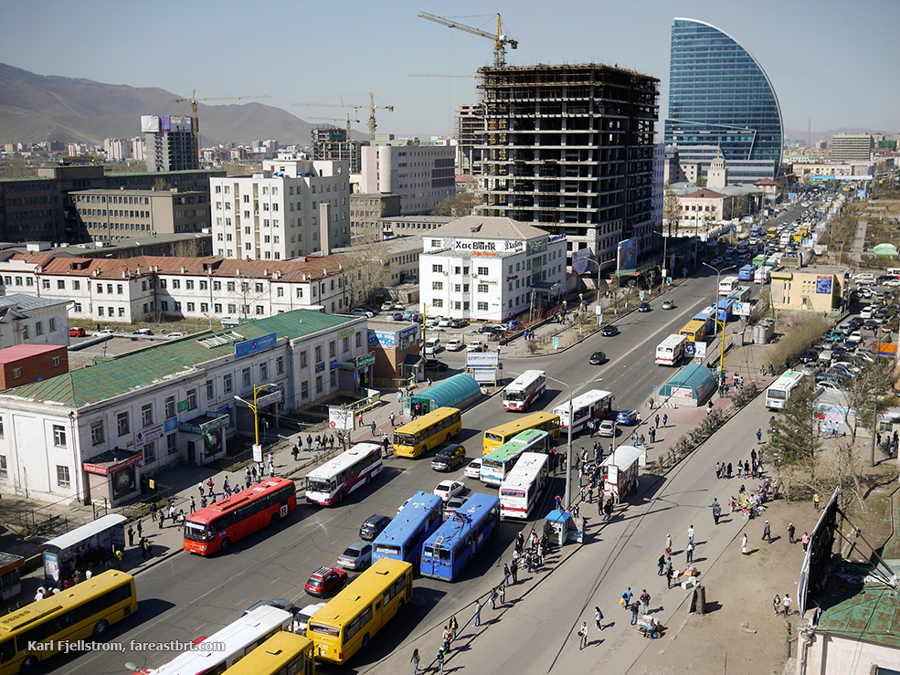
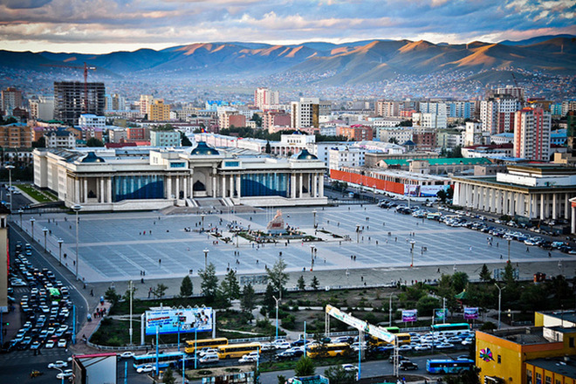

Slide 5
Tuul river basin

Slide 6
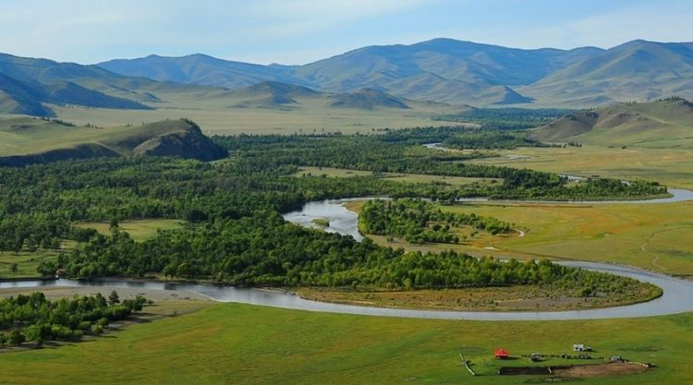
The Tuul River basin includes a variety of landscapes including mountain taiga and forest steppe in the upper catchment, and predominantly steppe downstream of Ulaanbaatar City.
The river flows through 10 soums within 3 provinces and 4 districts.
50,000 km2
720 km long.

Slide 7
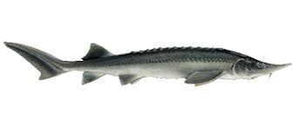
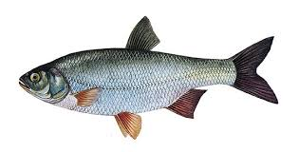
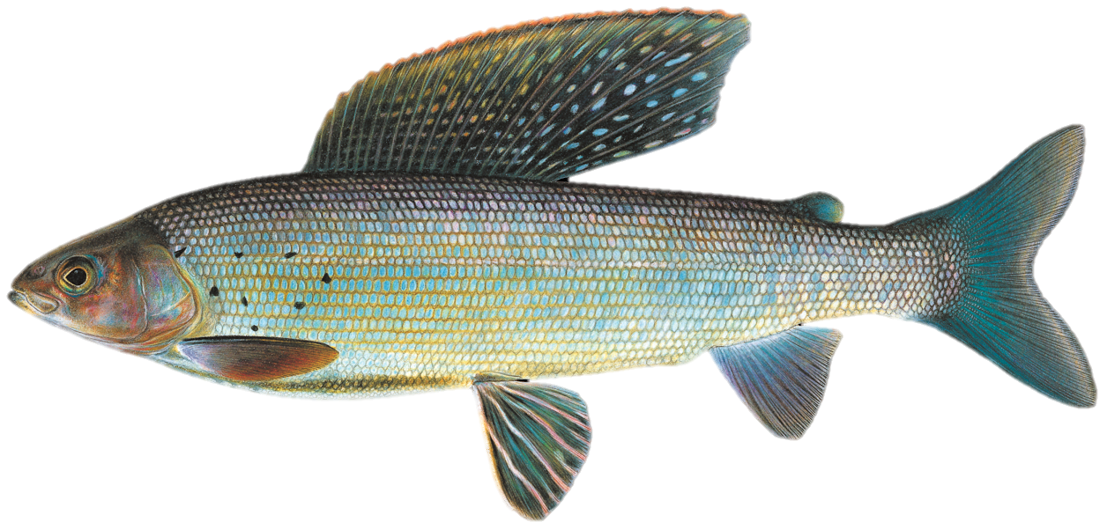
Fauna
Siberian sturgeon
Leuciscus idus
Brachymystax lenok
Arctic grayling

Slide 8
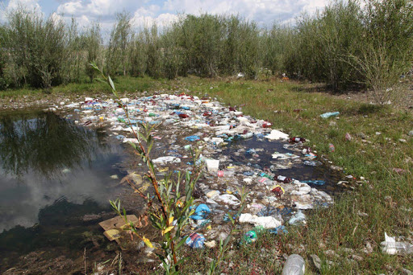
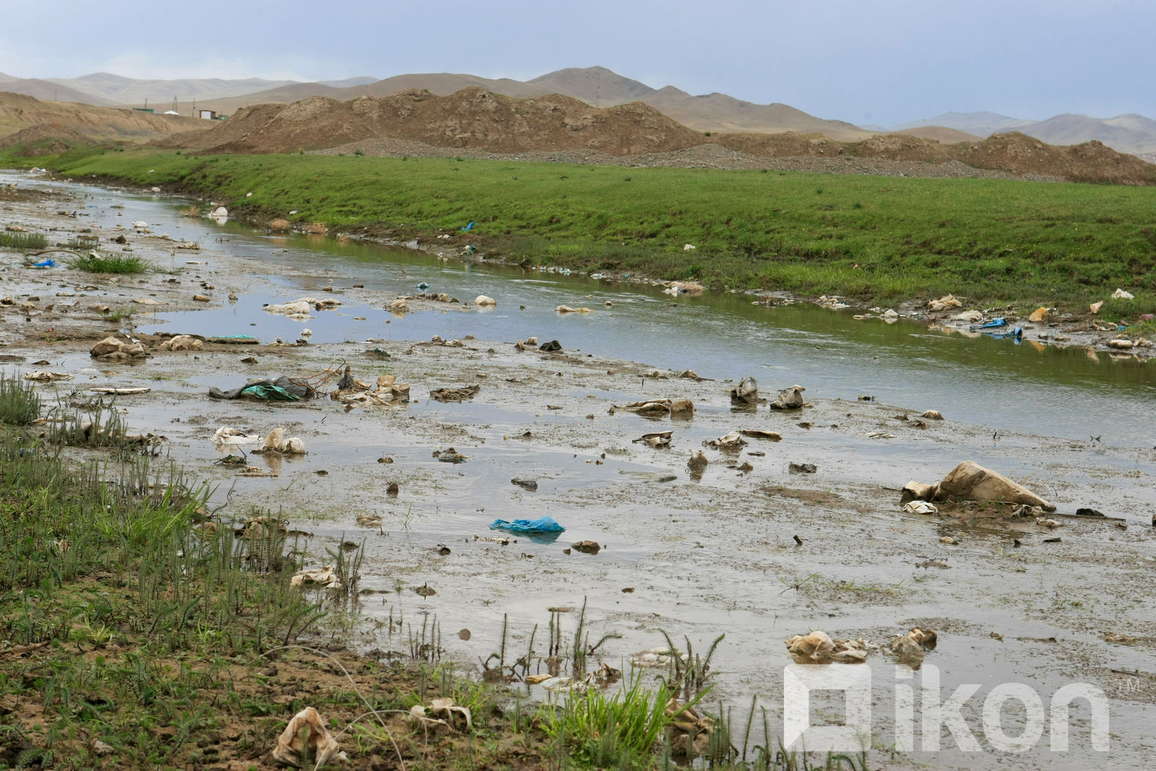
Pollution in Tuul river

Slide 9
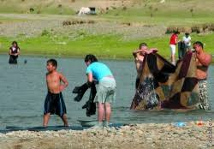
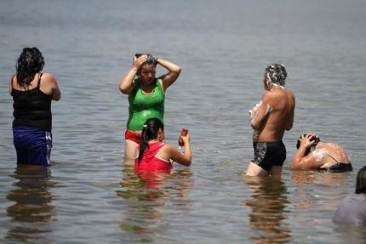

Slide 10
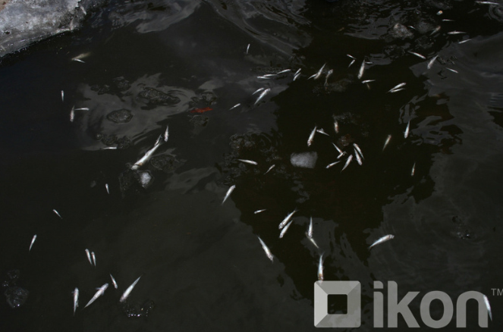
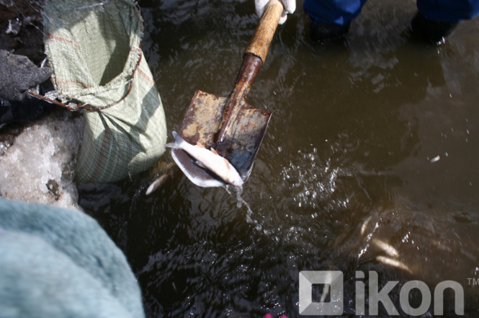
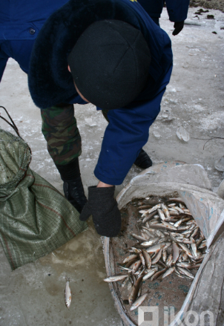
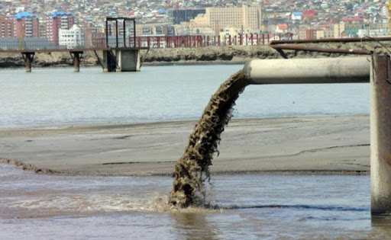
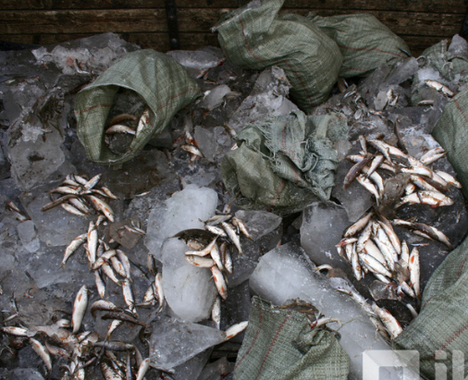

Slide 11
Solution to improve the current health of the Tuul River
To clean the wastes on the river bank and depth of river
To improve the wastewater treatment facilities
To reduce dependence on groundwater supplies through wastewater recycling at the central wastewater treatment plant of Ulaanbaatar City.

Slide 12
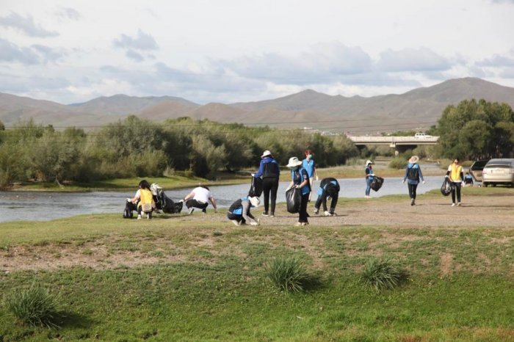

Slide 13
Source
https://en.climate-data.org/asia/mongolia/ulaanbaatar/ulaanbaatar-490/#temperature-graph
http://web.nso.mn/ub_city_group/about-ulaanbaatar
https://www.britannica.com/place/Ulaanbaatar
https://www.discovermongolia.mn/about-mongolia/destinations/ulaanbaatar-capital-city
https://ikon.mn/n/byj
http://www.touristinfocenter.mn/news_more.aspx?CateID=0&NewsID=1597
http://extwprlegs1.fao.org/docs/pdf/mon169814.pdf
http://www.tusgaar.mn/88006?fbclid=IwAR1O4qHlQ7CEDNnIQC2XwGXaBVE9H08TW2VkJg3indiP59wYa3OGckpVDWY
https://ikon.mn/n/12z9

