Slide 1
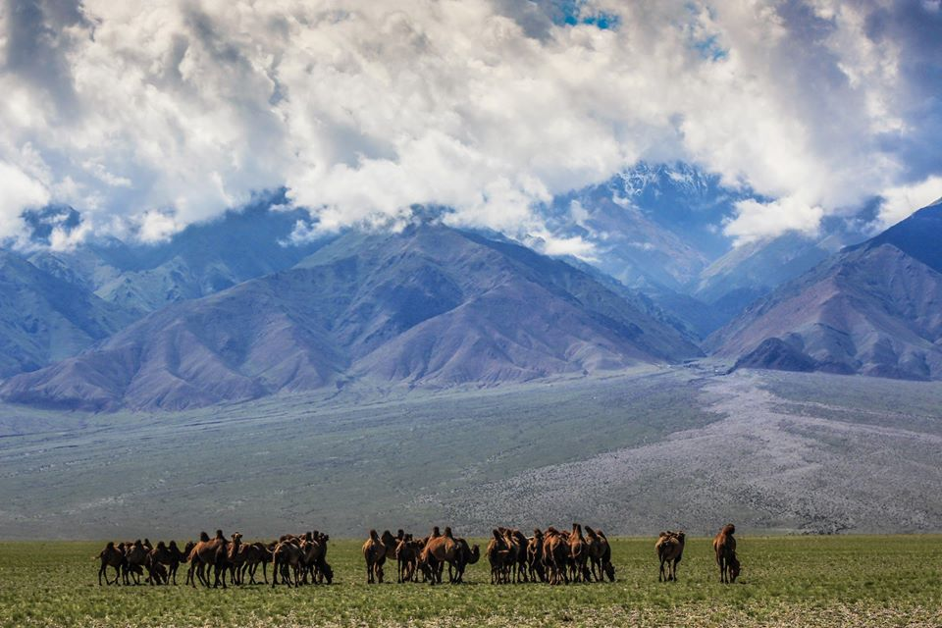
Ecological Issue in Arkhangai province, Mongolia
Landscape Ecology
Enkh-Amar Oyunsanaa
2020

Slide 2
Reasons to choose Arkhangai province
Arkhangai ranks first in Mongolia in terms of the number of livestock.
Tourism is one of the business resources in Arkhangai.
There are many natural resources are observed.

Slide 3
Character of the landscape of the Arkhangai province
Arkhangai is located in forest-steppe and steppe zones in Mongolia.
The soil structure is mainly forest gray, dark alluvial soil, mountain dark brown soil.

Slide 4
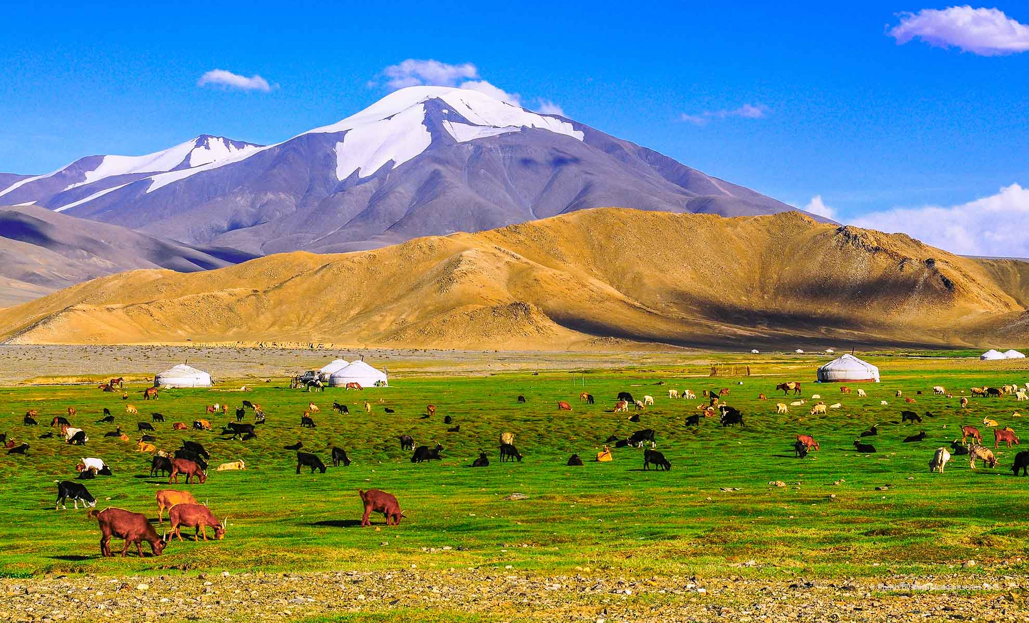
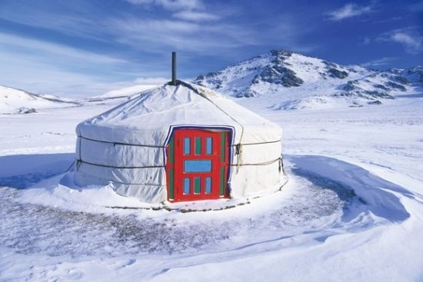
Ecological introduction
In Arkhangai, climate is very harsh. In summer time, temperature is (+14)-(+20)˚C, in winter time, it is (-20) – (-25)˚ C

Slide 5
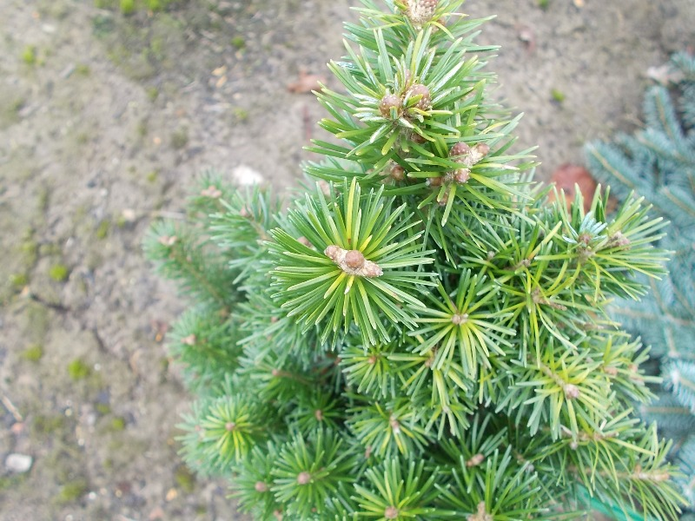
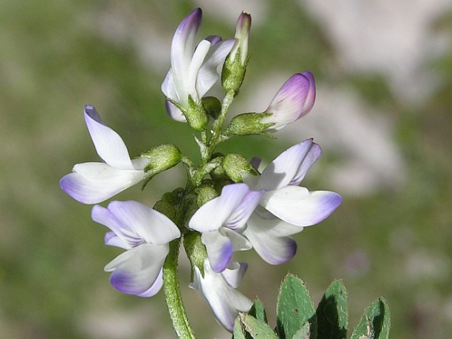
Ecological introduction
Around 1,700 species of flora can be found in the territory of the Arkhangai province.
More than 20 species of trees and shrubs are found in Arkhangai.
Abies Sibirica
Astragalus Alpinus

Slide 6
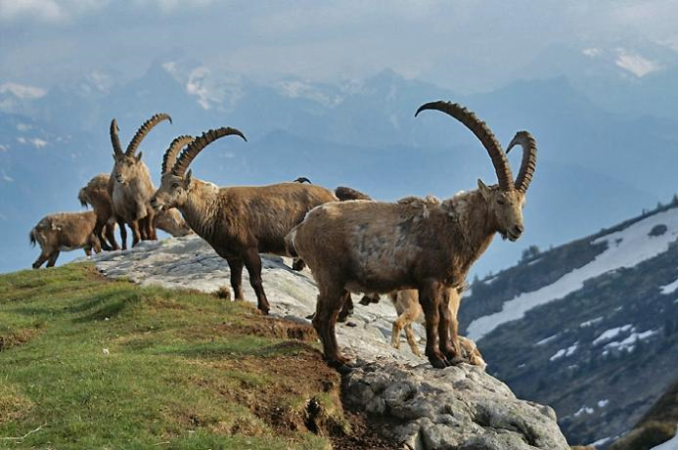
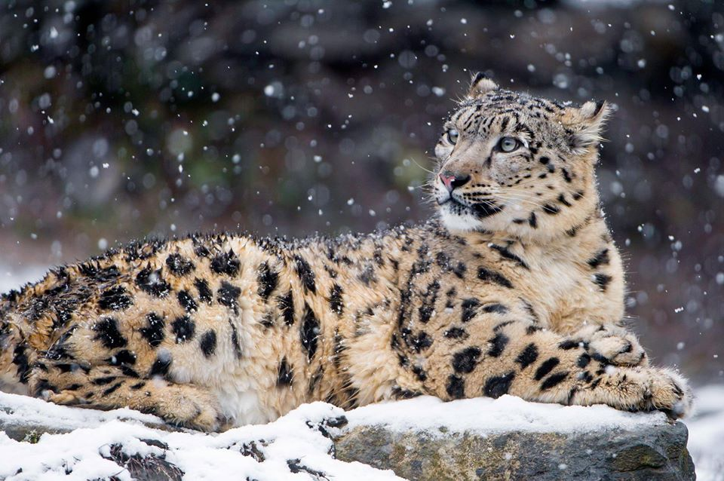
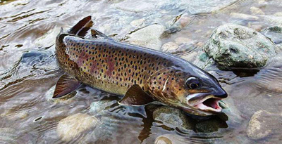
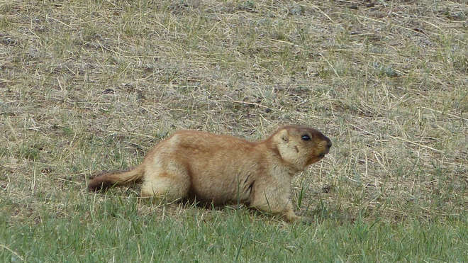
Fauna in Arkhangai
Capra Sibirica
Uncia Uncia
Gypaetus Barbatus
Brachymystax Lenok
Marmota Sibirica

Slide 7
Basic environmental/ecological issue of the area

Slide 8
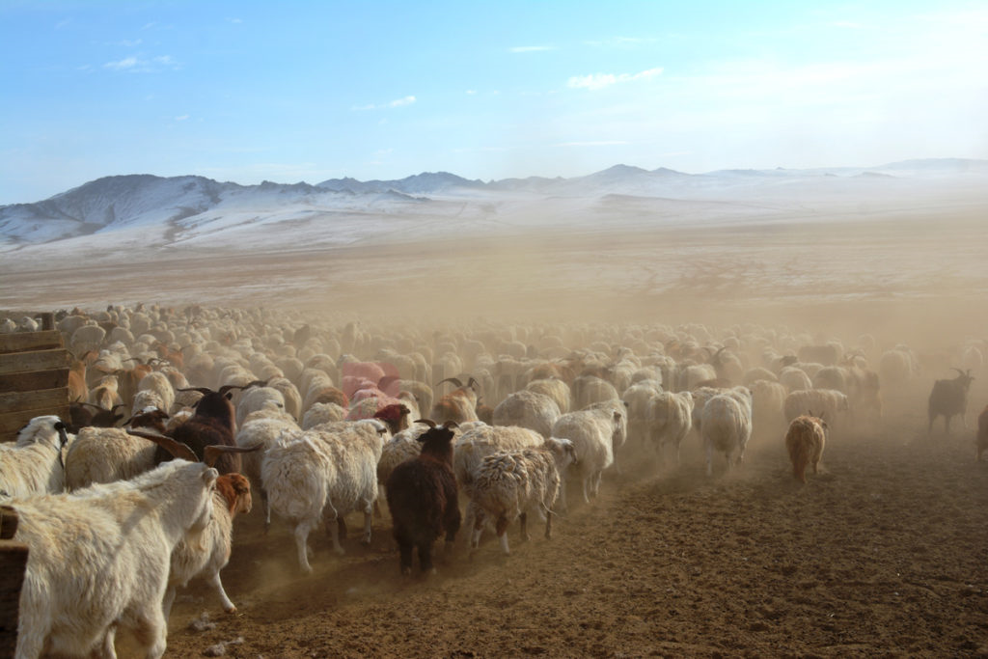
Overgrazing

Slide 9
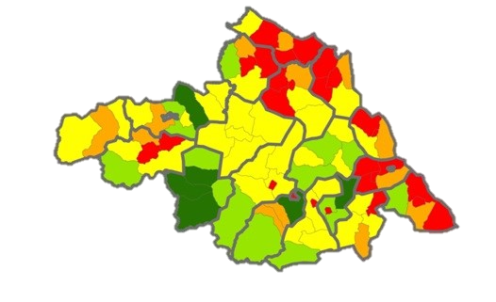
Overgrazing map in Arkhangai province
In 2015
In 2019
Legend
Pasture capacity, %
Border of state
Border of province
Border of soum
Lake
0-50 pasture resource
50.1-100 enough capacity for pasture
100.1-300 carrying capacity of pasture has exceeded by 1-3 times
300.1-500 carrying capacity of pasture has exceeded by 3-5 times
500.1< carrying capacity of pasture has exceeded multiple times

Slide 10
Reasons of overgrazing
Biomass of plants are eaten until they are unable to regenerate the springers. The roots of the plants die and are completely destroyed.
The key reason why herders raise too many animals is main resources of their livelihood are products from live stocks (dairy products, meat, leather, cashmere).

Slide 11
Potential solutions to overgrazing

Slide 12
1) To take taxes from herders for using pasture land in order to improve the land.
TAX

Slide 13
2)To equate live stock numbers with grazing capacity.
If pasture capacity is appropriate
If pasture capacity is exceeded
Live stocks are healthy and high productive
The quality of pastures will increase
Forage reserve in drought and heavy snowfall
Live stocks are small and low productive
In drought and in heavy snows a lot losses will occur

Slide 14
3) To operate pasture rotation in the area
Appropriate pasture management
Use 50% of the harvest for animal feed
Total harvest
100%
Leave 50% in the soil to allow the plants to germinate

Slide 15
Sources
https://eic.mn/flora/index.php?id=8&count=10
https://www.cpr.mn/wp-content/uploads/2017/08/Ухаалаг-МАА-бий-болгох-зөвлөмж.pdf
http://arkhangai.gov.mn/Танилцуулга
http://arkhangai.khural.mn/n/4tyon
https://docplayer.net/42324711-Mongol-orny-belcheeriyn-tolov-baydlyn-undesniy-taylan.html
https://elevation.maplogs.com/poi/arkhangai_mongolia.85598.html

Slide 16
