Slide 1
GARGANO NATIONAL PARK
Mendel University in Brno
Faculty of Forestry
Subject: Landscape Ecology
MARIA ROSA CURCETTI

Slide 2
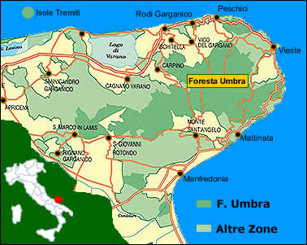
Geography
The Gargano National Park is a national park in the province of Foggia, southern Italy. Aside from the Mount Gargano promontory from which it takes its name, it includes also the Tremiti Islands archipelago and the Foresta Umbra, a large wood protected area established in 1977.
-The territory (118,144 ha) is located entirely in the Province of Foggia.
.The Gargano National Park Authority is based in Monte Sant'Angelo.

Slide 3
ECOLOGICAL INTRODUCTION OF THE AREA

Slide 4
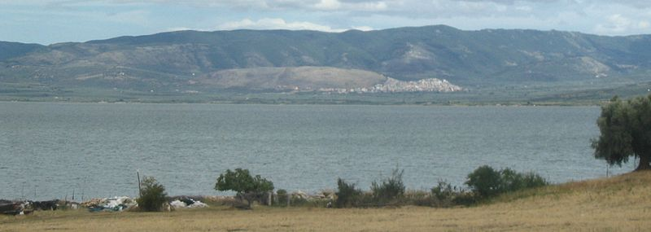
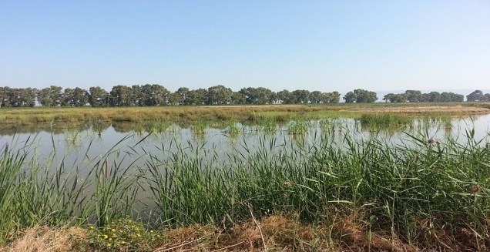
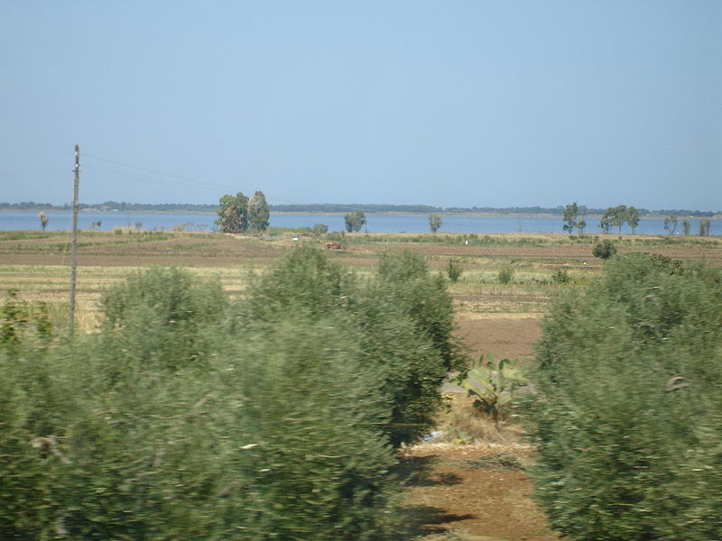
Hydrology
The river environment is completely absent on the Gargano promontory and there is no real surface hydrographic network. An exception is a small area to the north, where the few streams of limited length and capacity are concentrated, mostly inlets of the lagoons of Lesina and Varano, two brackish pools of water with a total surface area of ​​about 11,000 ha.
Varano Lake
Lake Salso
Lesina Lake

Slide 5
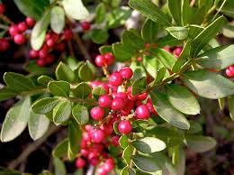
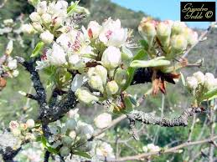
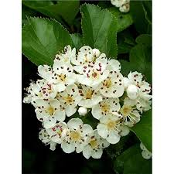
Flora
The flora is very varied and particular: there are about 2,200 botanical species (about 35% of the national flora). Thanks to the particular climatic conditions and the northern winds that are loaded with humidity, about 1300 mm fall on the Gargano promontory. of water in the form of rain. This provides the development of a particular microclimate in which some plant essences manage to live in conditions not found in other parts of Italy and the world
Pistacia lentiscus
Pirus pyraster
Crataegus monogyna

Slide 6
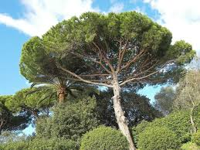
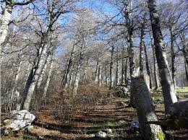
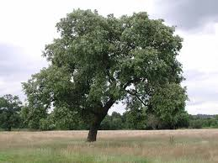
Phenomenon of Macrosomatism
The phenomenon of macrosomatism, that is, an abnormal growth of plant species
Pinus halepensis
Fagus
Quercus ilex

Slide 7
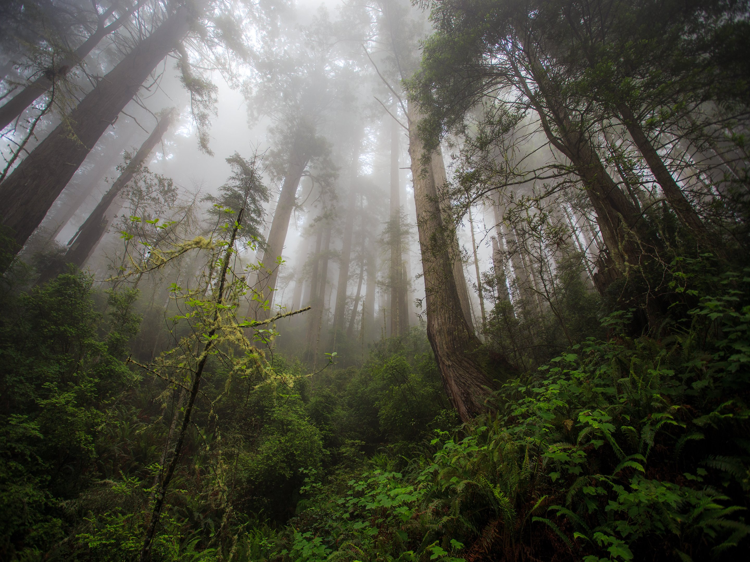
FOREST RETAINS WATER

Slide 8
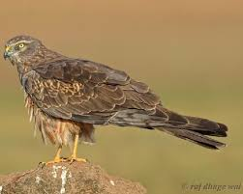
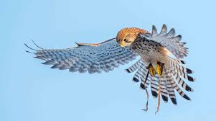
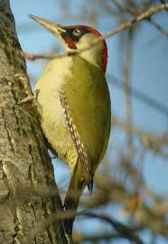
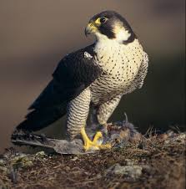
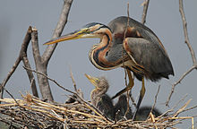
FAUNA
About 170 species of birds nest in the Gargano
Falco tinnunculus Linnaeus
Circus pygargus
Picus viridis
Falco peregrinus
Ardea purpurea

Slide 9
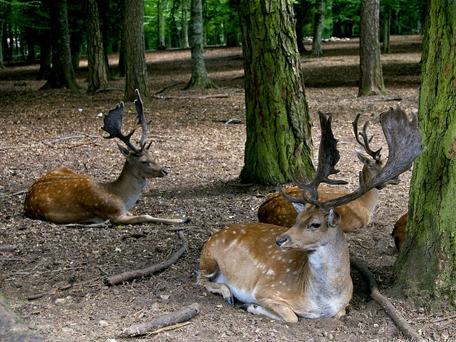
PRESENCE OF BIODIVERSITY

Slide 10
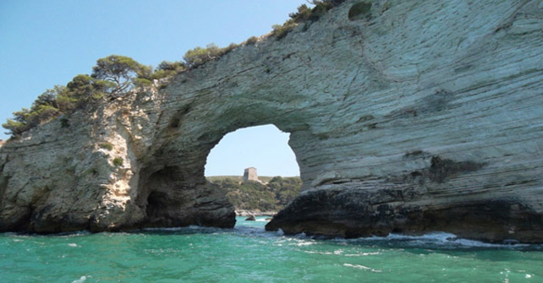
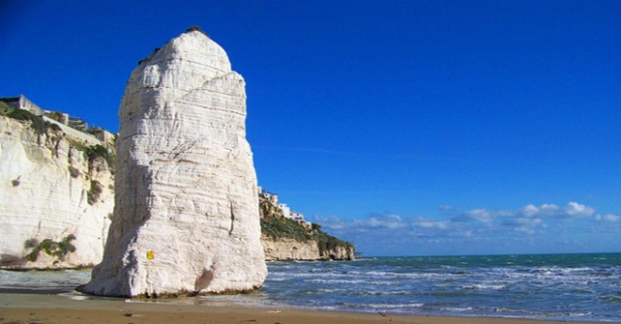
Tourism and itineraries
In Gargano peninsula we can find different types of tourism:
Trips in sea caves;
Visiting Bays and beaches; ( Vignanotica Bay, Pugnochiuso and Vieste)
Tremiti Islands;
Religious tourism ( San Giovanni rotondo)
Enogastronomic Tourism.

Slide 11
Problems
The major problems that affected this area are four:
Dry summers that could bring to fire;
Abusive buildings;
Pollution due to the accumulation of the waste;
Oil drilling in the Adriatic sea.

Slide 12
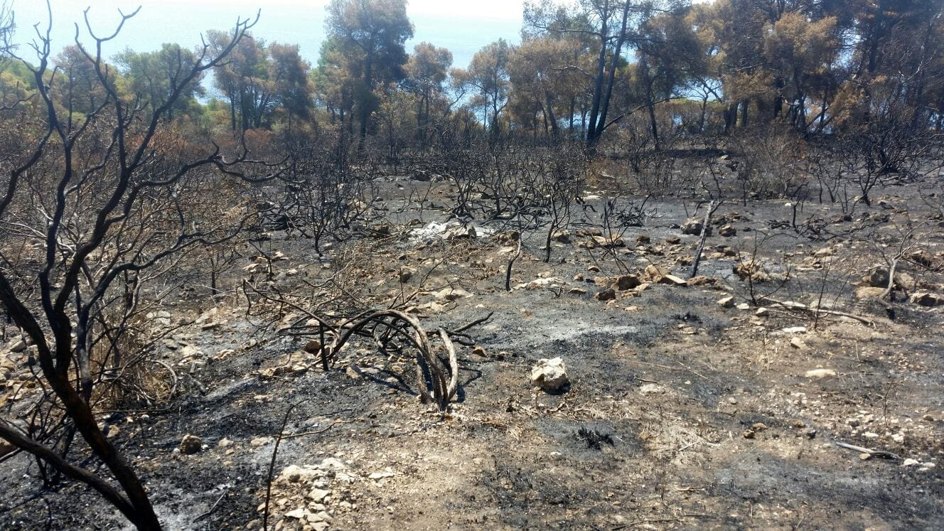
FIRES

Slide 13
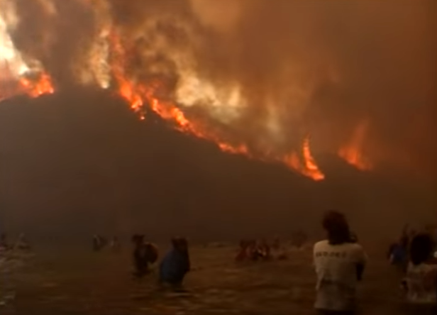
Peschici, 2007

Slide 14
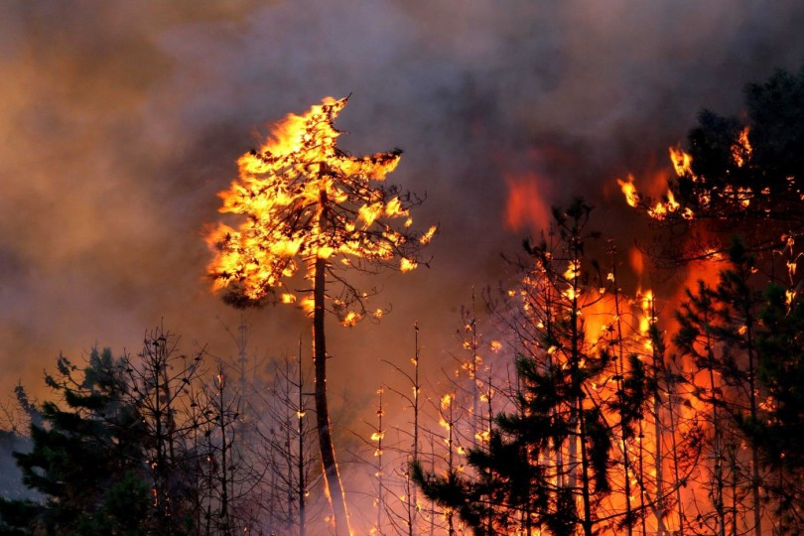
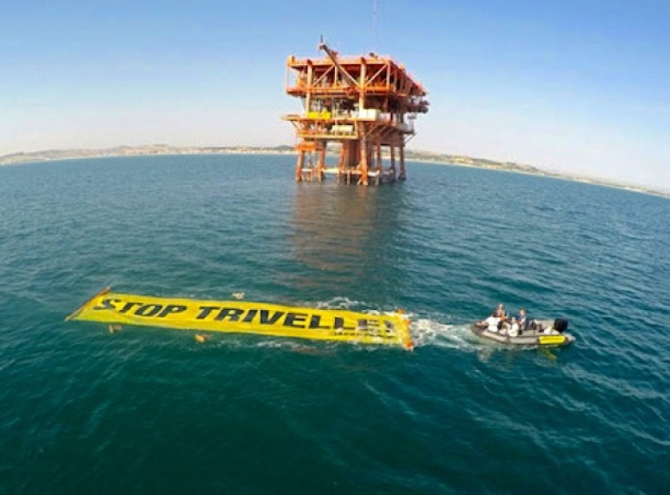
POTENTIAL SOLUTIONS
More controls from police, firefighter and forestal guards;
Fight corruption and abusivism by the government;
Find a sustainable way to the estraction of natural resources
Recreational tours
School tourism
Biodiversity promotion

