Slide 1
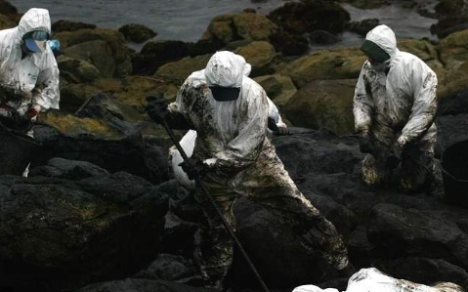
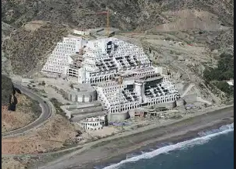
Landscape ecology
Cristina Carro
Embiromental and ecologycal issues in Spain

Slide 2
Why Spain?
It is my country, therefore where ecological disasters affect me the most.
There really have been, and there are still ecological disasters that make people think about where society wants to go.

Slide 3
Natural disaster.
sudden changes in the environment causing loss as material as humans.
In this presentation I'm going to talk about disasters, both, environmental impact and infrastructures that cause problems.

Slide 4
LE
Landscape ecology studies the variations that landscapes undergo at spatial level, usually on a large scale, and also over time.
The study of landscapes focuses on the organization and reordering of the territory, understanding it as an ecosystem or sum of ecosystems that suffer variations.
Landscape ecology is a useful tool to give sustainable use to the territory and reduce environmental vulnerability.

Slide 5
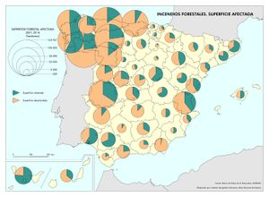
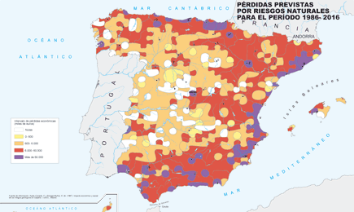
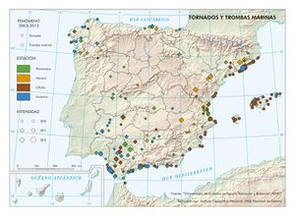
About spain
Most of the environmental disasters in spain happen on the mediterranean coast.
Photo: natural risk btween 1986-2016
Photo: Fires
Photo: marine storms and tornadoes

Slide 6
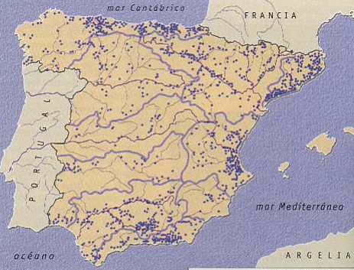
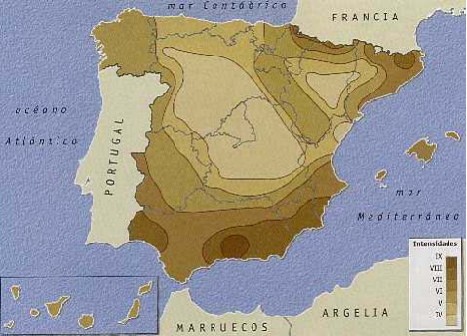
Photo: seismicity
Photo:floods

Slide 7
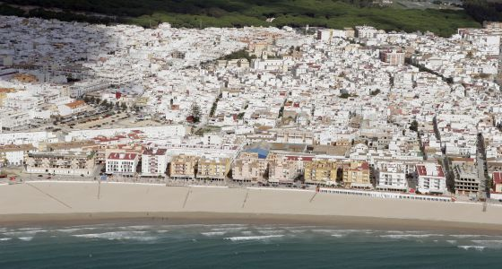
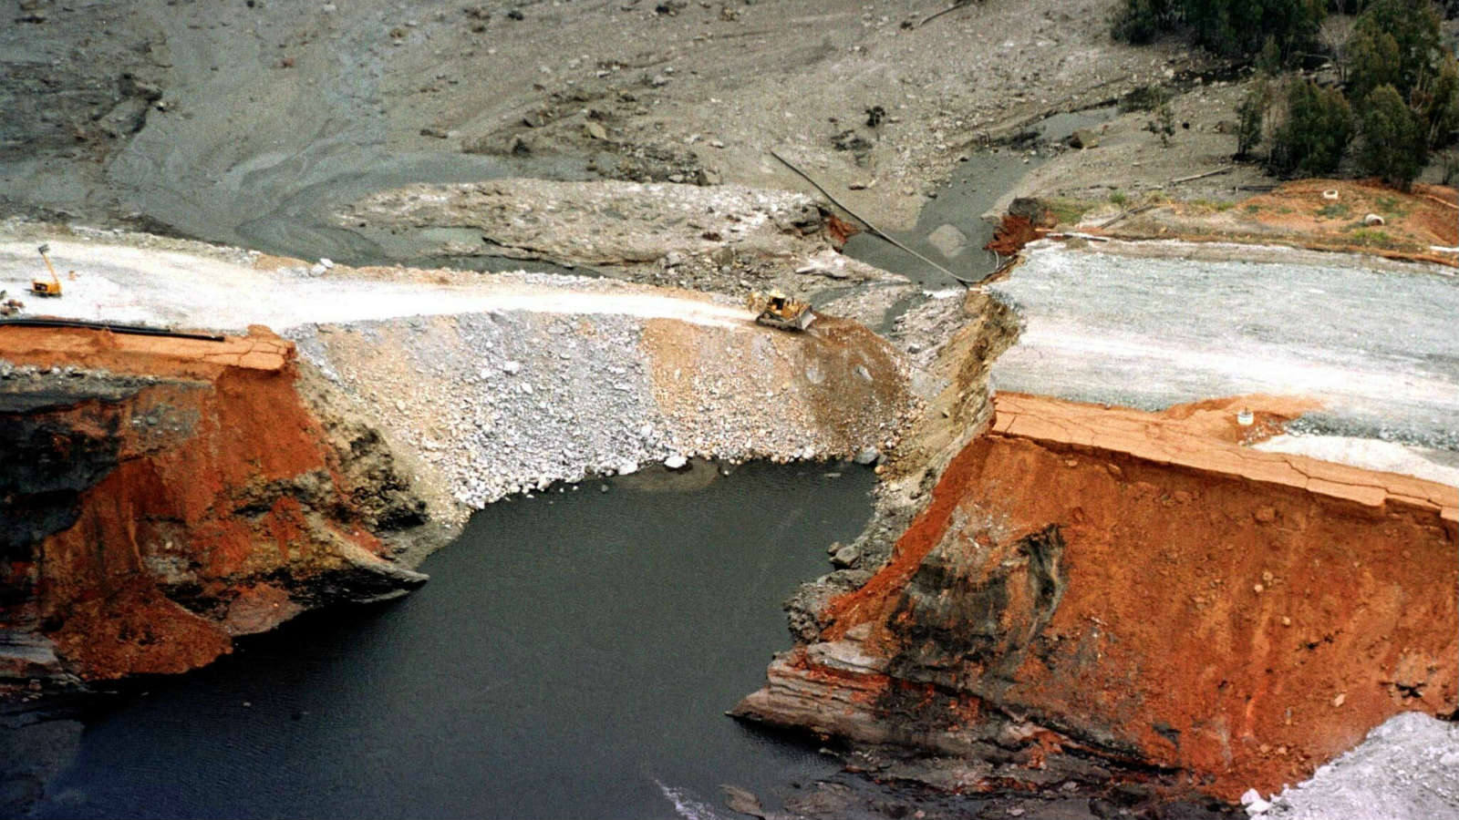
Photo:houses on the coast
Photo:landslide

Slide 8
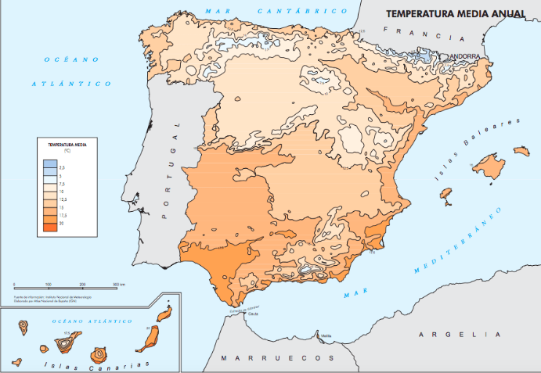
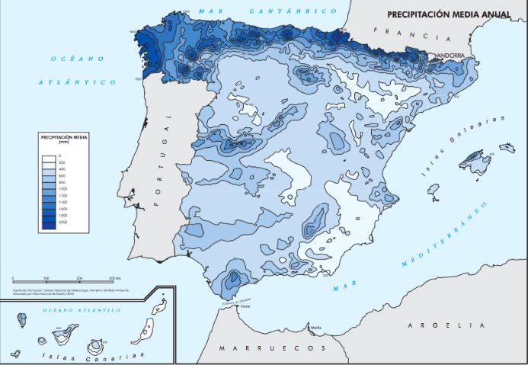
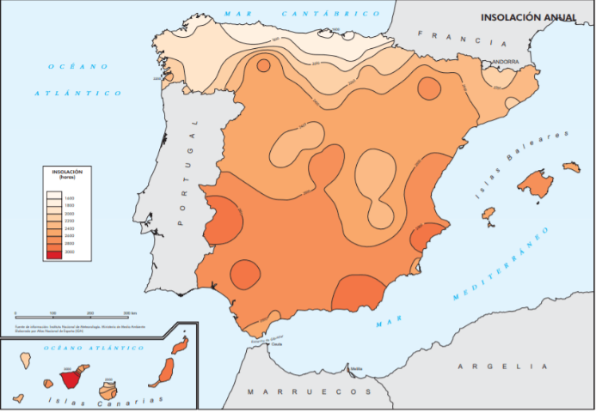
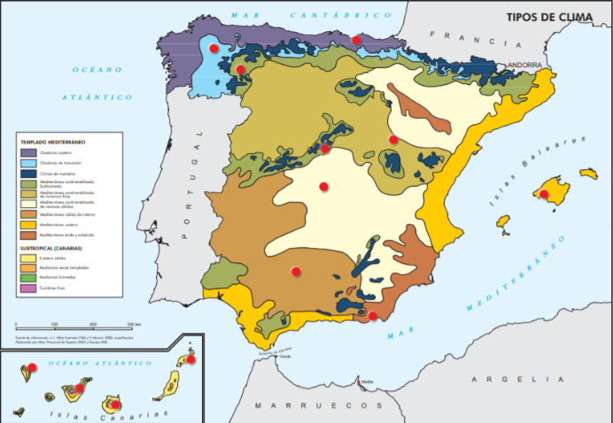
Climate
Temperature
Precipitation
Insolation
Climate

Slide 9
Spain's worst environmental disasters

Slide 10
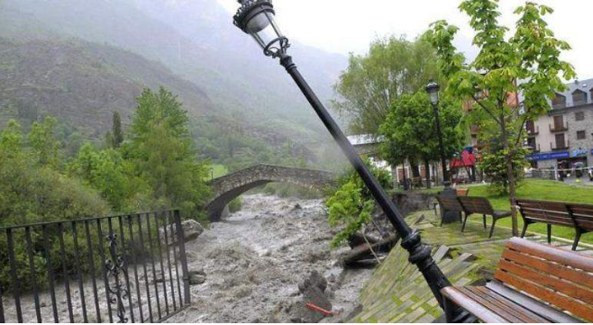
Floods
Flood in a camping

Slide 11
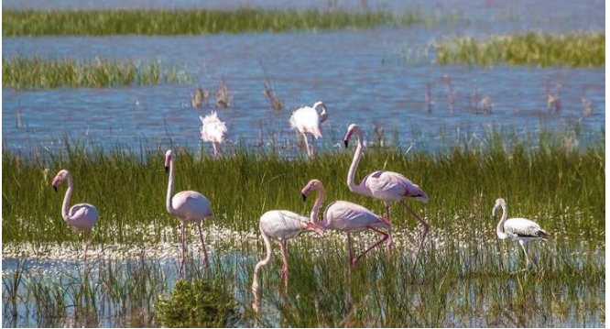
Toxic spills
toxic discharges in the natural area of ​​doñana

Slide 12
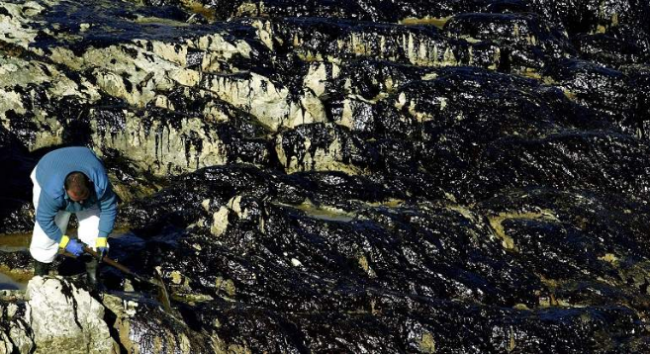
Oil spill
oil spill in the atlantic ocean

Slide 13
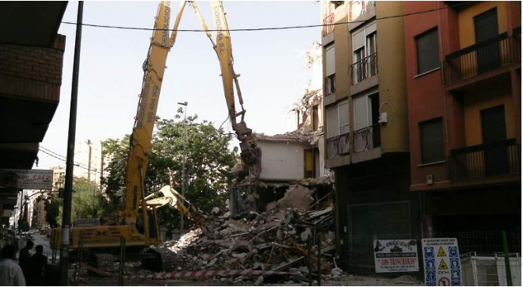
Earthquake
earthquake in the south of spain (caused the death of people

Slide 14
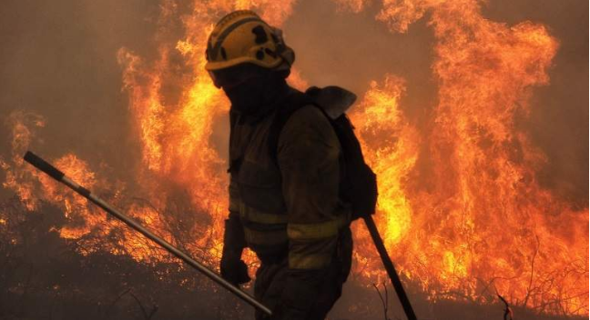
Fires

Slide 15
Fires
Spain is one of the countries in Europe with the highest fire rate.
This is due to:
the poor care of the forests.
the low social awareness of the loss of biodiversity when a fire happens.
the poor management of the territory.

Slide 16
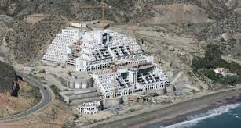
Visual disasters
Those are the so-called ghost hotel and ghost highway.
Infrastructures made without any need to alter and divide the landscape, in addition to bullying the law

Slide 17
What can we do?
We cannot avoid natural disasters, only human ones, but we can prevent them or make them less harmful.
We should not build houses or other types of infrastructure on land where water previously dominated or on land at risk of collapse.
The construction of houses on the coast should be more controlled.

