Slide 1
Nature Reserve Bosco Selva Alberobello
Landscape ecology
Student: Ilaria Vincenca Calò
Academic year: 2019/2020

Slide 2
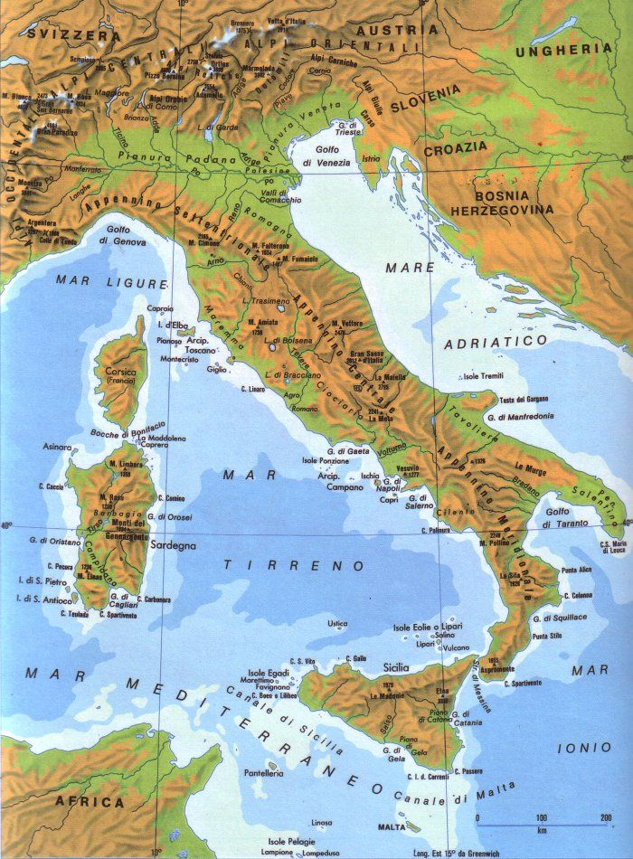
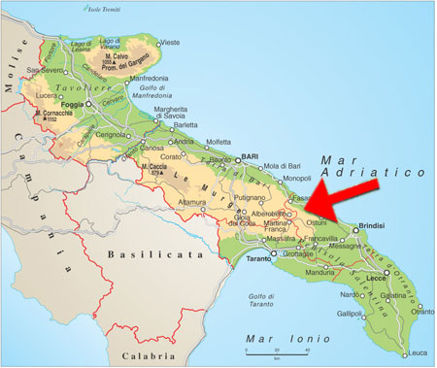
WHERE IT IS?

Slide 3
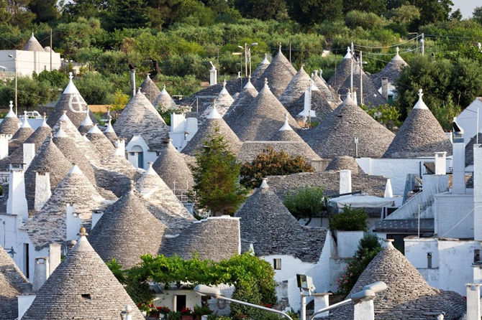
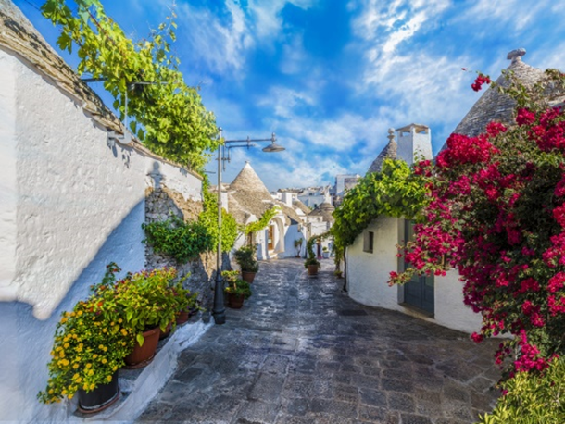
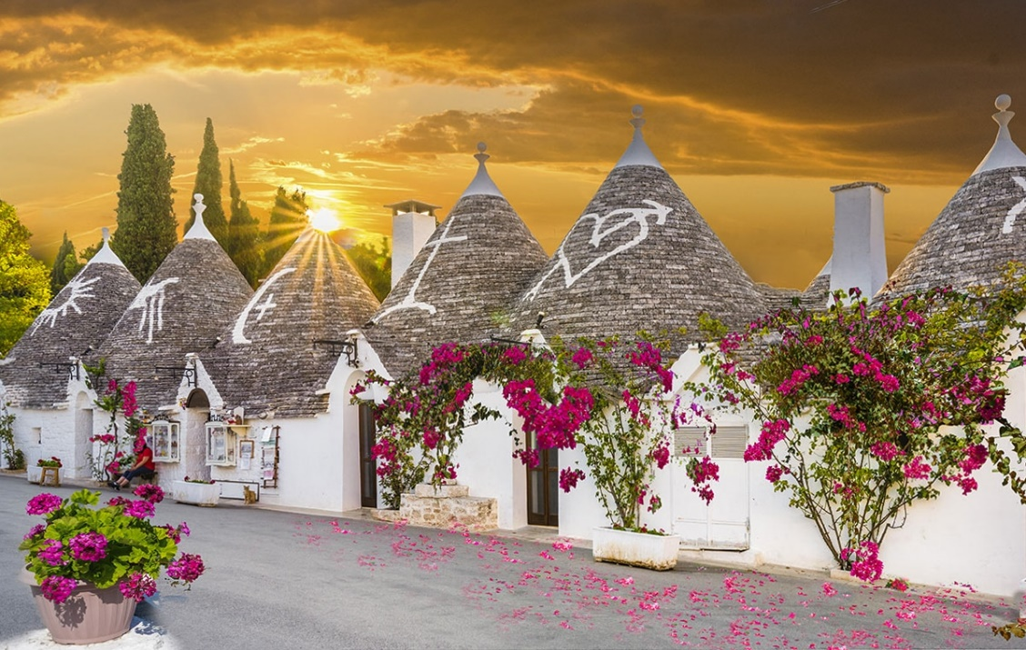

Slide 4
The Bosco Selva is considered the 'green lung' of Alberobello and is only 800 meters from the village, along the Trulli del Bosco. Its 45-hectare area liberates more than 920 tonnes of pure oxygen in one year, revealing itself in the territory a unique natural oasis for its biodiversity and, according to recent studies, a container of pure air in the region. The reserve is also a real park with countless walking or cycling trails, children’s play areas and open picnic.

Slide 5
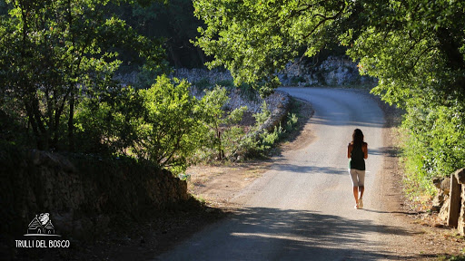
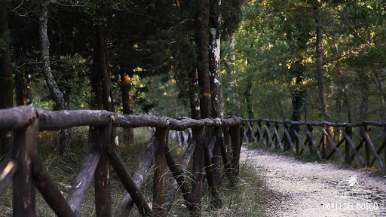
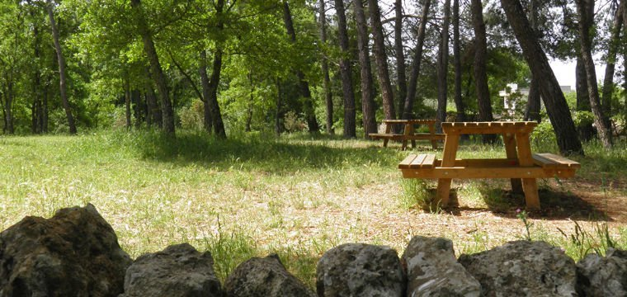
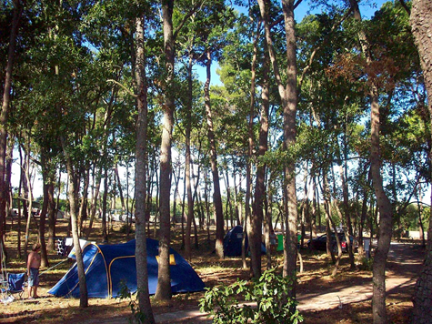

Slide 6
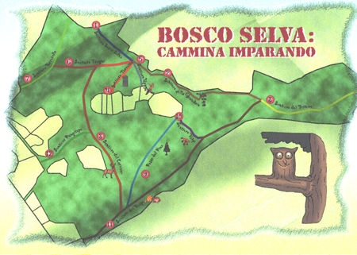
WALK AND LEARN

Slide 7
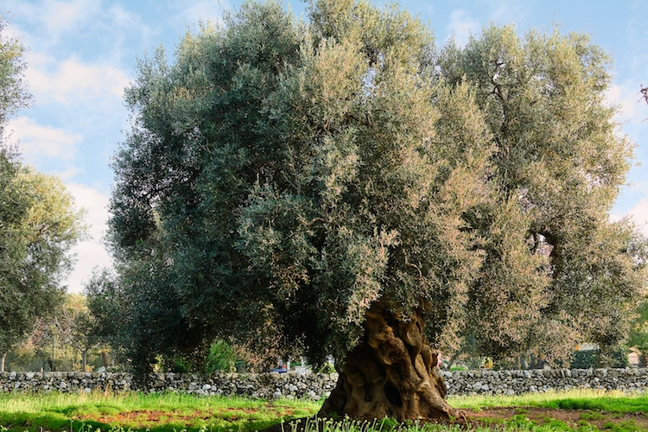
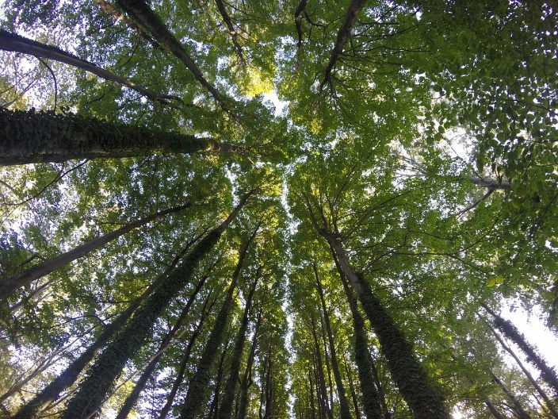
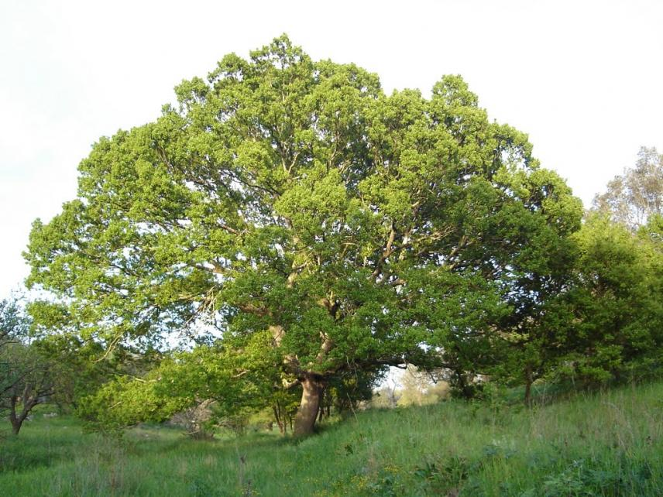
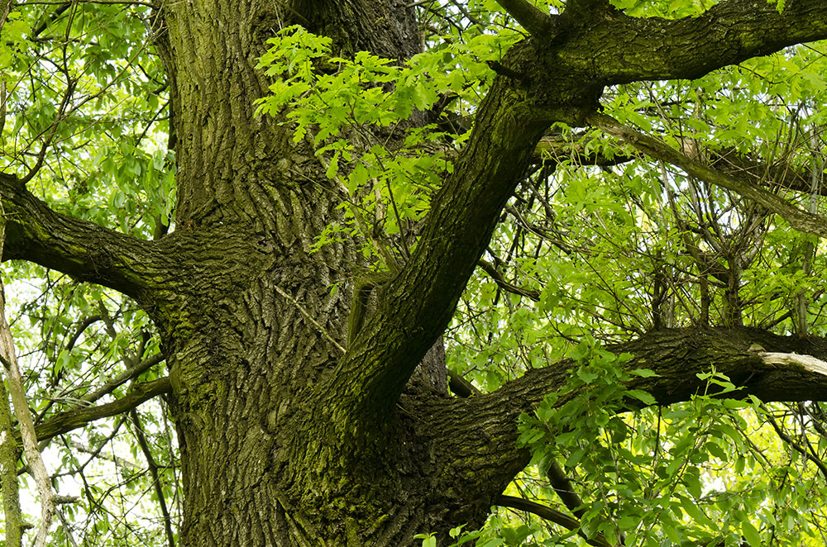

Slide 8
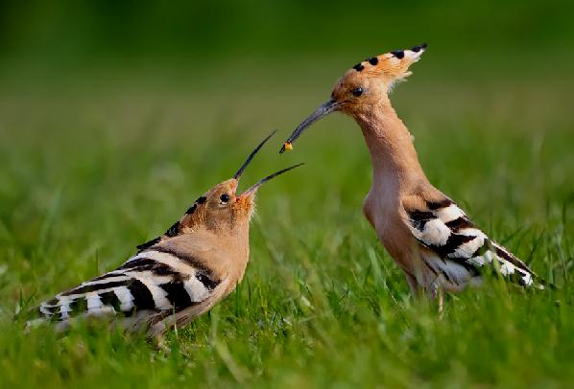
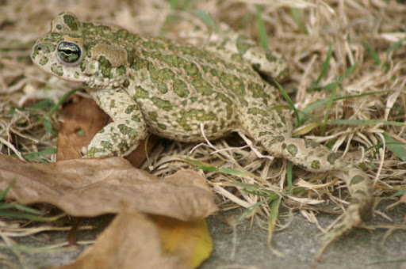
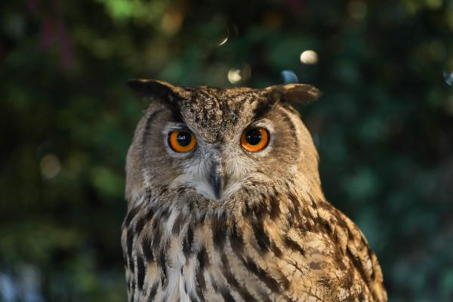
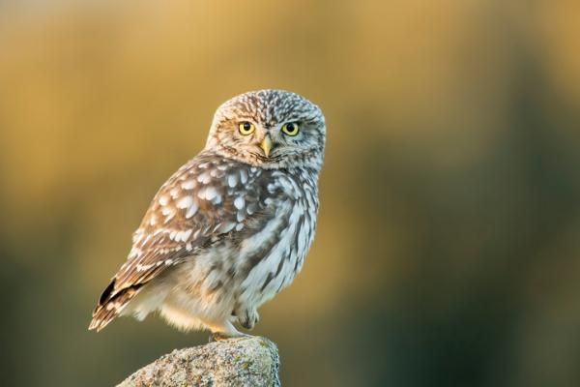
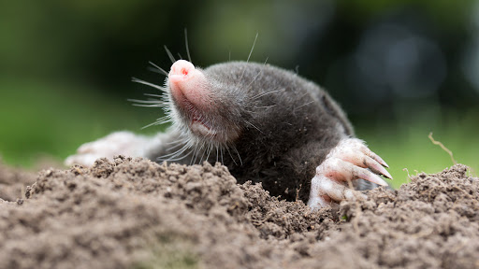

Slide 9
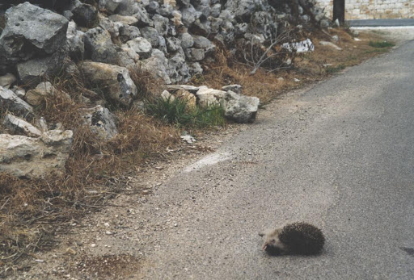
Biopreservation
This park is an opportunity to preserve many species of animals and vegetables. It's possible to observe the great organization that belongs to this park which makes the presence of the humans and environment perfectly balanced. However, the protection of certain defenceless animals at risk of dying as a result of the proximity of the reserve to areas in which cars circulate should be encouraged

Slide 10
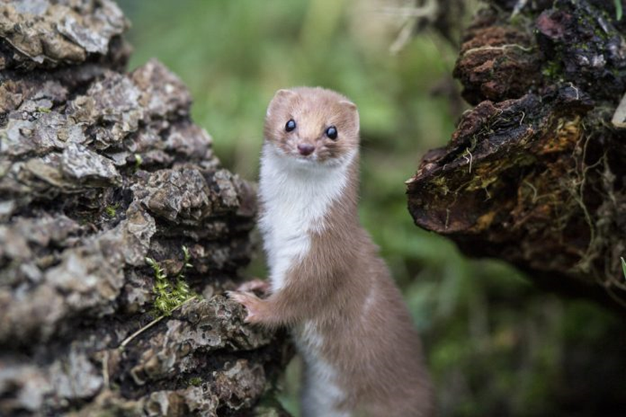
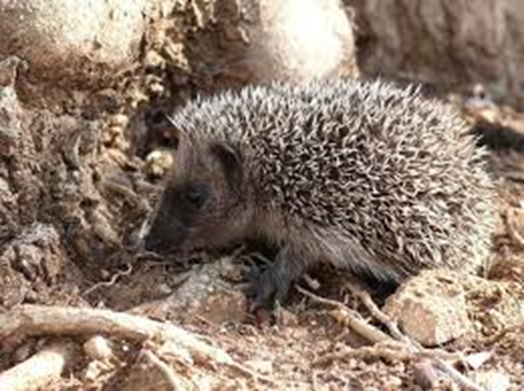
POTENTIAL SOLUTION
Increase security;
Increase animal control and protection;
Avoid environment pollution caused by human;
School tourism.

Slide 11
THANKS FOR YOUR ATTENTION

