Slide 1
Environmental Issue in Zaamar Tuv province, Mongolia
LANDSCAPE ECOLOGY W-2019/2020
Bayartulga Altankhuyag

Slide 2
CONTENT
1
2
3
Introduction
Ecological condition
Landscape
3
2
General introduction of
the topic and rationale
4
Ecological introduction, climate of the area
Characteristics of landscape of the area
4
5
1
5
Environmental issue
Solutions
What is the most important environmental issue in the area
What actions could be solutions to this environmental issue

Slide 3
INTRODUCTION
Rationale
Although the mining industry accounts for a large part of industrial part in Mongolia, it impacts on the environment more than its benefit. Due to the large gold resources in Zaamar soum of Tuv province, there is a lot of illegal mining.
In other words, no one is responsible for the environmental loss. This presentation will demonstrate some experiences I possessed while working there as an environmental specialist and try to explain some solutions for the area.

Slide 4
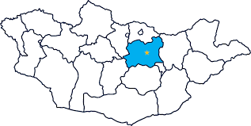
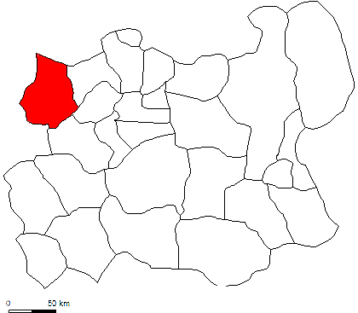
ZAAMAR SOUM
Map, Geographical location, Climate
Zaamar soum is a continuation of the Khentii mountain range.
The wide mountain valleys in the northern part of the country have brown soils which suitable for agriculture, and the southern part is a steppe with hills.
The climate is sharply continental.
Dry summer with an average temperature of 22°C in July
Severe winter with an average temperature of (−28 °C) in Jan
An average of 200-300 mm of precipitation falls annually.
Total area: 2900 km sq.
Altitude: 1500-1780m

Slide 5
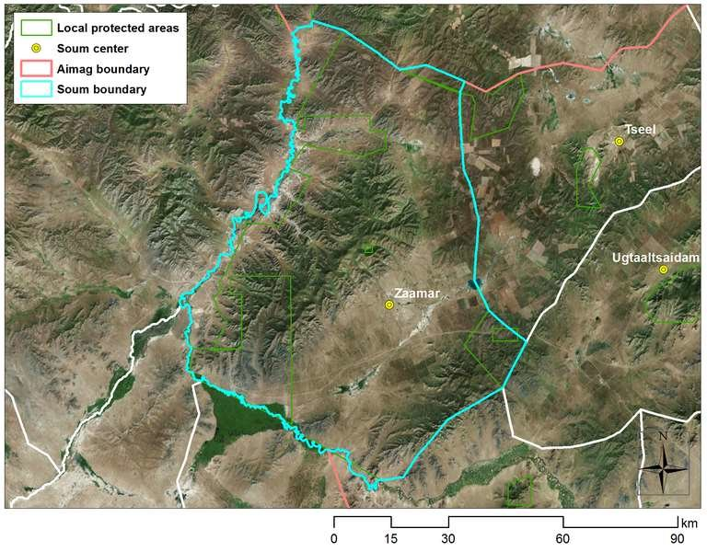
LANDSCAPE CHARACTERISTICS
Map of Zaamar soum
Landscape
Zaamar belongs to the Khentii mountainous region, which has a well-developed river network, abundant permafrost, high moisture content compared to other large regions, and a sharp continental climate.
Landscape substructure: Tertiary
Socio-economic phenomena, especially mining, has impacted strongly in the area.

Slide 6
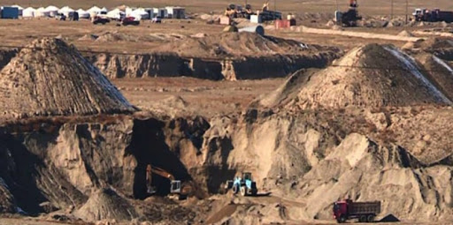
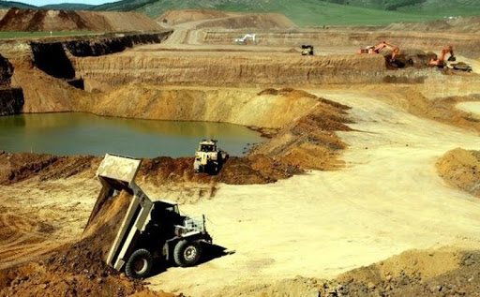
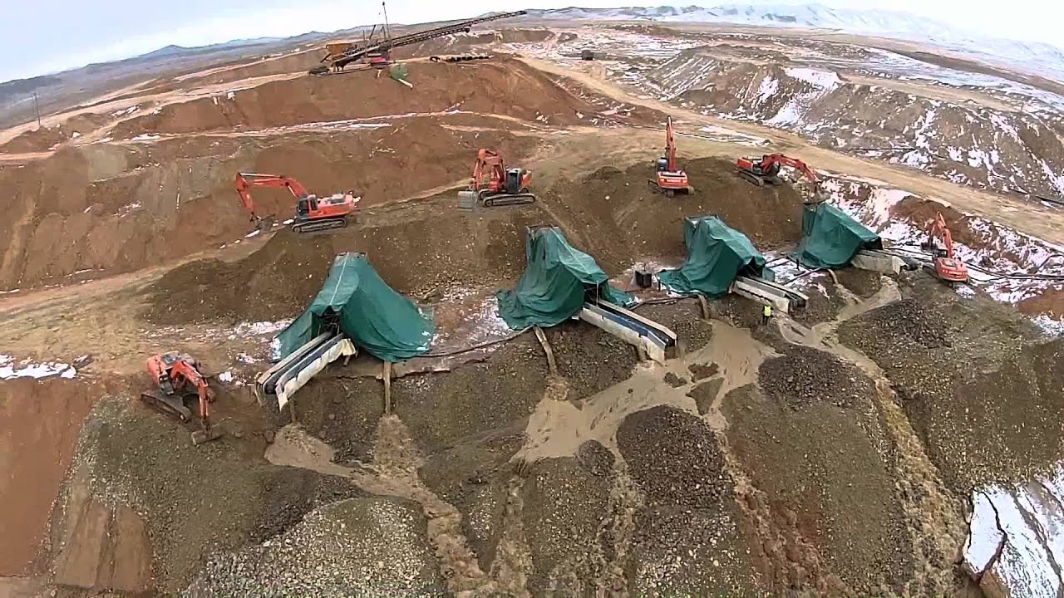
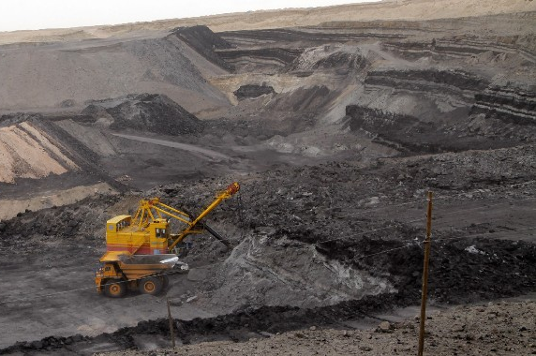
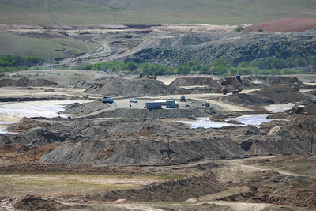
ENVIRONMENTAL ISSUE
Irresponsible mining

Slide 7
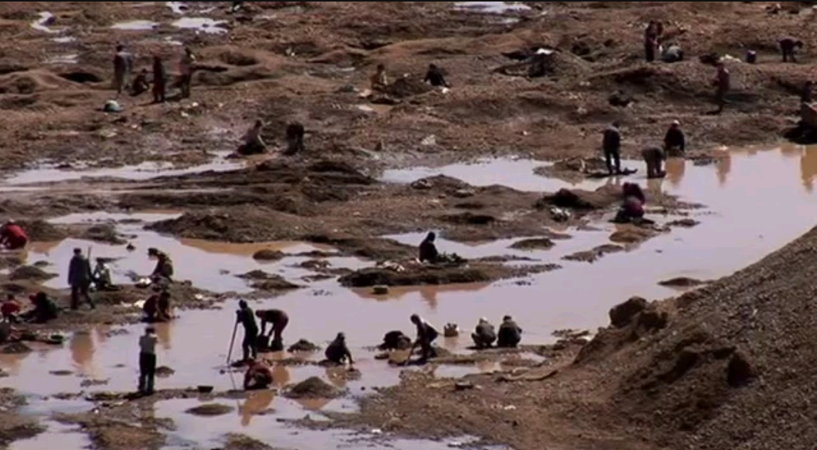
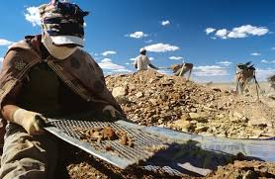
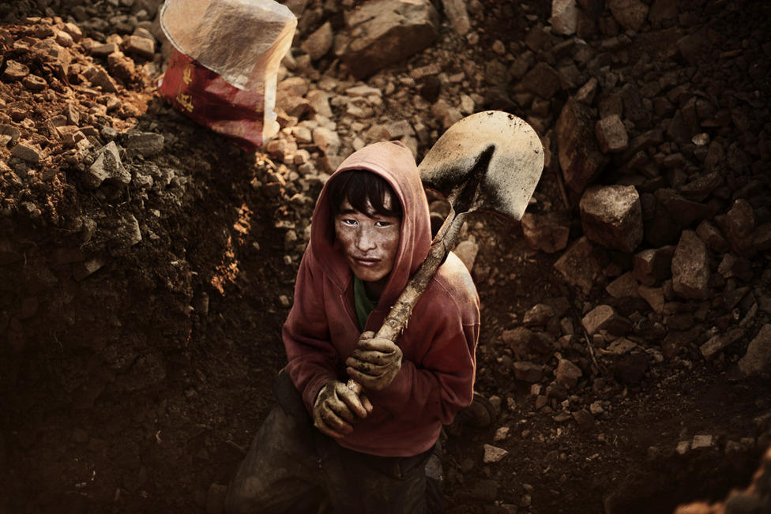
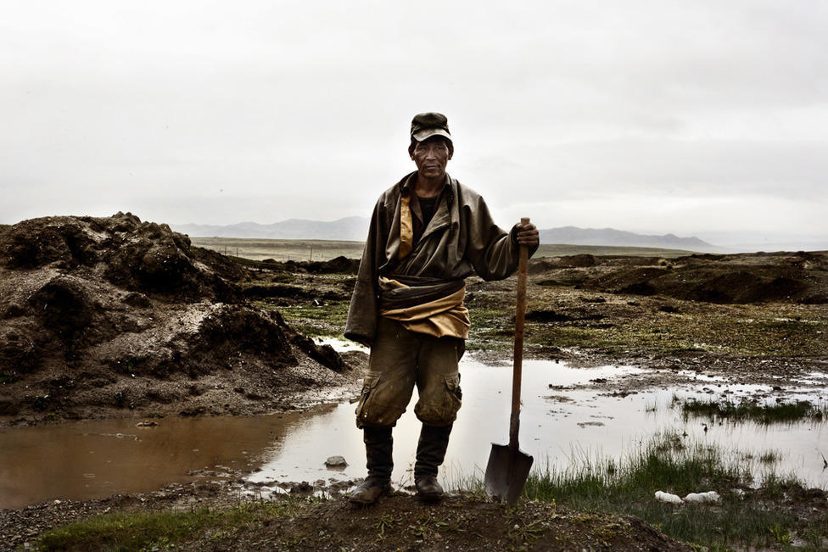
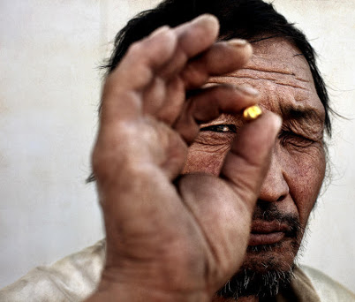
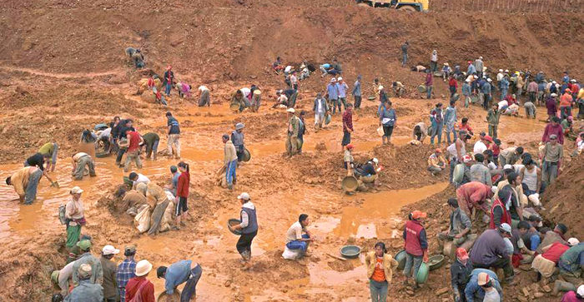
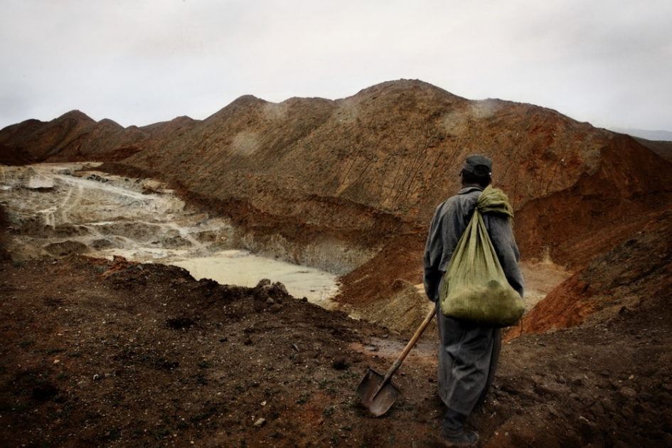
ENVIRONMENTAL ISSUE
Illegal mining (Individuals called as “Ninja”)

Slide 8
POSSIBLE SOLUTIONS
What actions can be solutions to this environmental issue,
and how to deal with it?

Slide 9
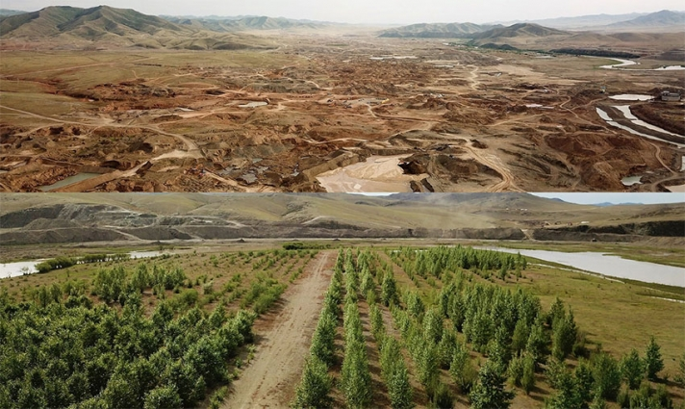
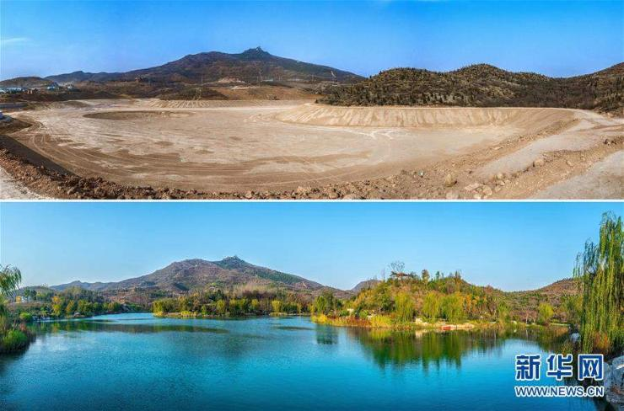
Strengthening and amending the law on mining activities
State should check regularly and let companies to do restoration up to standard

Slide 10
To increase public awareness of mining impact on the environment
To provide workplaces for ninjas “illegal individual miners”
Mining is not only about earning money or gold, but also it is about the environment
The economy of Mongolia is traditionally based on agriculture and livestock. Thus, support “ninjas” to work in the field of agriculture.

Slide 11
To seek financial aid for restoration work in the destructed area from possible funds
To increase the number of environmental specialists
State needs to consider importance of environment and promote professions related to environment for young pupils
Locals, administration sectors could write project proposals of restoration area for international funds

Slide 12
Wear facemasks and stay healthy!
THANK YOU FOR THE ATTENTION
Bayartulga Altankhuyag
yaltankh@mendelu.cz

