Slide 1
Gobi desert in Mongolia (Umnugovi province)
Subject:Landscape Ecology
Student:Khongorzul Odsuren

Slide 2
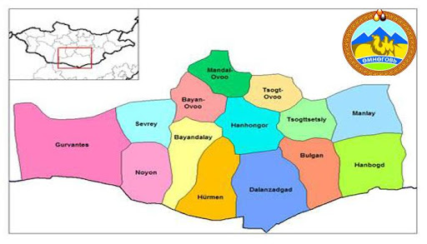
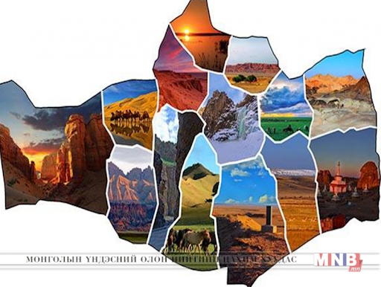
Umnugovi province
Location: Umnugovi province is located in the southernmost part of Mongolia and borders China to the south, Bayankhongor to the west, Uvurkhangai to the northwest, Dundgovi to the north, and Dornogovi to the east.
The province center, Dalanzadgad, is 560 km from Ulaanbaatar. It has the largest area of ​​165.0 thousand square kilometers in Mongolia and has a sparse population of 3.4 square kilometers per person and 1 household per 13.2 square kilometers.
Population:Umnugovi province has a population of 69,902 at the end of 2019, an increase of 2.6 percent or 1,788 people from the end of 2018 population data. 51.1 percent of the total population are men and 48.9 percent are women. In terms of working age, 31.8 percent are children aged 0-15, 62.0 percent are 16-59 years old, and 6.2 percent are over 60 years old.

Slide 3
Character of the landscape of the area
Umnugovi is the largest aimag in Mongolia. The territory of the aimag is included in the Gobi desert region and on average d.t.d. Located at an altitude of 1300-1600 m. Here, the continuation of the Altai Mountains, Gurvan Saikhan , Sevrei, Noyon Bogd , Nomgon , Tost , Nemegt , Altana Mountain , Gilbent etc. There are mountains up to 3,000 m high and the Khongor Sands , which are more than 100 km long , and the famous Great Gobi , Galba , Borzon , Zeemeg , Zag and Suuj , which are 100 km wide .
There are many cold springs such as Khadat , Nemegt , Soft , Enger Buleen and Talkhit, and hot springs in Elgen and Salkhit .
Rural soils are rich in valuable minerals such as copper , lead , coal , iron ore , marble , fluorspar , snow and smoky crystals
The climate is extreme continental, with temperatures as low as -20-30 degrees Celsius in winter, 30-38 degrees Celsius in summer, and wind speeds of 5-15 m / s, sometimes 34-45 m / s.

Slide 4
Map of Umnugovi province’s natural belt
Elevation map of Umnugovi province
dry steppe
desert steppe
the desert of the north
some desert
Desert
the real desert

Slide 5
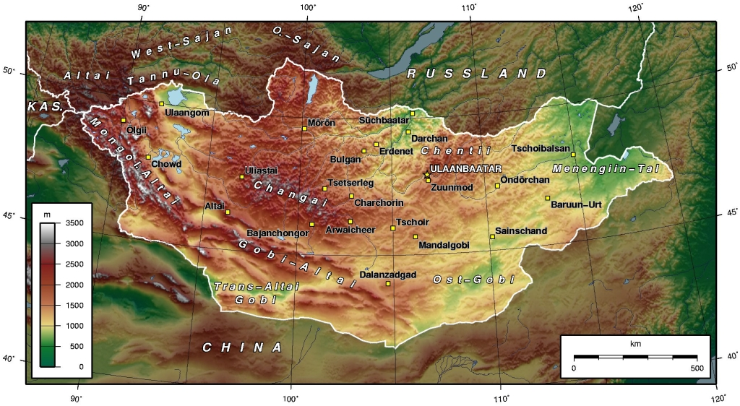

Slide 6
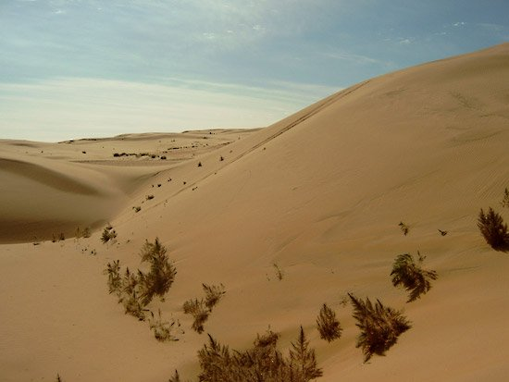
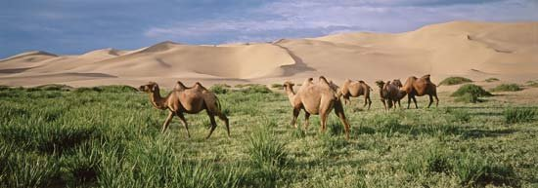
Southern Mongolia
Mongolians consider that there are 33 different Gobi, where sandy desert occupies only 3 percent of the total territory. The area is often imagined as a lifeless desert like in many other parts of the world. Gobi Desert is a land of dinosaurs and it is the home for camel breeders rich with wildlife and vegetation. Dinosaur skeletons and their petrified eggs have been preserved here to the present day. Wild asses, camels, snow leopards, mountain sheep and gazelles flourish here, as do different types of flora.

Slide 7
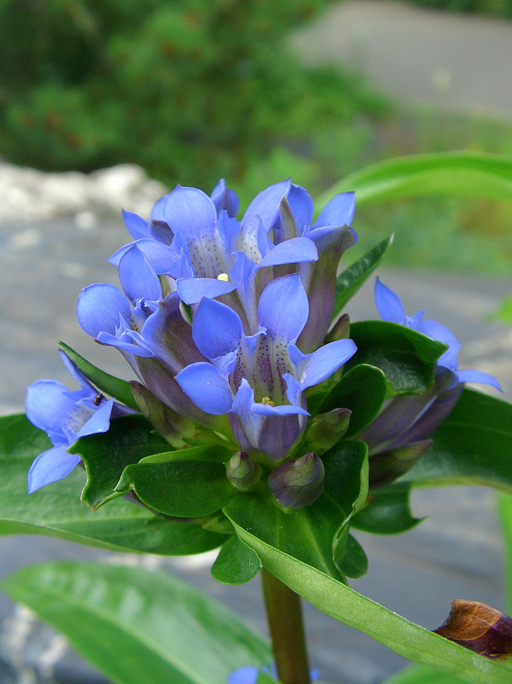
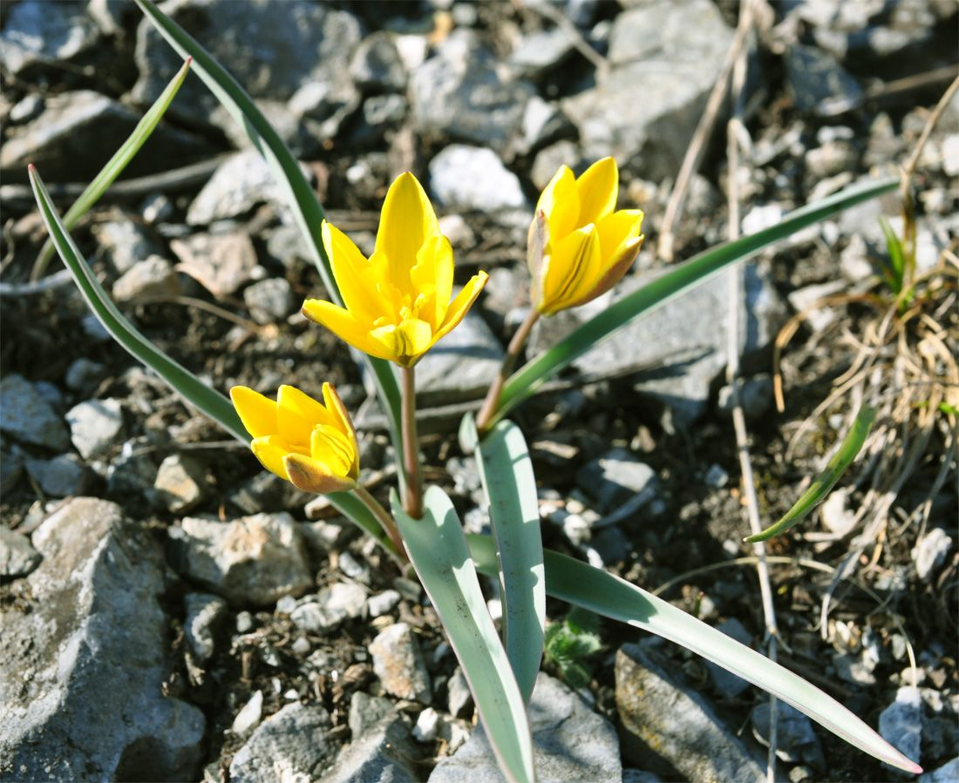
Drought, heat-resistant, good nutrition, a small green leaves with sparse vegetation, including more than 250 types of plants and dominated by astragalus, golden root, gentiana, serjimyadag variety of medicinal plants are abundant.
Flora
Astragauls adsurgens
Gentiana marcophylla
Tulipa uniflora

Slide 8
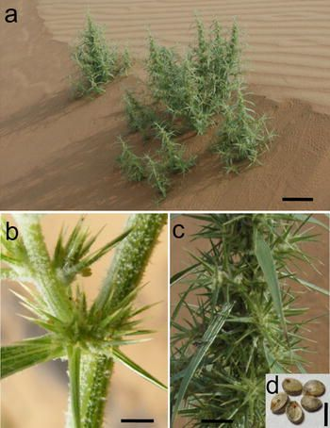
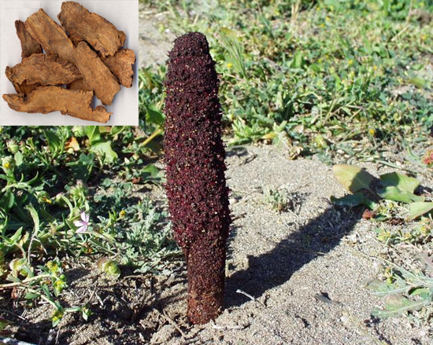
Admission is free, goyo, tsulhir sweet herbs...
Cynomorium songarium Rupr
Nitraria schoberi
Agriophyllum squarrosum

Slide 9
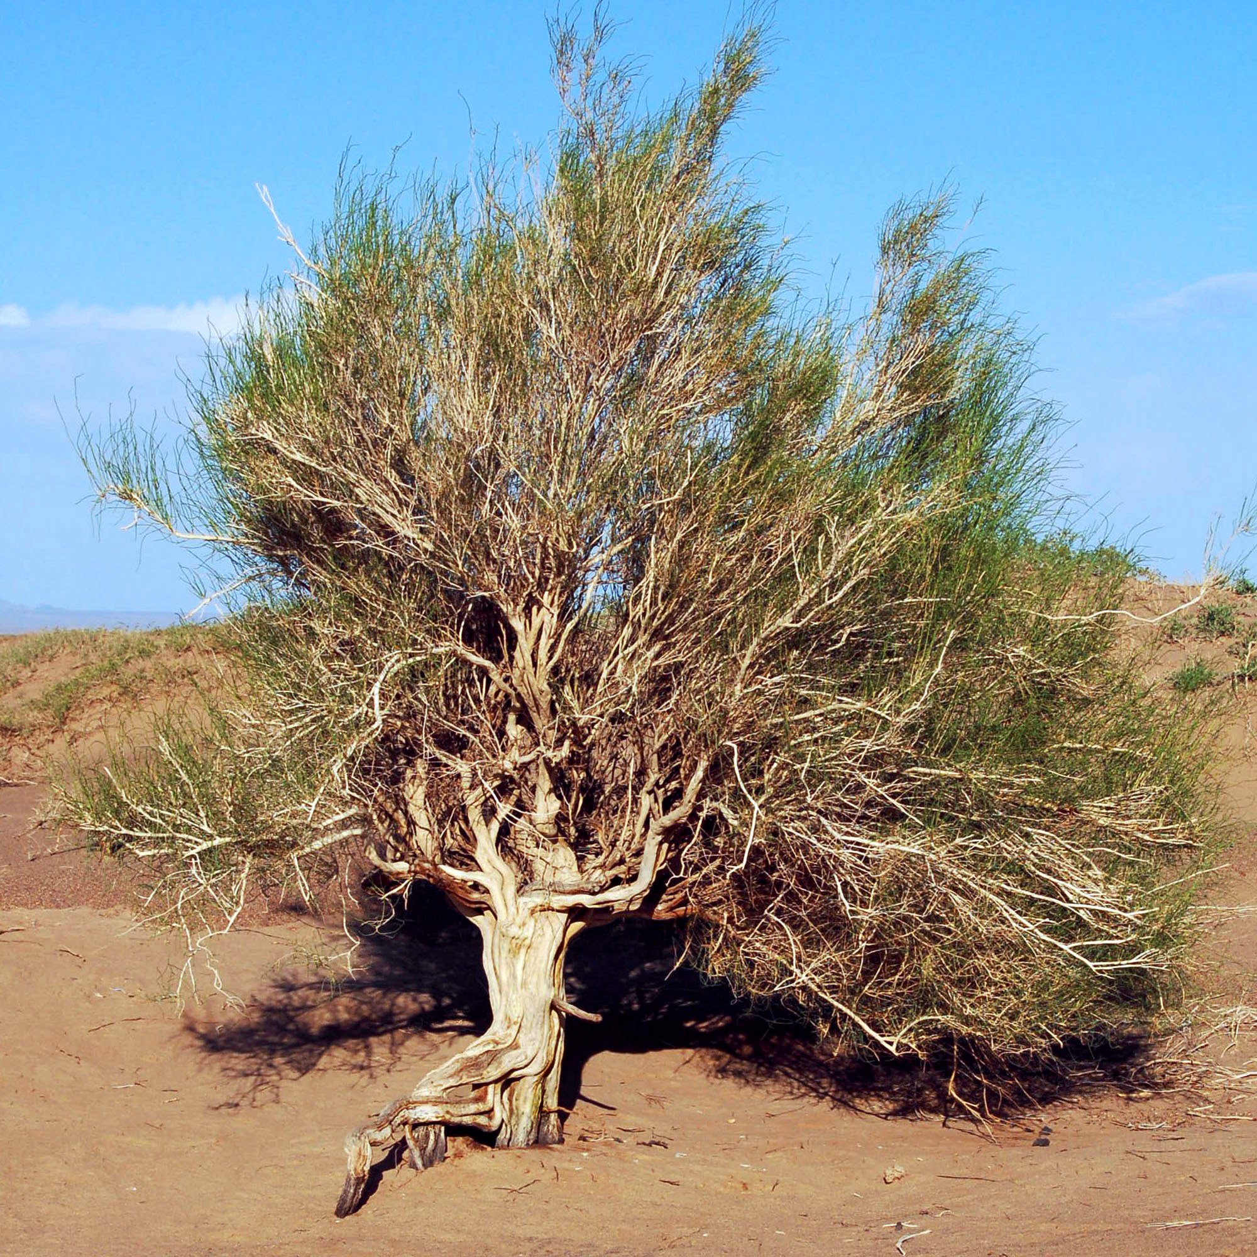
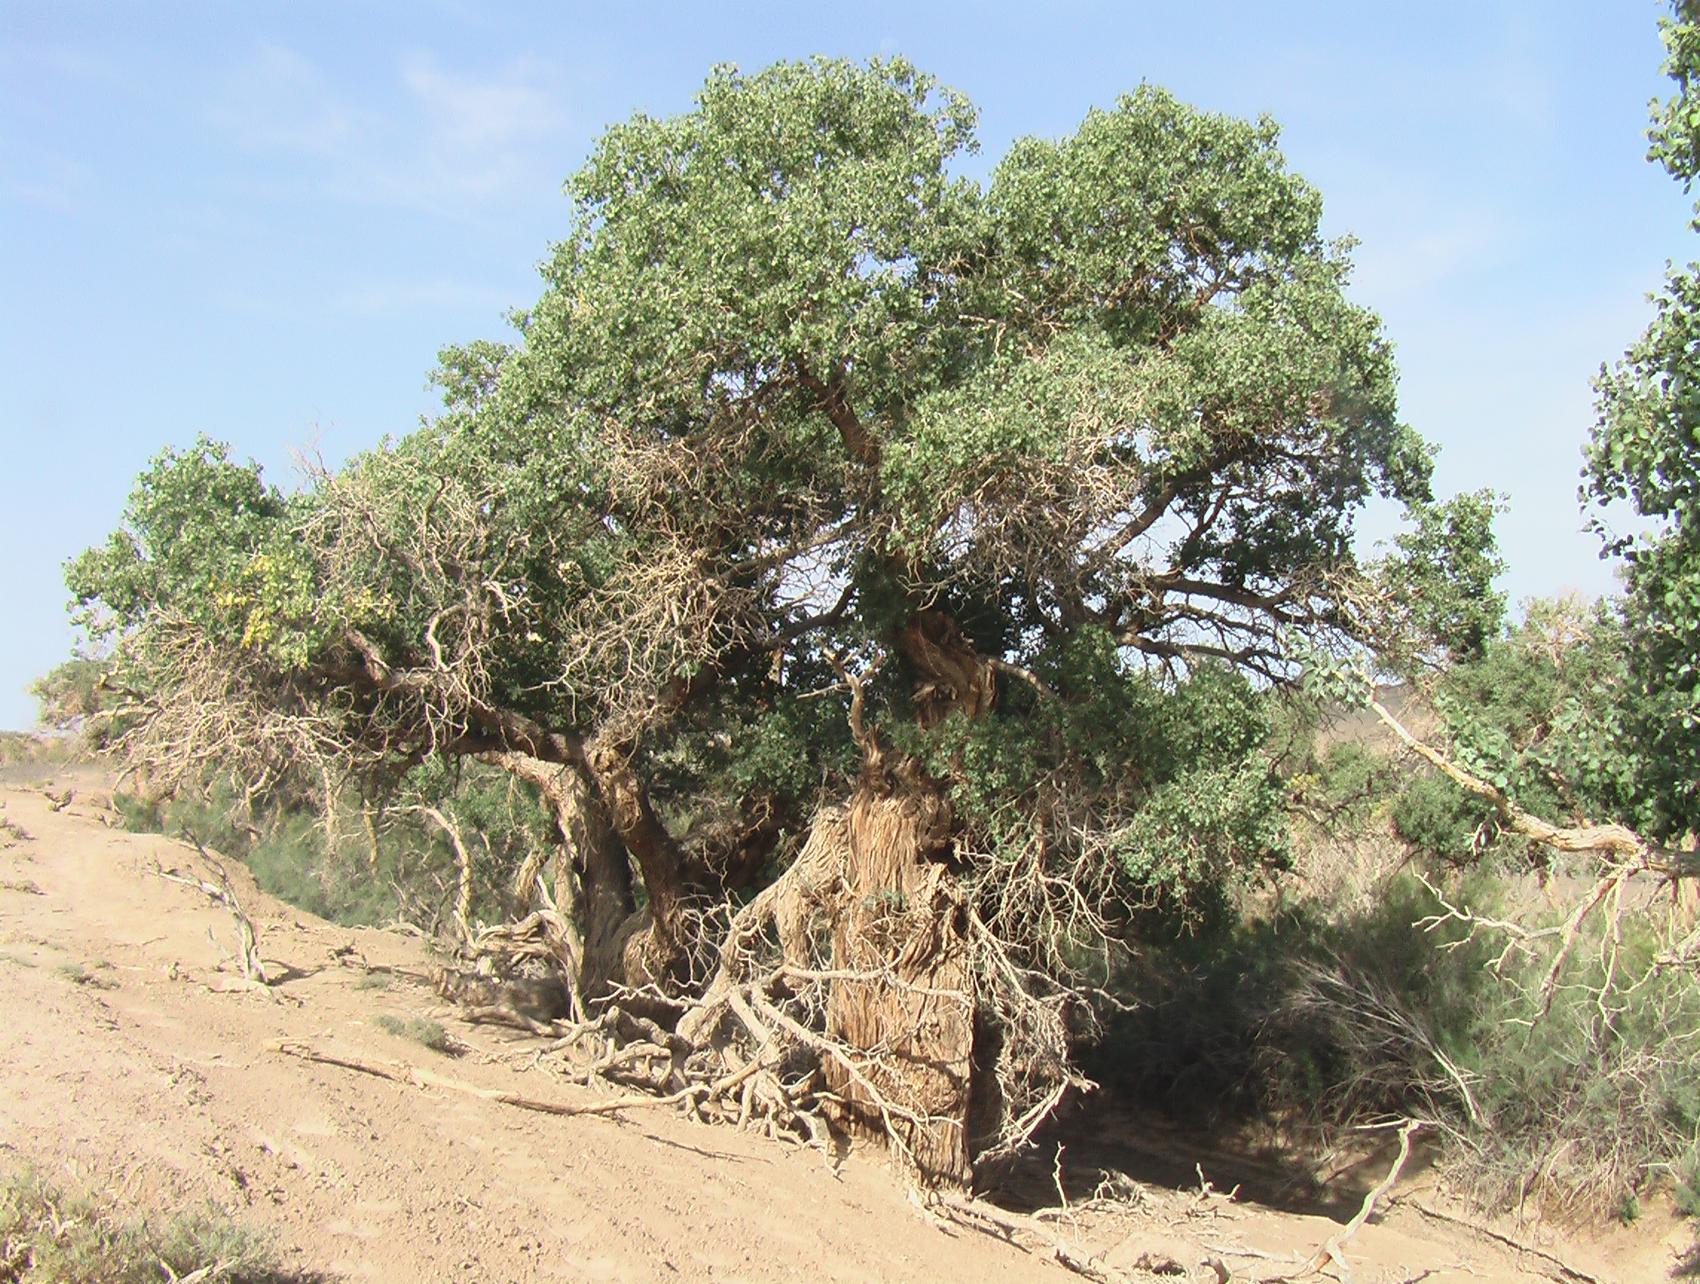
Populus diversufola
Ulmus pumila
Haloxylon ammodendron

Slide 10
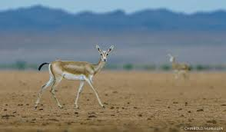
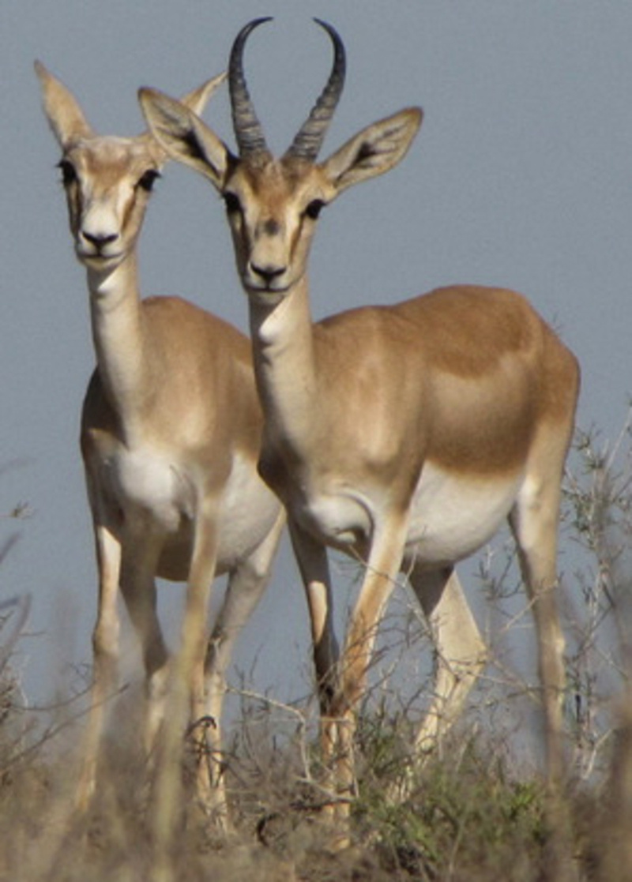
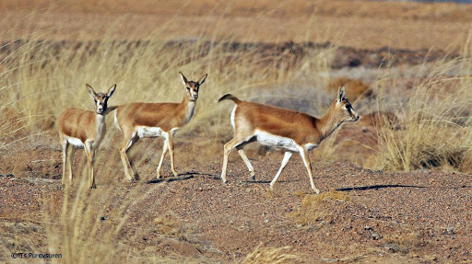
Gazella subgutturosa
Camelus bactrianus
Procapra gutturosa

Slide 11
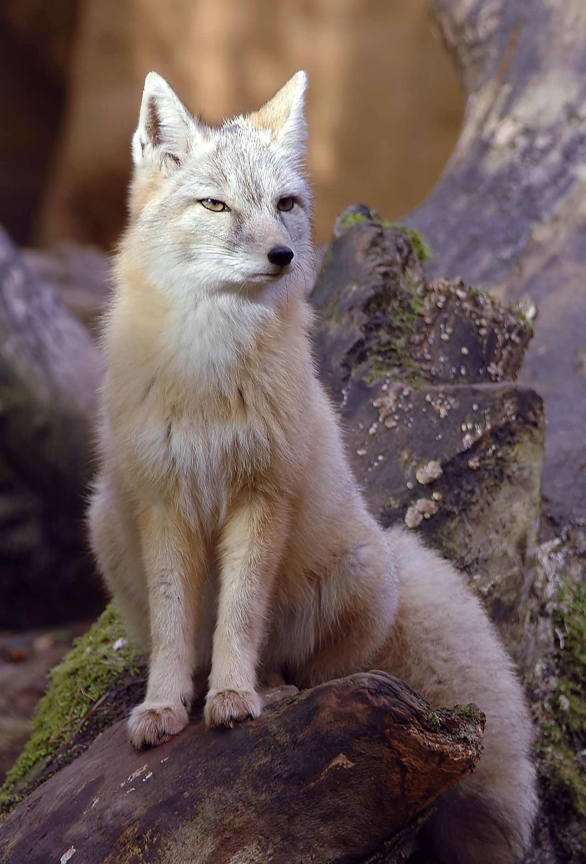
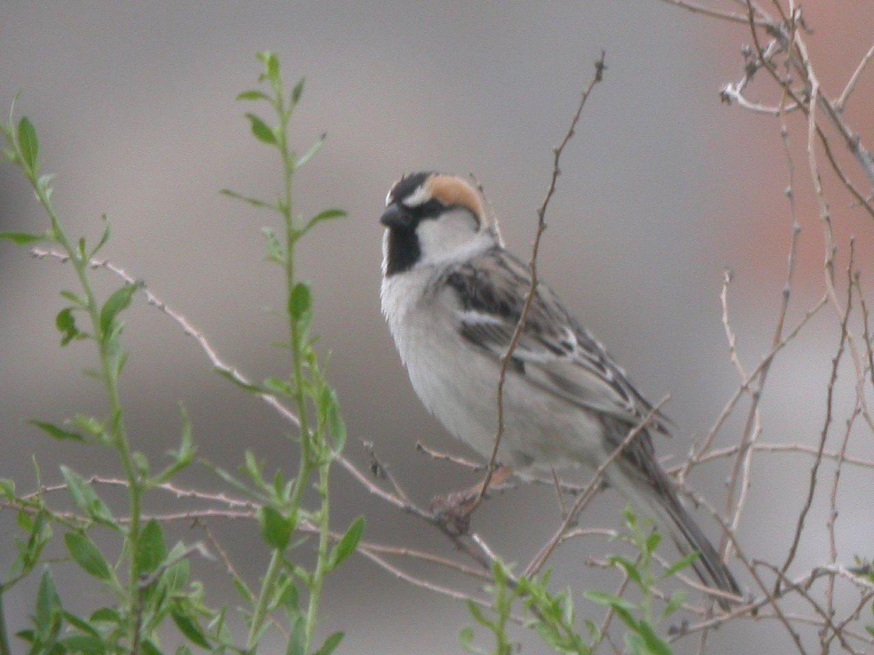
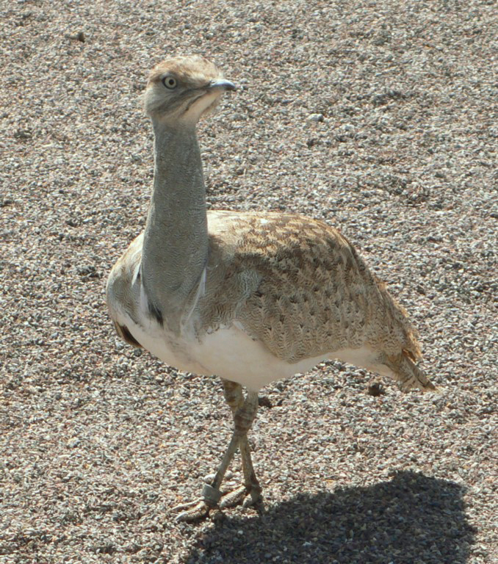
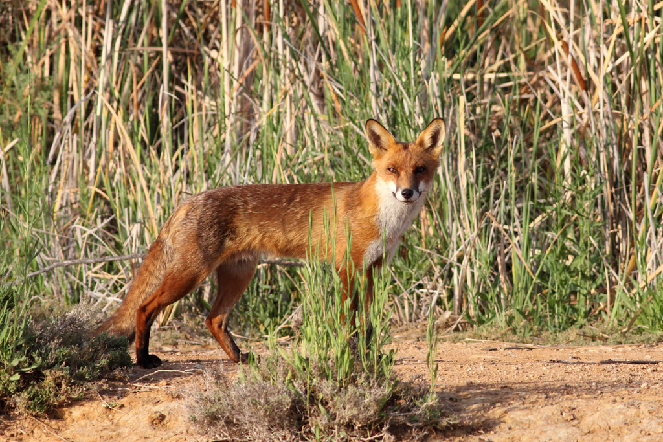
Passer ammodendri
Lynx lynx isabellina Blyth
Vulpus corsac
Chlamydotis undulata
Vulpes vulpes, Linnaeus

Slide 12
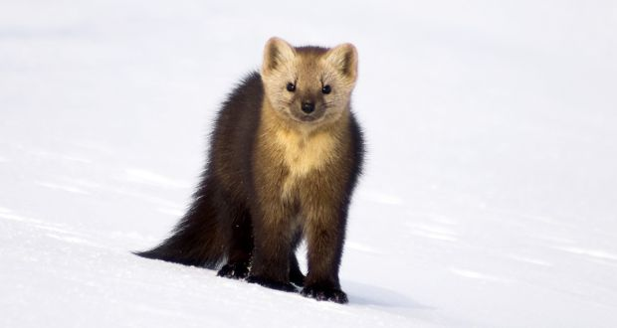
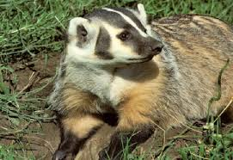
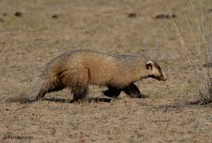
Black-tailed gazelles, lynx, fox and commercial hunting, rabbit, badger, marten and the common flat ass, wild, beards, mountain goats and rare animals.
Lepus tolai
Martes zibellina
Taxidea taxus

Slide 13
Why I chose the Umnugovi province’s ecological issues?
For a long time, dust storms in the Gobi are called UGALZ and TUIREN by Mongolians.
This means blowing faceless sand until you can't see the place in front of you. In Mongolia, dust storms often cause damage to citizens and organizations, and sometimes reach catastrophic levels, adversely affecting human and animal habitats.
Dust storms can disrupt livestock grazing, lead to livestock losses, power outages due to falling power and communication poles, and sand displacement in urban areas and roads. Strong storms can cause topsoil erosion, soil erosion, sand displacement, and increased desertification, as well as increased air turbidity and changes in the radiation balance.

Slide 14
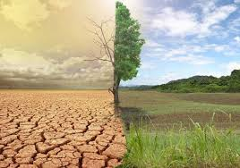
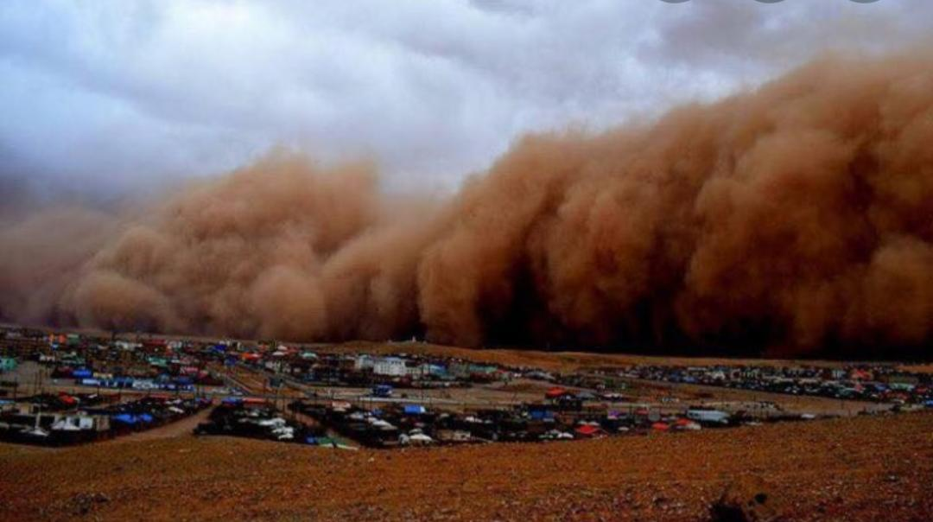
Observed problems
Desertification is taking place due to water scarcity.
The soil fertility is lost due to the lack of plants and trees.
Due to the weak soil of the Gobi, it is blown away by the wind and creates strong storms.

Slide 15
POTENTIAL SOLUTIONS
In the Gobi, forest strips can be established to protect crops from cold and strong winds and to reduce water evaporation. In addition, work should be done to increase snow cover and moisture in the rehabilitation area. In order to keep the snow in the area, grilles are built in the upper part of the wind to collect the snow. You can also reduce water evaporation by planting 2-3 rows of trees around the area to create a green grove.
Methods of protection and of small springs Due to high water evaporation in the Gobi, it is common for water from small springs to evaporate and dry up. One way to prevent this is to build a greenhouse-type plastic bag structure around a small spring source. As a result, parts of the evaporated water reach the walls of the greenhouse and are absorbed into the water and back into the soil, expanding the source of the spring. Experimenting with it will help increase the number of small water sources, such as springs.

Slide 16
Used edition
https://mn.m.wikipedia.org/wiki/%D0%93%D0%BE%D0%B2%D0%B8%D0%B9%D0%BD_%D1%83%D0%B3%D0%B0%D0%BB%D0%B7_%D1%81%D0%B0%D0%BB%D1%85%D0%B8
http://www.omnogovi.gov.mn/i/3
http://www.nam.mn/omnogovi/medee/355

