Slide 1
BARK BEETLE IN CROATIA
Landscape ecology
Domagoj Antolić

Slide 2
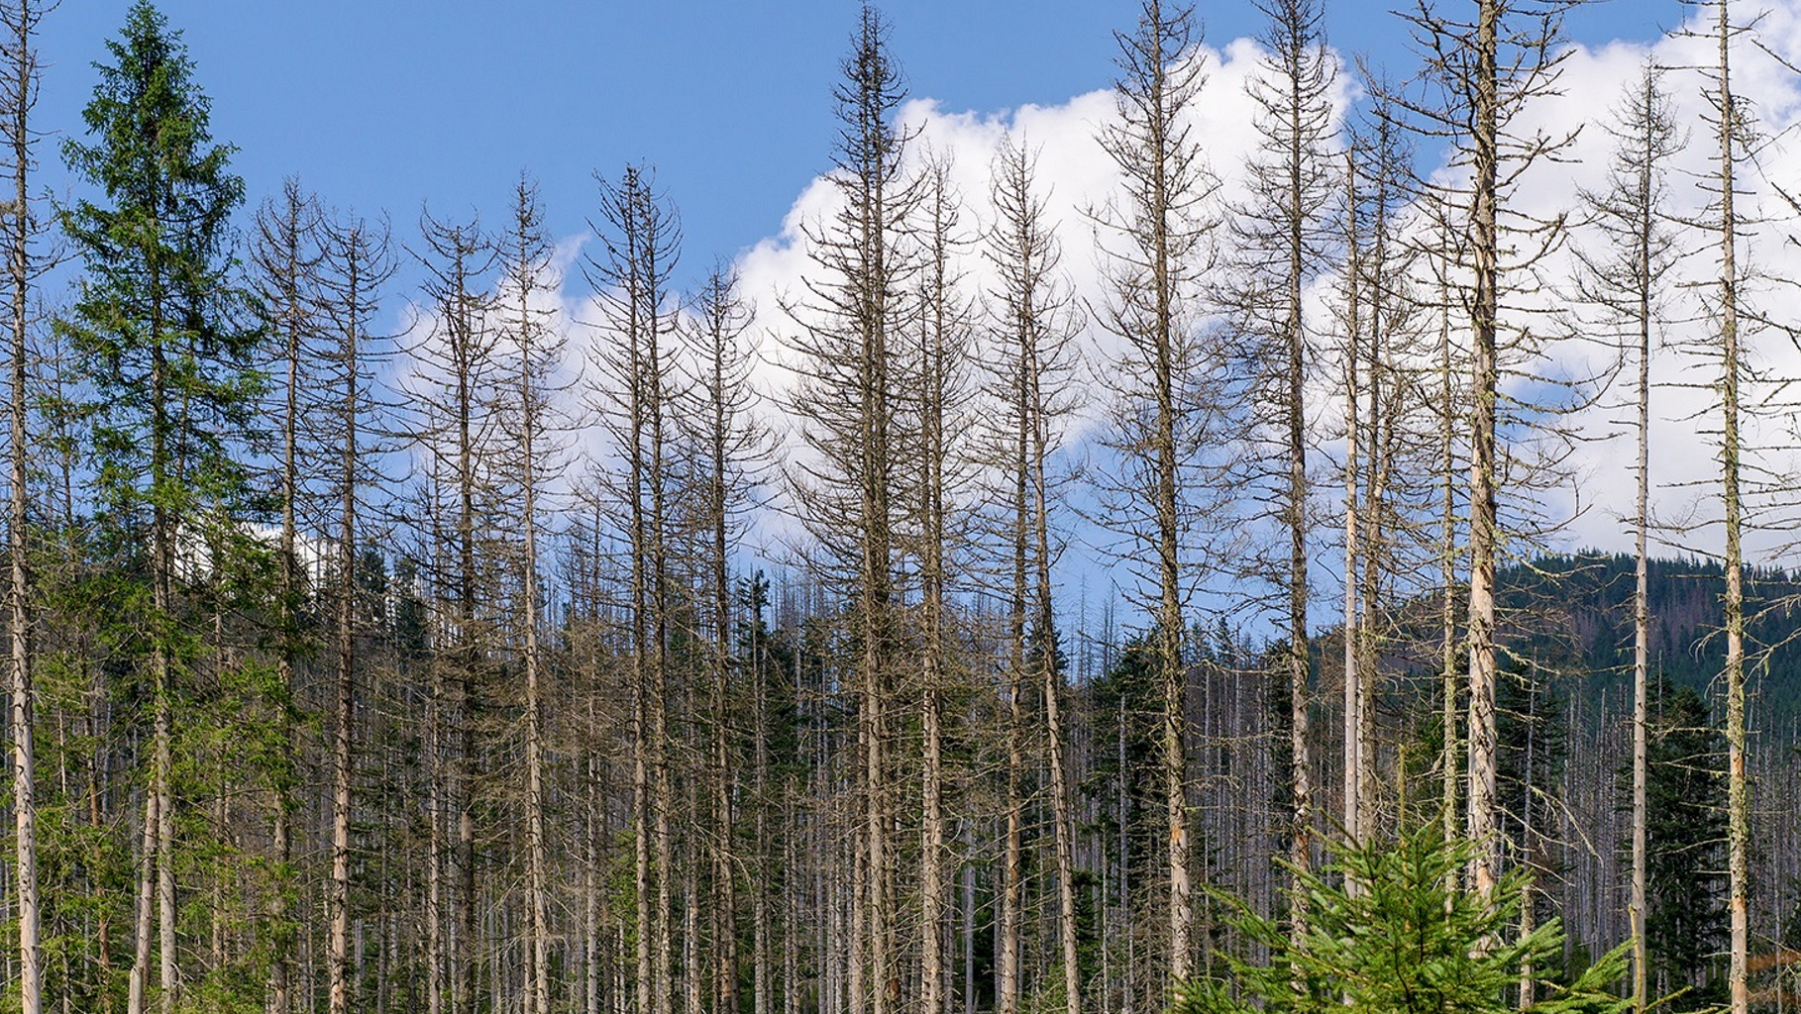
serious problem in most european countries – Croatia, Czech Rep, Slovakia, Germany, Austria...
negative impact on forest ecosystems and landscape

Slide 3
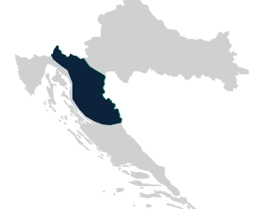
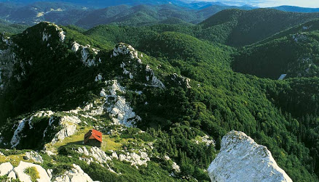
Character of the landscape of the infected area
mountainous region in Croatia (400 – 1500 above sea level)
cca 65% is covered by forests
extremely rich flora and fauna
low population

Slide 4
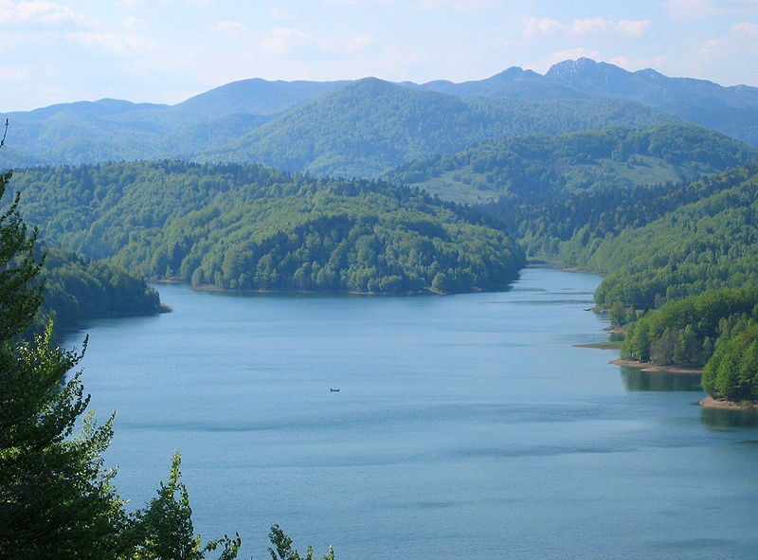
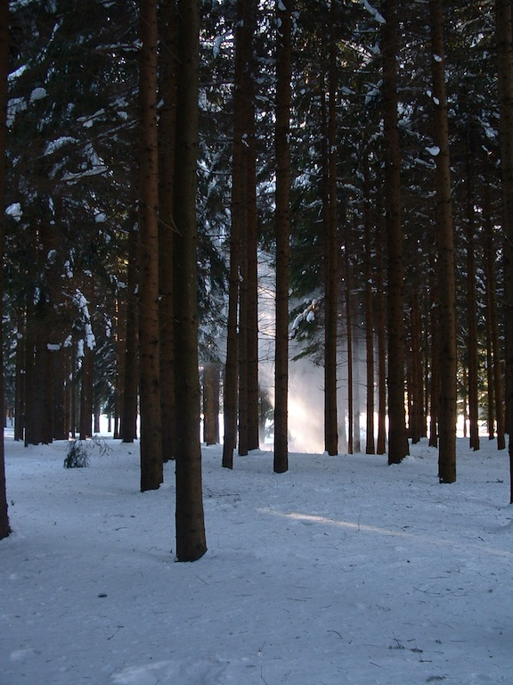
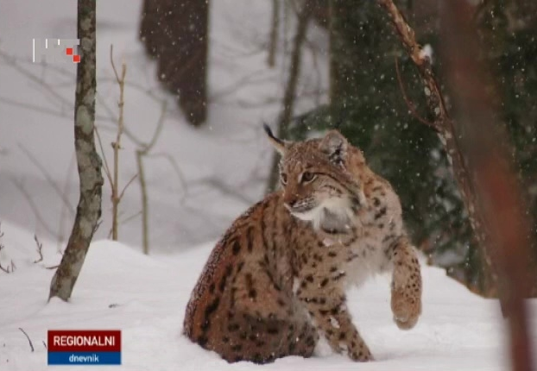
Animals: wolf, bear, lynx (3 european predators), wild cat, wild boar, roe deer, weasel, marten, rabbit...
Plants: fir, beech, spruce, elm, hornbeam...

Slide 5
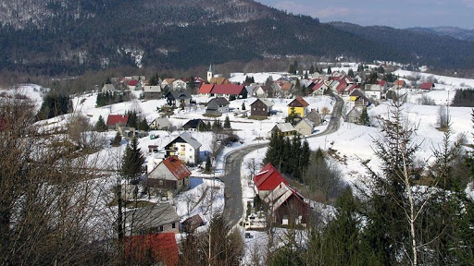
Climate
short and fresh summers and long and harsh winters with lots of snow
large amounts of precipitation (+2500 mm)
average temperature: january -1,2°C and july 16,8°C

Slide 6
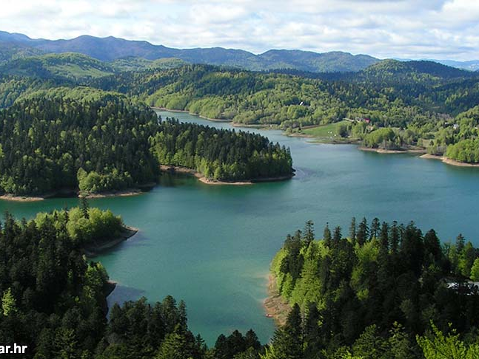
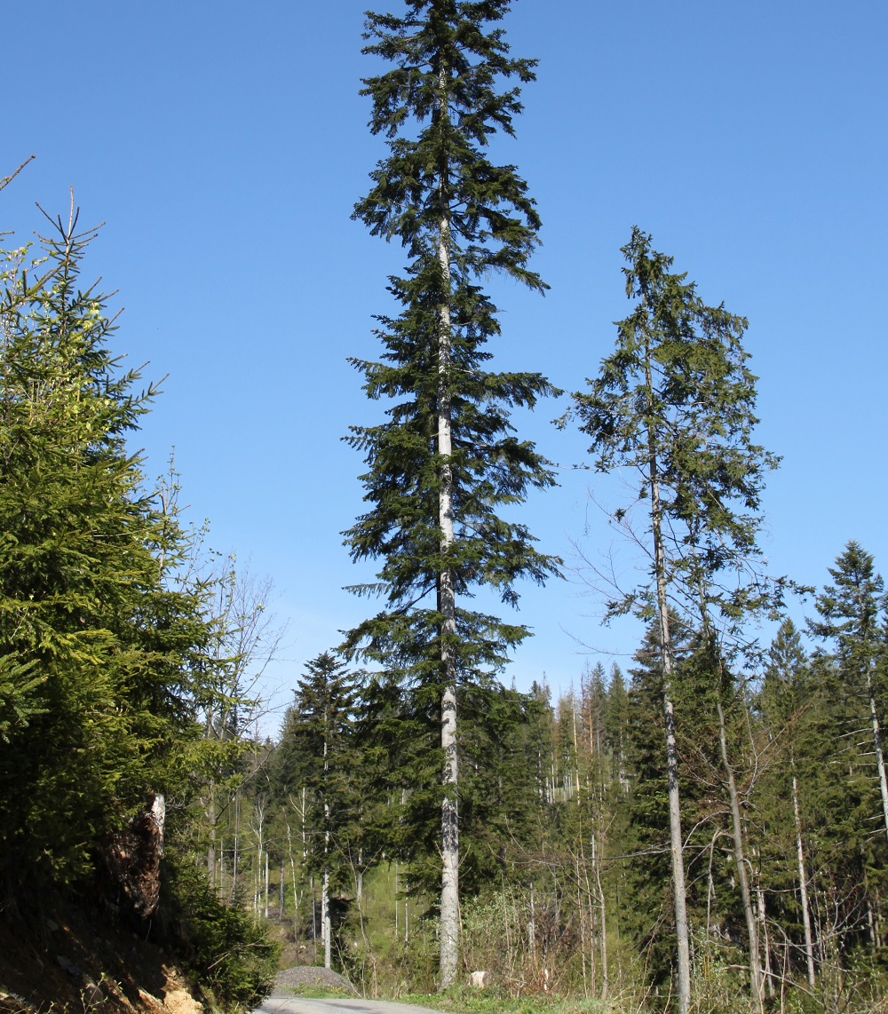
SILVER FIR
ecologically, economically and traditionally the most important conifer in Croatia
negative impact – bark beetle, drought, frost, acid rain, air and soil pollution...

Slide 7
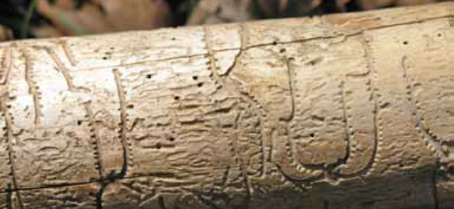
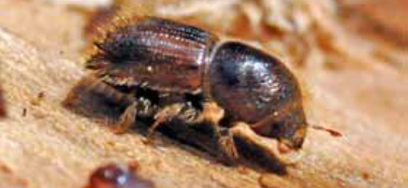
Bark beetle
Precondition for bark beetle attack
  Dry years (drought)
  Poor soil quality
  Climate factors

Slide 8
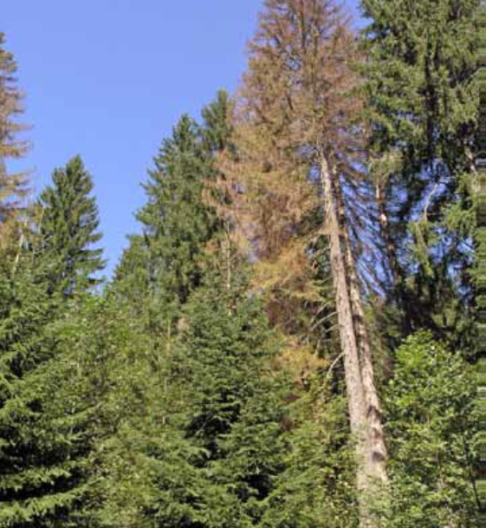
insect attack causes the tree to dry - physiological weaknesses and dying
appearance of other pests and/or fungi
windbreak and windswept

Slide 9
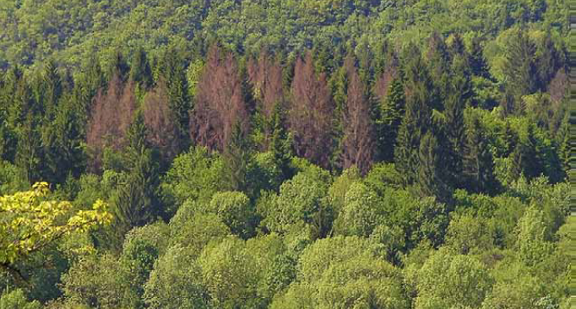
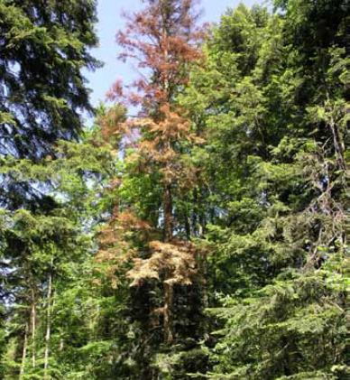
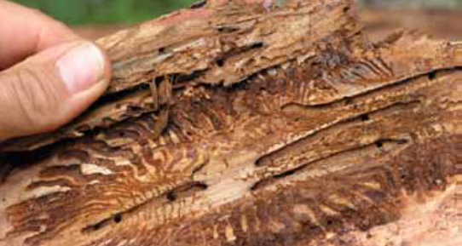

Slide 10

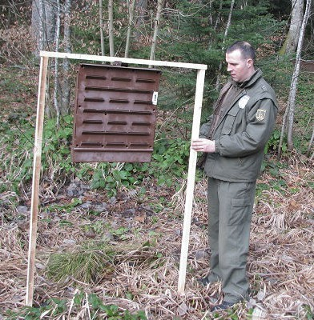
PHEROMONE TRAPS
sticky scent boards made of plastic
destroying of trapped insects
chemical agents

Slide 11
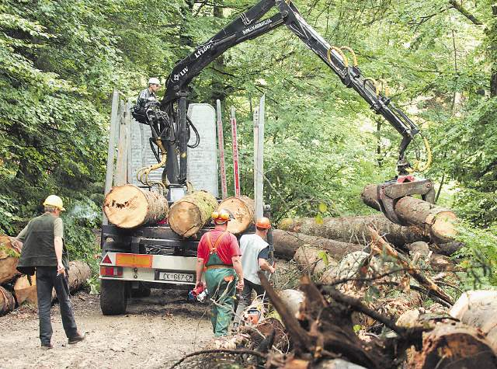
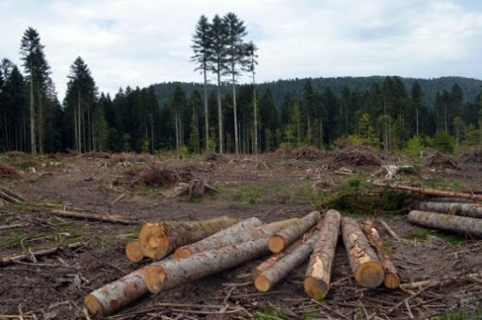
FELLING NAD EXPORT OF INFECTED TREES

Slide 12
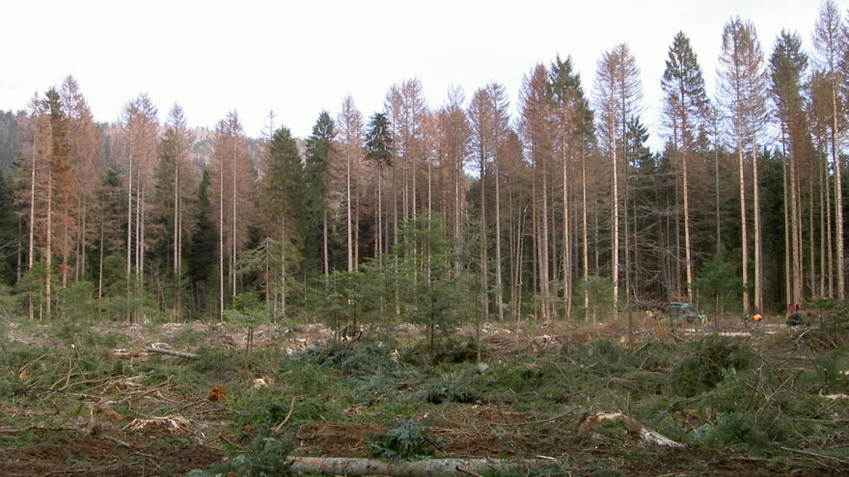
CHANGES
Loss of forests – plants and animals habitat, place for recreation and sport
Aesthetic aspect of nature
Soil erosion and degradation
CO2 absorption
Water retention

Slide 13
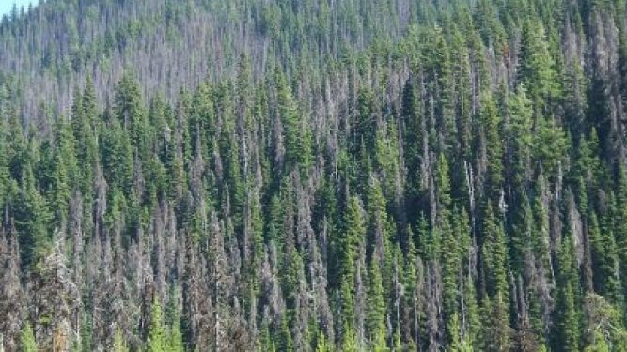
Czech Republic
50% of forests in CZ is spruce
commercial and ecological problem – high timber price, sawmills and plantations

Slide 14
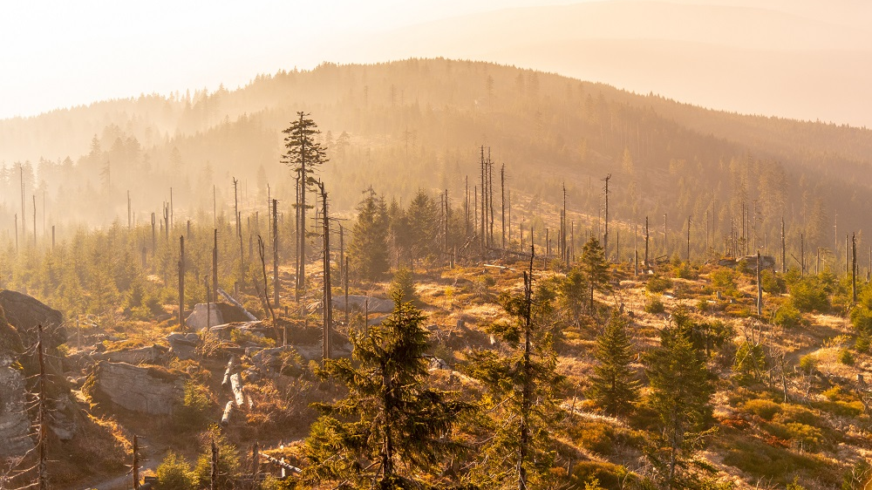
SUMAVA NATIONAL PARK

Slide 15
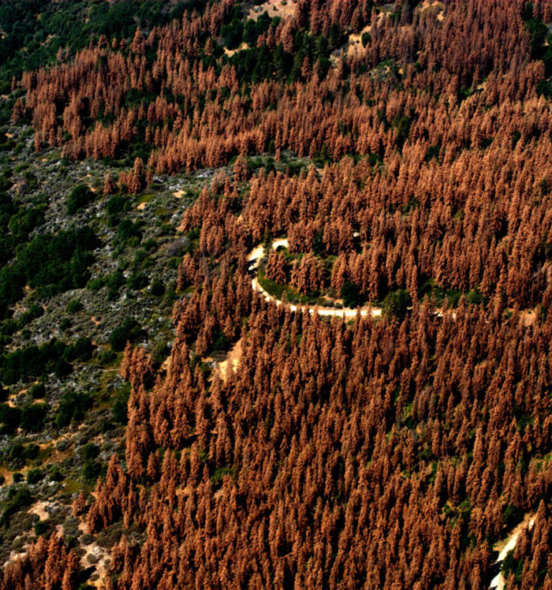
The same problem in most countries in Europe (especially in central Europe)
Devastating for forests and lumber industry → jobs ?
NO UNIQUE SOLUTION !

Slide 16
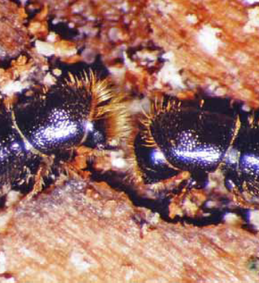
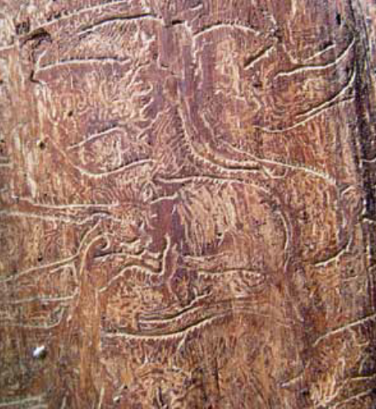

Slide 17
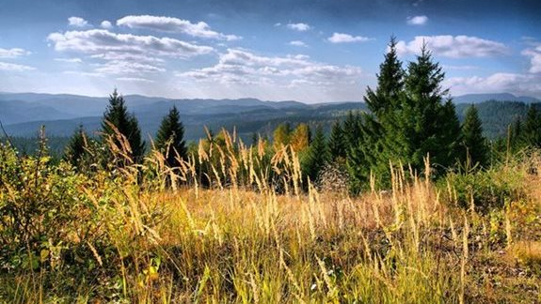
T H A N K Y O U !

